Slide 1
Rainbows, Fiber Optics, Sun Dogs, Sun Glasses
Physics 1161: Lecture 18
sections 26-8 & 25-5
Notes:
1

Slide 2
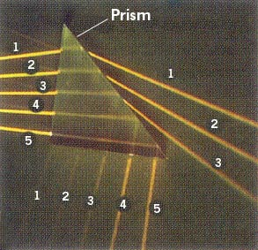
Internal Reflection
All rays reflect internally, but the top three rays reflect only a small percentage internally; most energy leaves the prism.
The fourth and fifth rays are reflected 100 % internally

Slide 3
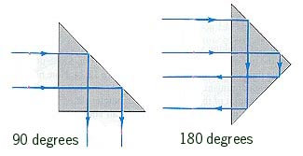
Internal Reflection in Prisms

Slide 4
Total Internal Reflection
Recall Snell’s Law: n₁ sin(θ₁)= n₂ sin(θ₂)
(n₁ > n₂ ⇒ θ₂ > θ₁ )
θ₁ = sin⁻¹(n₂/n₁) then θ₂ = 90
“critical angle”
θ₂
Light incident at a larger angle will only have reflection (θ_{i} = θ_{r})
n₂
θ_{r}
n₁
θ_{i}
For water/air:
n₁=1.33, n₂=1
θ₁ = sin⁻¹(n₂/n₁)
= 48.8⁰
θ_{c}
θ₁
normal

Slide 5
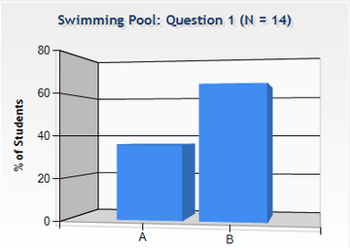
Pool
Checkpoint
Can the person standing on the edge of the pool be prevented from seeing the light by total internal reflection ?
1) Yes 2) No

Slide 6
Pool
Checkpoint
Can the person standing on the edge of the pool be prevented from seeing the light by total internal reflection ?
“There are millions of light ’rays’ coming from the light. Some of the rays will be totally reflected back into the water,
but most of them will not.”
1) Yes 2) No

Slide 7
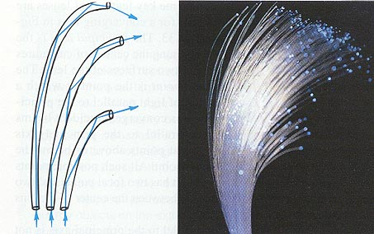
Fiber Optics

Slide 8
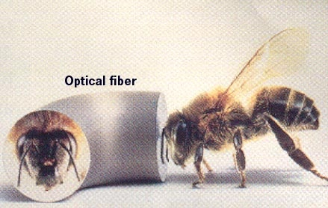
Fiber Optics

Slide 9
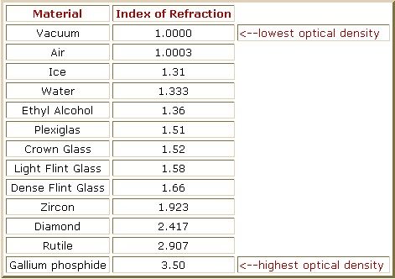
Indices of Refraction

Slide 10
What is the critical angle of a diamond-air boundary?
critical angle

Slide 11
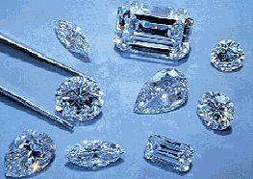
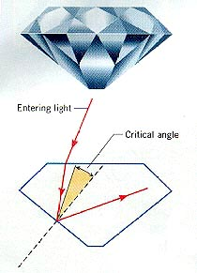
Internal Reflection in Diamond
The critical angle for
diamond in air is
24.5 º.
Any ray which strikes the inside surface at an angle greater than 24.5º will be totally internally reflected.

Slide 12
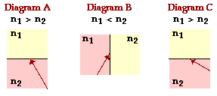
The diagrams show incident rays approaching a boundary with a second medium. The relative indices of refraction of the two media are indicated. In which diagram will total internal reflection occur, providing the angle of incidence exceeds the critical angle?
Diagram A
Diagram B
Diagram C
None of these

Slide 13
The diagrams show incident rays approaching a boundary with a second medium. The relative indices of refraction of the two media are indicated. In which diagram will total internal reflection occur, providing the angle of incidence exceeds the critical angle?
Diagram A
Diagram B
Diagram C
None of these

Slide 14
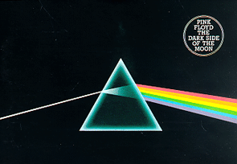
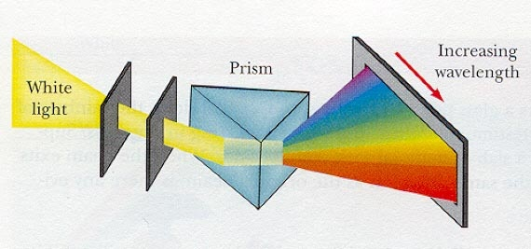
Dispersion
Blue Bends Best

Slide 15
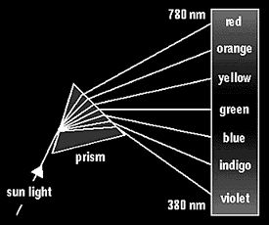
Different Frequencies
Different Indices of Refraction

Slide 16
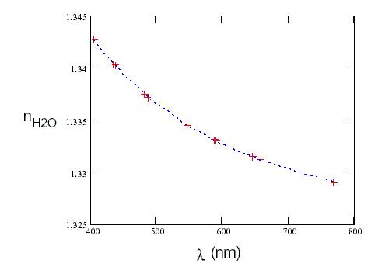
Refractive Index
Function of Wavelength

Slide 17
Table of Indices

Slide 18
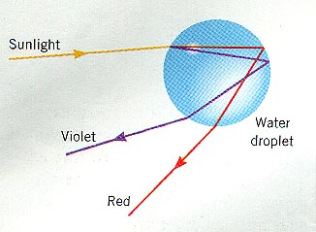
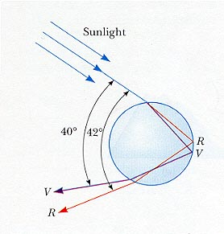
Refraction & Reflection in a Raindrop

Slide 19

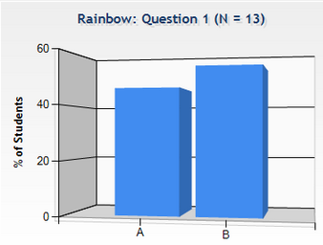
Rainbow:
Checkpoint
Wow look at the variation in index of refraction!
Which is red?
Which is blue?
Skier sees blue coming up from the bottom (1), and red coming down from the top (2) of the rainbow.
Blue light is deflected more!
Notes:
refraction, reflection, refraction

Slide 20
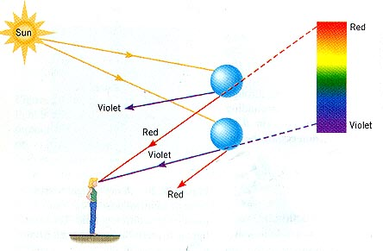
Rainbow Formation
An observer sees
red light coming
from droplets of
water higher in
the sky.
Droplets of water
lower in the sky
send violet light
to the eye.

Slide 21
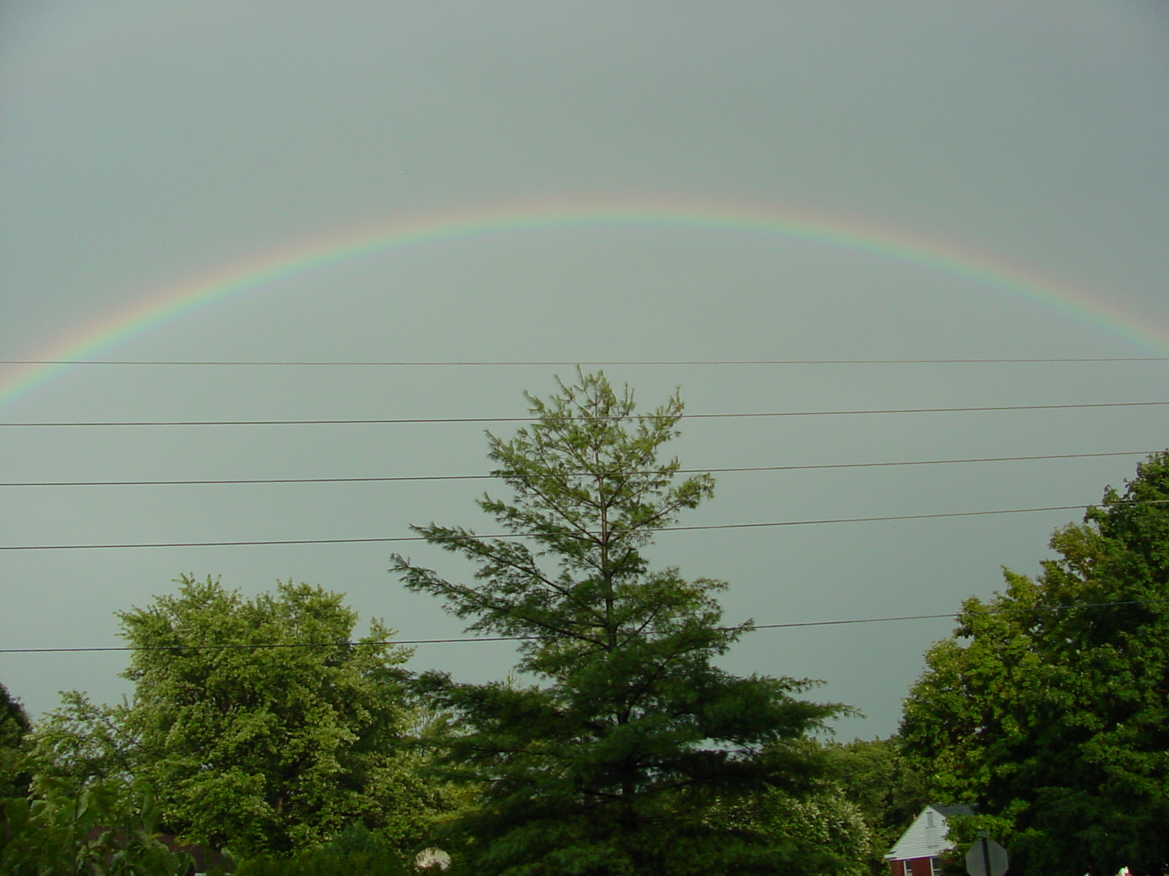
Rainbow Arch

Slide 22
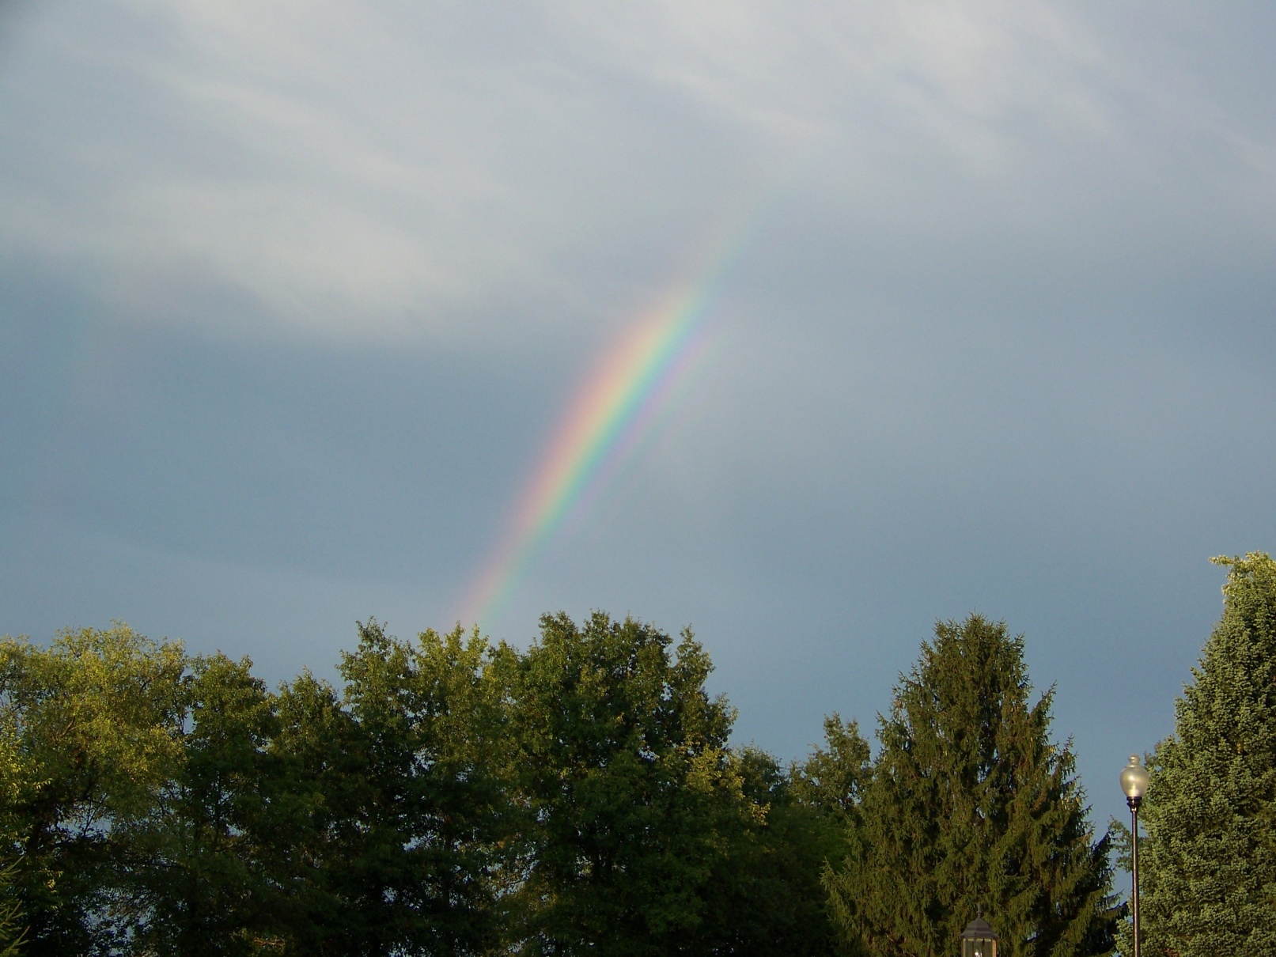
Rainbow

Slide 23
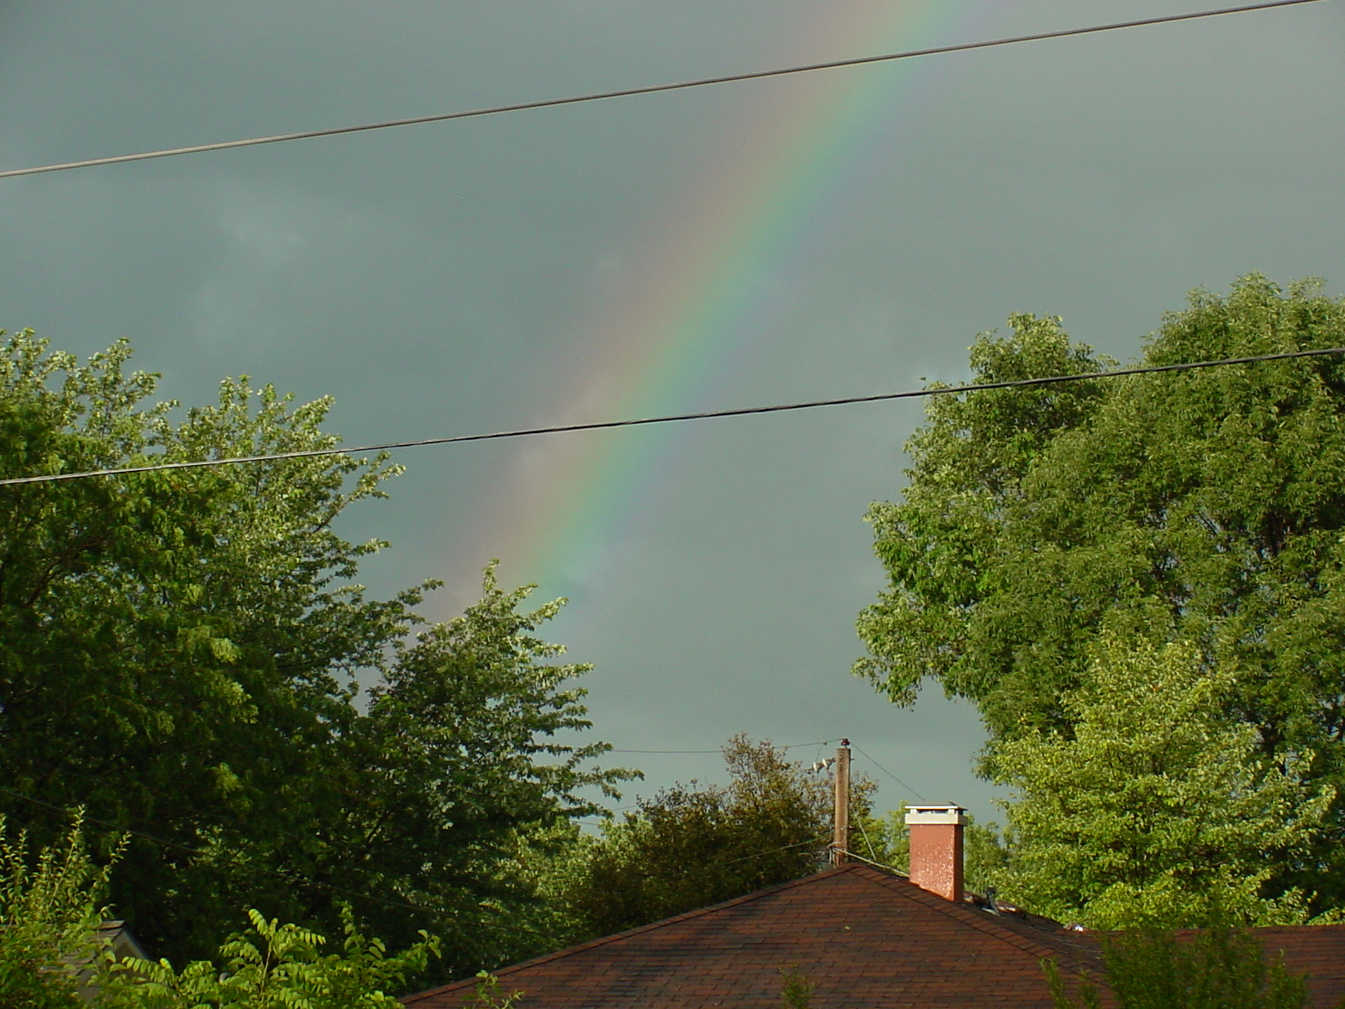
Rainbow Zoom

Slide 24
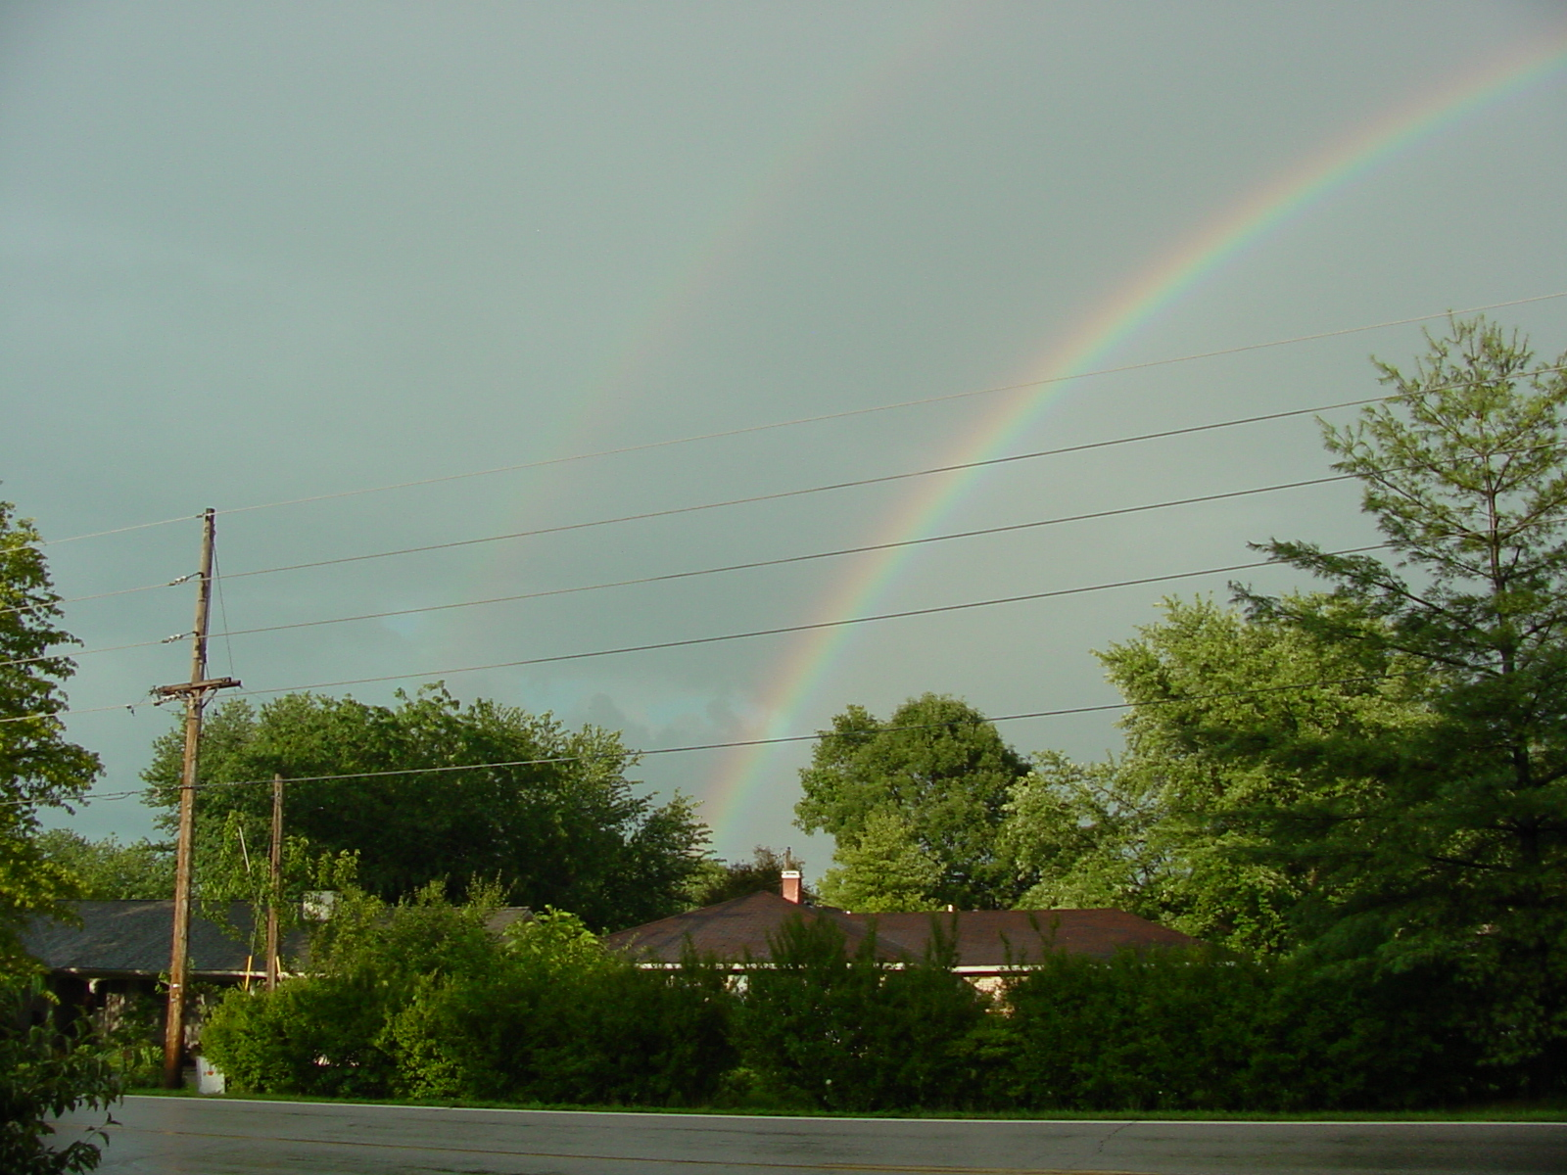
Double Rainbow

Slide 25

Double Rainbow on Way to School

Slide 26
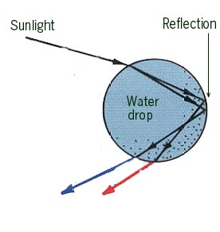
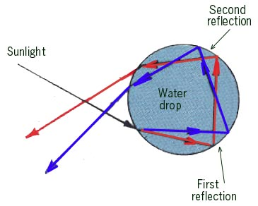
Double Rainbow Diagrams

Slide 27
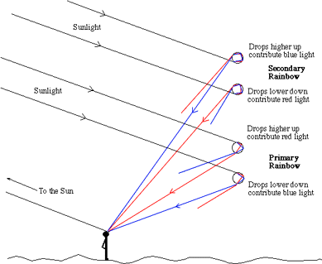
Double Rainbow Diagram
Notes:
Is the 5th-order rainbow observable?
The 5th- and 6th-order rainbows are situated in Alexander's dark band between the primary- and secondary rainbows (R:42° and R:51° respectively: the two ‘common' rainbows, or 1st- and 2nd-order rainbows). The 3th, 4th, 5th, 6th, 7th. and so on -order rainbows are the so-called high-order rainbows or 'laboratory rainbows' (as I call them): they are produced by multiple reflections of sunlight inside water-droplets and are sadly enough unobservable in nature (these bows re very broad and weak: if it wasn't because of it's angular proximity to the sun, the 3th-order rainbow should be well observable, but the irradiating effect of Newton's zero-order rainbow spoils the show (the zero-order rainbow is the backward transmitted sunlight through the spherical raindrops, creating an area in the sky of an almost uniform brilliance: a diffuse glow around the sun...). Now: some of you already know that by looking through a 90° prism (not a 60° prism) you can bring all the spectral colors of the (primary) rainbow back to white: as long as you know how to hold the prism you will see the primary bow as a very bright, sharp-edged white arc + an adjacent system of at least 5 or 6 sharp supernumerary arcs ! For those who are unfamiliar with this technique: you MUST try this out ! By adding a polarisation-filter to the prism you can make the arcs even brighter! (the rainbow is one of the most polarized phenomena in nature).

Slide 28
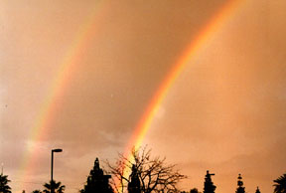
Double Rainbow Picture

Slide 29

Alexander’s Dark Band
Sky is light inside primary rainbow
Dark between primary and secondary bows
Light beyond the secondary rainbow
Dark region between is called Alexander’s Dark Band
Notes:
Notice the contrast between the sky inside the arc and outside it. When one studies the refraction of sunlight on a raindrop one finds that there are many rays emerging at angles smaller than the rainbow ray, but essentially no light from single internal reflections at angles greater than this ray. Thus there is a lot of light within the bow, and very little beyond it. Because this light is a mix of all the rainbow colors, it is white. In the case of the secondary rainbow, the rainbow ray is the smallest angle and there are many rays emerging at angles greater than this one. Therefore the two bows combine to define a dark region between them - called Alexander's Dark Band, in honor of Alexander of Aphrodisias who discussed it some 1800 years ago!
Notice that the sky inside the rainbow is brighter than the sky outside it. That's because the water droplets inside the rainbow reflect and refract sunlight straight back to you, making that part of the sky seem brighter. Raindrops above the rainbow send light away from you.

Slide 30
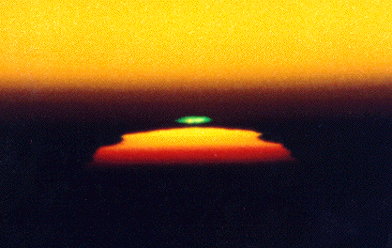
Green Flash
http://www.faqs.org/faqs/astronomy/faq/part3/section-13.html

Slide 31
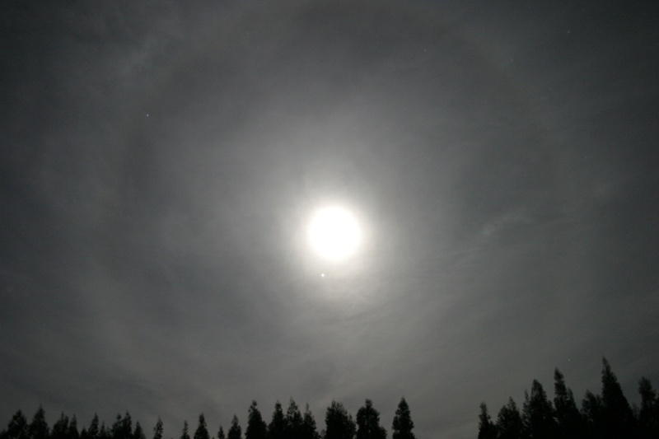
Does moon halo predict bad weather?

Slide 32
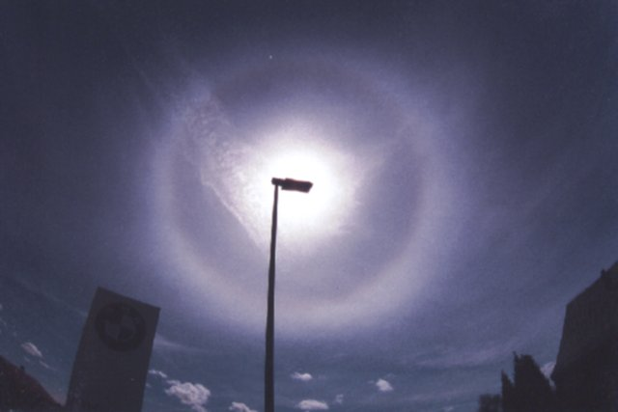
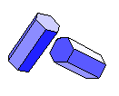
22º Halo
A halo is a ring of light surrounding the sun or moon.
Most halos appear as bright white rings but in some instances, the dispersion of light as it passes through ice crystals found in upper level cirrus clouds can cause a halo to have color.
Diameter less than 20.5 micrometers
Randomly oriented hexagonal ice crystals

Slide 33
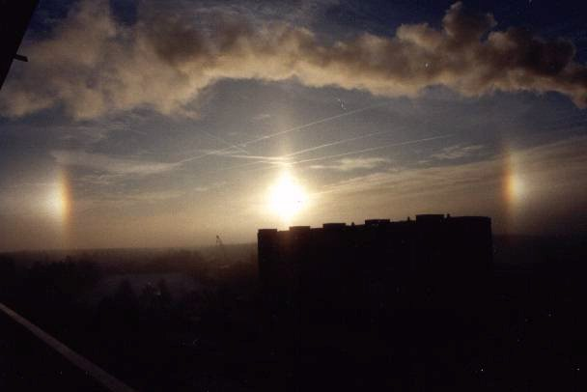
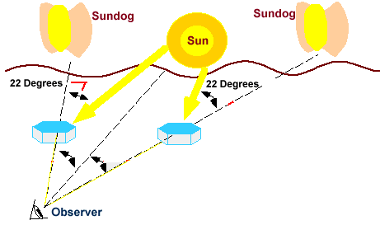

Sundogs
Sundogs or parhelia on right and left of sun
Hexagonal ice crystals
Flat faces horizontally oriented
Diameter greater than 30 micrometers

Slide 34
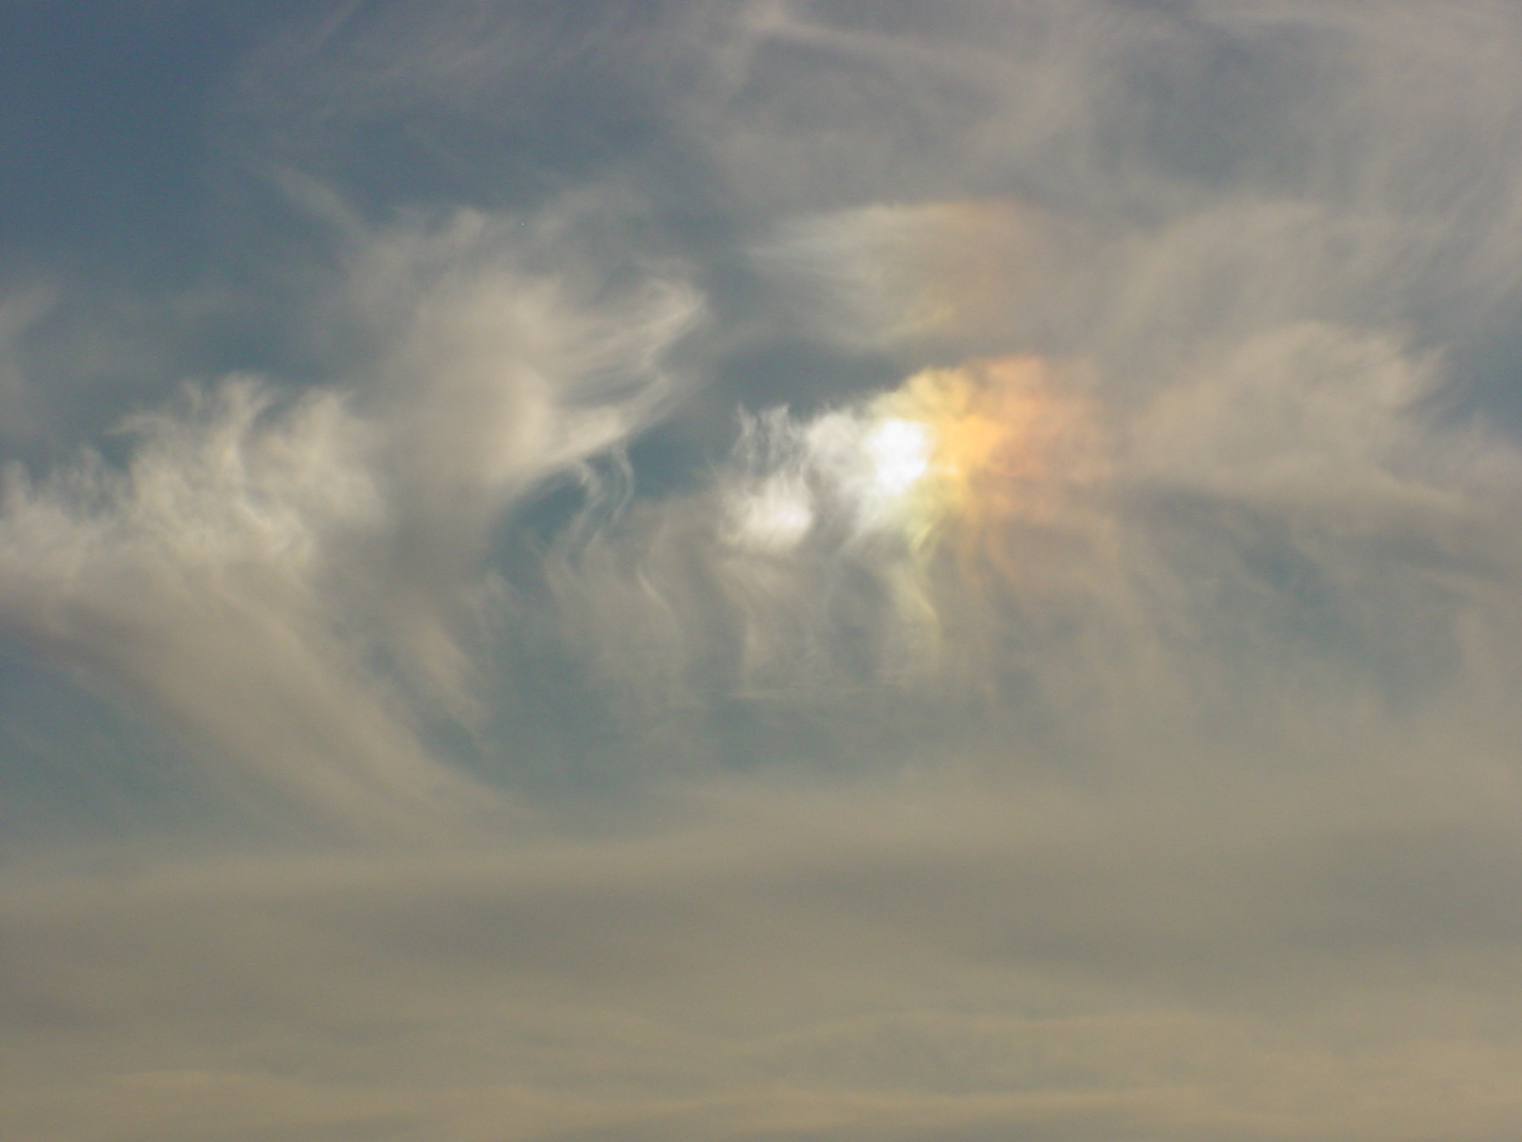
Sundog

Slide 35
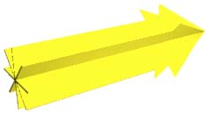

Unpolarized & Polarized Light

Slide 36
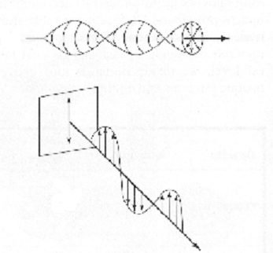
Polarization of Light
Unpolarized
Electric fields of unpolarized light vibrate in all directions perpendicular to the direction the light travels.
A polarizing filter can constrain light to vibrate in only one direction
Polarized

Slide 37
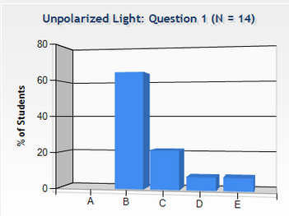
Unpolarized Light
Checkpoint
Unpolarized light (like the light from the sun) passes through a polarizing sunglass (a linear polarizer).
The intensity of the light when it emerges is
  Zero
  1/2 what it was before
  1/4 what it was before
  1/3 what it was before
  Need more information

Slide 38
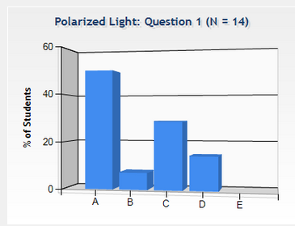
Polarized Light
Checkpoint
Now, horizontally polarized light passes through the same glasses (which are vertically polarized).
The intensity of the light when it emerges is:
  Zero
  1/2 what it was before
  1/4 what it was before
  1/3 what it was before
  Need more information

Slide 39
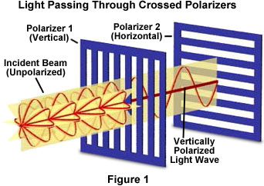
Polarizing Filters

Slide 40
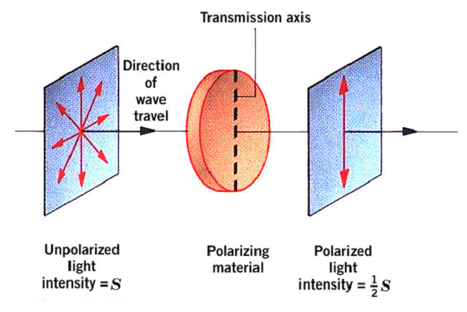
Polarization

Slide 41
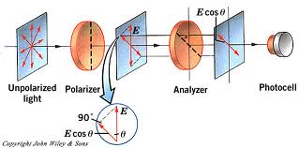
Law of Malus
When a second polarizer is rotated, the vector component perpendicular to its transmission plane is absorved, reducing its amplitude to
E = E₀cos
Since the transmitted intensity is proportional to the square of the amplitude, the intensity is given by the formula
I = I₀cos²
Theta is the angle between the two poloarizers.

Slide 42
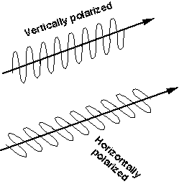
Polarization

Slide 43
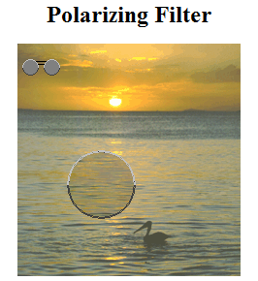
Reflected Horizontally Polarized
Polarization of Reflected Light

Slide 44
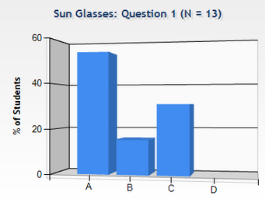
Sun Glasses
Checkpoint
Polaroid sun glasses are often considered better than tinted sunglasses because:
  They block more light
  They are safer for your eyes
  They decrease glare
  They are cheaper

Slide 45
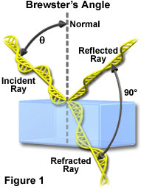
Brewster’s Angle
At this angle of incidence all the reflected light is polarized parallel to the surface of the material (non-conducting)
Polarization of Reflected Light

Slide 46
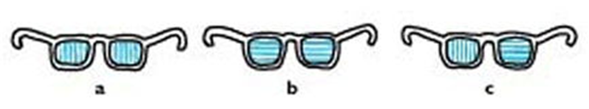
Which pair of glasses is best suited for automobile drivers? (The polarization axes are shown by the straight lines.)
A
B
C

Slide 47
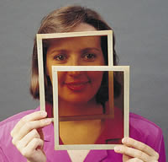
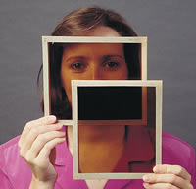
Two Polarizers
Parallel Axes
Perpendicular Axes

Slide 48
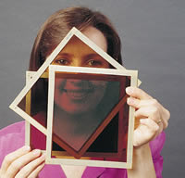
Insert Third Polarizer

