Slide 1
Physics 1161 Lecture 2
Vectors
&
Electric Fields

Slide 2
Three Charges
Example
Calculate force on +2μC charge due to other two charges
  Calculate force from +7μC charge
  Calculate force from –3.5μC charge
  Add (VECTORS!)
Q=+2.0μC
4 m
6 m
Q=+7.0μC
Q=-3.5 μC
Notes:
F = (0.0045 N, 0.002 N) = (0.0049 N, 24º)
Preflight: What is direction of force on third charge due to dipole

Slide 3
Three Charges
Example
Resolve each force into x and y components
Add the x-components & the y-comp.
Use Pyth. Theorem & Trigonometry
to express in R,θ notation
Q=+2.0μC
53º
53º
4 m
6 m
Q=+7.0μC
Q=-3.5 μC
Notes:
F = (0.0045 N, 0.002 N) = (0.0049 N, 24º)
Preflight: What is direction of force on third charge due to dipole

Slide 4
Three Charges
Use Pyth. Theorem & Trigonometry to express in R,θ notation
φ
Since resultant is in first quadrant, θ = φ

Slide 5
Electric Force on Electron by Proton
Example
What are the magnitude and direction of the force on the electron by the proton?
q=1.6x10⁻¹⁹ C
e-
+
r = 1x10⁻¹⁰ m
  Toward the left

Slide 6
Comparison:
Electric Force vs. Electric Field
Electric Force (F) - the actual force felt by a charge at some location.
Electric Field (E) - found for a location only – tells what the electric force would be if a charge were located there:
F = qE
Both are vectors, with magnitude and direction

Slide 7
Electric Field
Example
Charged particles create electric fields.
  Direction is the same as for the force that a + charge would feel at that location.
  Magnitude given by: E ≡ F/q
Field at A due to proton?
q=1.6x10⁻¹⁹ C
A
+
r = 1x10⁻¹⁰ m
  Toward the right
Notes:
If a tree falls in the forest, and no one is around to hear it, does it make a sound?

Slide 8
What is the direction of the electric field at point A, if the two positive charges have equal magnitude?
Up
Down
Right
Left
Zero
y
A
+
+
B
x

Slide 9
What is the direction of the electric field at point A, if the two positive charges have equal magnitude?
Up
Down
Right
Left
Zero
y
A
+
+
B
x

Slide 10
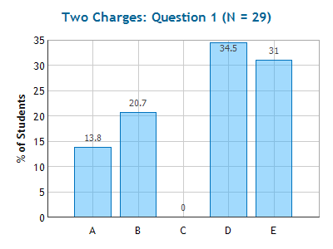
Two Charges
Checkpoint1
What is the direction of the electric field at point A?
Up
Down
Left
Right
Zero
y
A
+
B
x

Slide 11
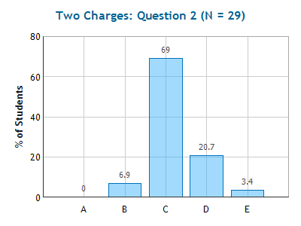
Two Charges
Checkpoint 2
What is the direction of the electric field at point B?
up
down
Left
Right
Zero
y
A
+
B
x

Slide 12
What is the direction of the electric field at point C?
Left
Right
zero
y
+
C
-
x

Slide 13
Electric Field Applet
http://www.cco.caltech.edu/~phys1/java/phys1/EField/EField.html

Slide 14
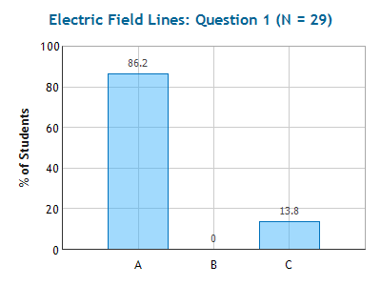
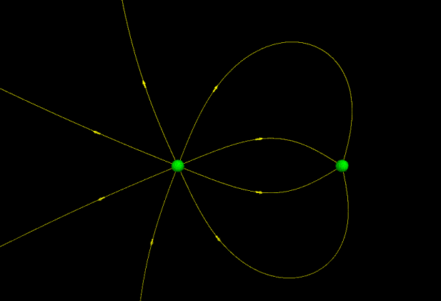
Checkpoint
X
A
B
Y
Charge A is
1) positive 2) negative 3) unknown
Field lines start on positive charge, end on negative.

Slide 15
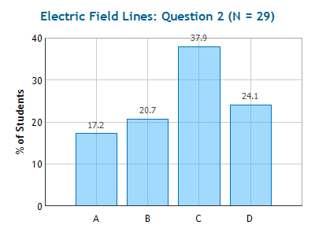
Checkpoint
X
A
Y
B
Compare the ratio of charges Q_{A}/ Q_{B}
1) Q_{A}= 0.5Q_{B} 2) Q_{A}= Q_{B} 3) Q_{A}= 2 Q_{B} 4) can’t say
# lines proportional to |Q|

Slide 16
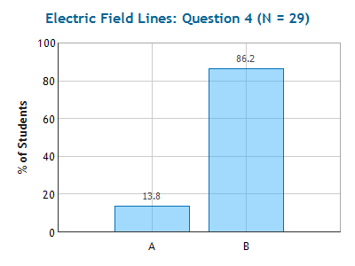
Checkpoint
X
A
Y
B
The electric field is stronger when the
lines are located closer to one another.
The magnitude of the electric field at point X is greater than at point Y
1) True 2) False
Density of field lines gives E

Slide 17
Compare the magnitude of the electric field at point A and B
E_{A}> E_{B}
E_{A}= E_{B}
E_{A}< E_{B}
B
A

Slide 18
E inside of conductor
Conductor ≡ electrons free to move
  Electrons feels electric force - will move until they feel no more force (F=0)
  F=qE: if F=0 then E=0
E=0 inside a conductor (in electrostatics)

Slide 19
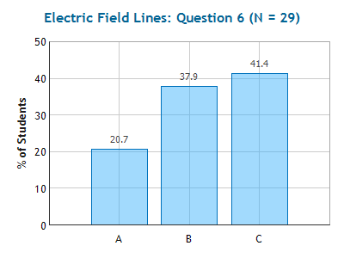
Checkpoint
X
A
B
Y
In a static situation
"Charge A" is actually a small, charged metal ball (a conductor). The magnitude of the electric field inside the ball is:
(1) Negative (2) Zero (3) Positive

Slide 20
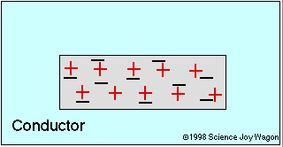
E inside of conductor in electrostatics
Conductor ≡ electrons free to move
  Electrons feel electric force - will move until they feel no more force (F=0)
  F=qE: if F=0 then E=0
E=0 inside a conductor (in a static situation)

Slide 21
Recap
E Field has magnitude and direction:
  E≡F/q
  Calculate just like Coulomb’s law
  Careful when adding vectors
Electric Field Lines
  Density gives strength (# proportional to charge.)
  Arrow gives direction (Start + end on -)
Conductors
  Electrons free to move ⇒ E=0

Slide 22
To Do
Read sections 19-6 & 19-7
Watch Prelecture 3 by 6am 1/15
Complete Checkpoint 3 by 6 am 1/15
Complete Homework 1 by 11pm 1/15
Complete Homework 2 by 11pm 1/17

