Slide 1
Welcome to Physics 1161!
Electricity & Magnetism (E&M)
Optics
Quantum Physics
Atomic Physics
Nuclear Physics
Relativity
http://www.smartphysics.com

Slide 2
Instructor
Cherie Bibo Lehman
cblehman@eiu.edu
  Please include course number in the Subject Line
1112 Physical Science – (c) 217.251.3734
Office Hours
  T: 1:00 PM – 2:00 PM
  W: 10:00 AM – 12:00 PM
  R: 1:30 PM – 2:30 PM
http://ux1.eiu.edu/~cblehman/

Slide 3
Grade Components
Prelectures 05%
Checkpoints 05%
Class Participation* 10%
Homework & Quizzes 25%
Hour Exams (highest 3 of 4) 30%
Final Exam 25%
100%
*Based on clicker responses

Slide 4
Grading Scale
90-100 A
80-89 B
70-79 C
60-69 D
<60 F

Slide 5
SmartPhysics
http://www.smartphysics.com
Online prelectures, checkpoints, and homework found there.
You will setup your password when you register for an account. Your logon is your EIU email. For example, my logon is cblehman@eiu.edu
Once you have set up an account, click on the Enrollments tab.
Course access key: lehman2
The unique identifier can be your name.
DO NOT ever contact SmartPhysics for tech support. Always contact me.

Slide 6
Pre-Lectures
Completing the Pre-Lectures will be 5% of your grade.
24 hours prior to each class, I will post on the SmartPhysics schedule a link to a pre-lecture power point or movie.
You should
  go through the pre-lecture
  read the relevant sections in the text before you move on to the checkpoint.

Slide 7
Checkpoints
Complete the checkpoints - 5% of your grade
  2 points (full credit) for honest attempt at preflight.
  Must do the entire preflight to earn any credit, including responding to questions about what you find most interesting or most difficult.
Click on link from Schedule Page.
Checkpoints are due by 6am the day of lecture – with the exception of checkpoint 1 which is due Tuesday night at 11pm

Slide 8
Homework
Credit for a problem is awarded when you submit the correct answer.
You can work a problem as many times as needed in order to obtain full credit.
After the due date, you will have 7 days to submit the homework for 80% credit.
Homework is due by 11pm on the due date.

Slide 9
PHY1161 Lectures
Not everything you need!
  Untangling and clarification of concepts & processes
  Comprehensive Textbook
  Calculations Homework + Discussion
  Hands-On Lab
Taking Notes
  Lecture note handouts will be available online prior to class
  Key pieces for you to fill in

Slide 10
Origin of Charge
Charge is an intrinsic property of matter
Two types:
  Positive Charge: Protons
  Negative Charge: electrons
  Opposites Attract! (likes repel)
Atoms are neutral
  Negatively charged electrons “orbit” r~10⁻¹⁰ m
  Positively charged central nucleus r~10⁻¹⁵ m
Notes:
Copper and wood both made of atoms, both have positive and negative charges, but are electrically very different. Why?

Slide 11
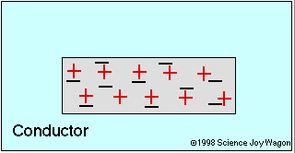
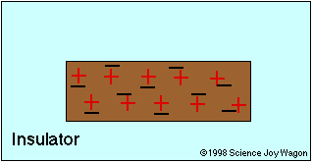
Conductors and Insulators
Q: How do electrons behave in a perfect conductor?
Q: How do electrons behave in a perfect insulator?
Most things are in between perfect conductor / insulator
Notes:
Copper and wood both made of atoms, both have positive and negative charges, but are electrically very different. Why?

Slide 12
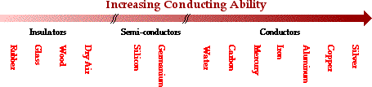
Conductors & Insulators
  Insulators: In these materials, once they are charged, the charges ARE NOT FREE TO MOVE. Plastics, glass, and other “bad conductors of electricity” are good examples of insulators.
  Conductors: In these materials, the charges ARE FREE TO MOVE. Metals are good examples of conductors.

Slide 13
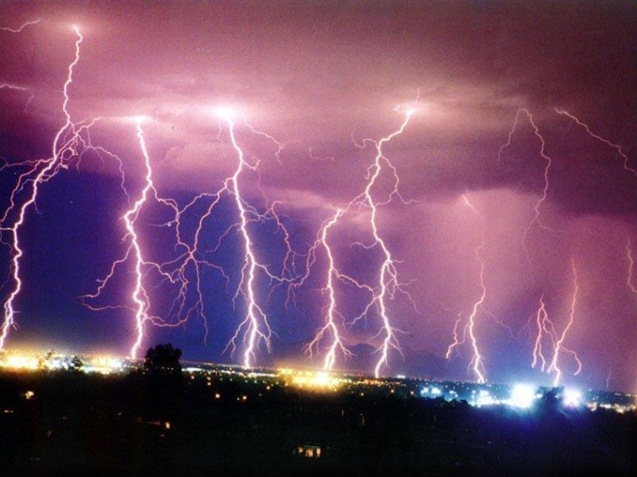
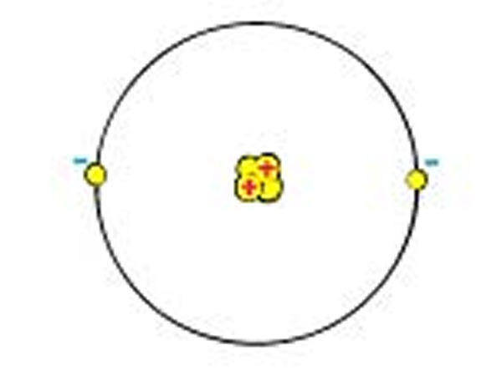
Charge
Standard unit of charge
Coulomb (C)
Coulomb is a huge unit of charge
Charge on one electron or proton is:
1.602 x 10⁻¹⁹C – often given letter e
A small spark between your finger and a door knob on the order of
microcoulombs
µC = 10⁻⁶C
Helium atom

Slide 14
Electroscope
Conduction
  Charged rod is brought near scope
  Charged rod touches scope transferring some charge
  Scope is left w/ same charge as rod
Induction
  Charged rod is brought near scope
  Scope is briefly grounded allowing charge to flow on (or off) scope
  Scope is left w/ opposite charge as rod

Slide 15
A negatively charged rod is used to charge an electroscope by induction. What is the resulting net charge on the electroscope?
Positive
Zero
Negative

Slide 16
If the conducting electroscope were replaced by an insulating ball and then charged by induction as above, what would be the net charge on the ball.
Positive
Zero
Negative

Slide 17
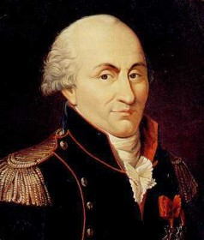
Law of Electrical Force
Charles-Augustin Coulomb
(1736 - 1806)
" The repulsive force between two small spheres charged with the same sort of electricity is in the inverse ratio of the squares of the distances between the centers of the spheres"
q₁
q₂
r
Notes:
7

Slide 18
Coulomb's Law
q₁
q₂
MKS Units:
r in meters
q in Coulombs
in Newtons
k = 9 · 10⁹ N-m²/C²
Coulomb’s constant
Notes:
8

Slide 19
Summary
Charges come in two varieties
  negative and positive
  in a conductor, negative charge means extra mobile electrons, and positive charge means a deficit of mobile electrons
Coulomb Force
Law of Superposition
→
→
→
F
=
F
+
F
1
2

Slide 20
Gravitational vs. Electrical Force
q₁
m₁
F
F
q₂
m₂
r
1
q
1
q
2
F
=
→
1
elec
4
πε
r
2
πε
0
F
elec
q
q
4
1
2
0
m
1
m
2
F
=
m
m
G
F
= G
grav
1
2
grav
r
2
For an electron:
→
* |q| = 1.6 × 10⁻¹⁹ C
F
elec
+
42
=
4
.
17
×
10
m = 9.1 × 10⁻³¹ kg
F
grav
* smallest charge seen in nature!

Slide 21
In the picture below, what is the direction of the force on the proton due to the electron?
Left
Right
Zero
Q_{p}=1.6x10⁻¹⁹ C
Q_{e} = -1.6x10⁻¹⁹ C
+
-
r = 1x10⁻¹⁰ m

Slide 22
What is the magnitude of the force on the proton due to the electron?
q_{p}=1.6x10⁻¹⁹ C
q_{e} = -1.6x10⁻¹⁹ C
F
+
-
  F= _______ N
r = 1x10⁻¹⁰ m

Slide 23
What is the magnitude of the force on the proton due to the electron?
  F= 2.3 x 10⁻⁸ N
q_{p}=1.6x10⁻¹⁹ C
q_{e} = -1.6x10⁻¹⁹ C
F
+
-
r = 1x10⁻¹⁰ m

Slide 24
A positive and a negative charge with equal magnitude are connected by a rigid rod, and placed near a large negative charge. What is the direction of the net force on the two connected charges?
Left
Zero
Right
-
+
-
Positive charge is attracted (force to left)
Negative charge is repelled (force to right)
Positive charge is closer so force to left is larger.

Slide 25
To Do
Purchase your clicker.
Read Sections 19-1 -- 19-5
Do checkpoint 1 before 6:00 AM 1/10/13.
Watch PreLecture-2 before 6:00 AM 1/10/13.
Do checkpoint 2 before 6:00 AM 1/10/13.
See you next time!

