Slide 1
Physics 1161 Lecture 4
Potential & Potential Energy

Slide 2
Recall Work from Phy 1151
Work done by the force given by:
  W = F d cos(θ)
  Positive: Force is in direction moved
  Negative: Force is opposite direction moved
  Zero: Force is perpendicular to direction moved
Careful! Ask WHAT is doing work!
  Opposite sign for work done by you!
Conservative Forces
  Δ Potential Energy = -W_{conservative}
Notes:
Use book or brick for prop. Ask students if I am doing positive or negative work, what about gravity.

Slide 3
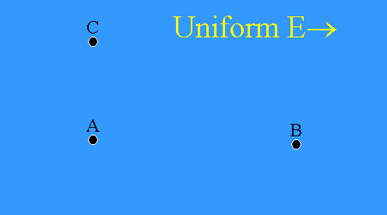
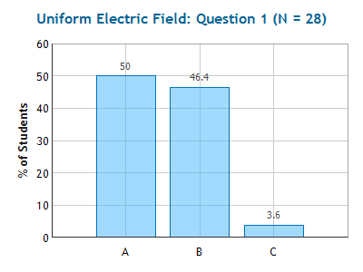
Checkpoint
Uniform Electric Field 1
F
In what direction does the force on a negative charge at point A point?
  left
  right
  up
Electric field points in the direction a POSITIVE charge would feel force.

Slide 4
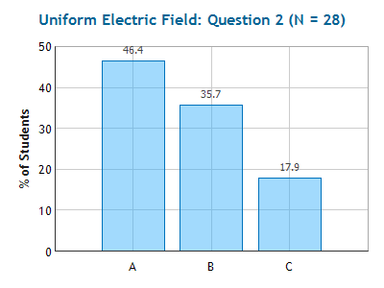
Checkpoint
Uniform Electric Field 2
motion
F
C
F
-
F
-
F
-
F
-
A
B
-
Uniform E→
When a negative charge is moved from A to C the ELECTRIC force does
  positive work.
  zero work.
  negative work.
The work is zero because the path is perpendicular to the field

Slide 5
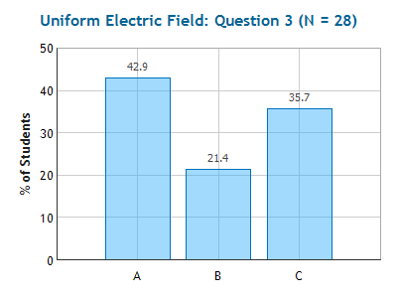
Checkpoint
Uniform Electric Field 3
C
A
B
F
F
F
F
F
-
-
-
-
-
-
Uniform E→
motion
When a negative charge is moved from A to B the ELECTRIC force does
positive work.
zero work.
negative work.
The work is negative the electric force opposes the direction of motion

Slide 6
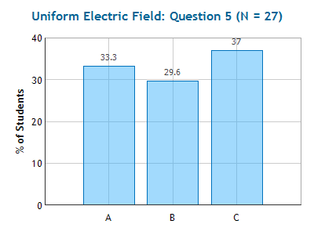
Checkpoint
Uniform Electric Field 5
C
A
B
-
-
-
-
-
Uniform E→
When a negative charge is moved from A to B, the electric potential energy of the charge
Increases
is constant
decreases
U_{E} = -W_{E field}
Like “climbing up hill” – increases potential energy

Slide 7
When a negative charge is moved from A to B, the electric potential energy of the charge
increases
is constant
decreases
+
C
B
A

Slide 8
When a negative charge is moved from A to B, the electric potential energy of the charge
increases
is constant
decreases
+
C
B
A

Slide 9
Electric Potential Energy
AC: W=0
+
E
C
CB: W<0
B
A
-
-
-
-
-
When a negative charge is moved from A to B, the electric potential energy of the charge
(1) increases
(2) is constant
(3) decreases
1) The electric force is directed to bring the electron closer to the proton.
2) Since the electron ends up further from the proton the electric field did negative work.
3) So the electric potential energy increased

Slide 10

Work and Δ Potential Energy
W = F d cos(q)
Gravity Electric
Brick raised y_{i}→ y_{f}
Charge moved ∞ → r_{f}
  F_{E} = kq₁q₂/r² (left)
  W_{E} = -kq₁q₂/r_{f}
  U_{E}= +kq₁q₂/r_{f}
  F_{G} = mg (down)
  W_{G} = -mgh
  U_{G}= +mgh
y_{f}→
r_{f}
h
y_{i}→

Slide 11
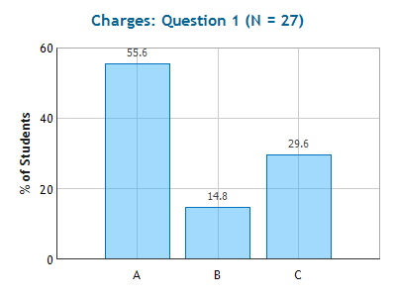
Checkpoint
Charges 1
1
+
5 m
5 m
+
-
2
5 m
3
The electric potential energy of this set of charges is:
(1) positive
(2) zero
(3) negative
Bring in (1): zero
Bring in (2): positive
Bring in (3): negative x 2

Slide 12
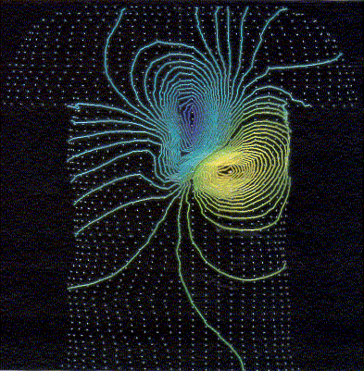
Electric Potential
(like height)*
Units Joules/Coulomb ≡Volts
  Batteries
  Outlets
  EKG
Really Potential differences
Equipotential lines at same height
Field lines point down hill
V = k q/r (distance r from charge q)
  V(∞) = 0
Notes:
Comment on lab w/ equipotential lines

Slide 13
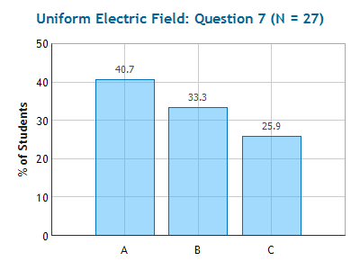
Checkpoint
Uniform Electric Field 7
The electric potential at point A is _______ at point B
greater than
equal to
less than
To go from B to A, a positive charge must climb “up hill” – increases potential energy. Hence A is at higher potential than B

Slide 14
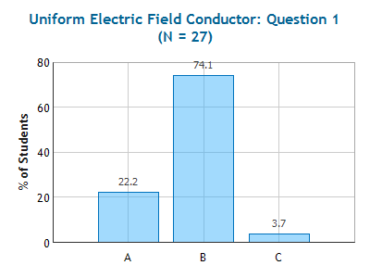
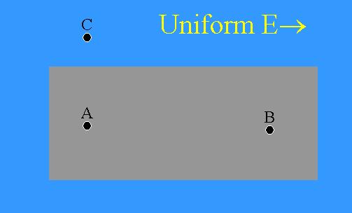
Checkpoint
Uniform Electric Field Conductor 1
conductor
The electric potential at point A is _______ at point B
greater than
equal to
less than
The electric field is zero at any point within a conducting material

Slide 15
The electric potential at A is _______ the electric potential at B.
greater than
equal to
less than
+
+
C
B
A

Slide 16
The electric potential at A is _______ the electric potential at B.
greater than
equal to
less than
+
E
+
C
B
A
1) Electric field lines point “down hill”
2) AC is equipotential path (perpendicular to E)
3) CB is down hill, so B is at a lower potential than (“down hill from”) A

Slide 17
Electric Potential due to Proton
What is the electric potential a distance r = 0.53×10⁻¹⁰ m from a proton? (Let V(∞) = 0)
What is the electric potential energy of an electron a distance r = 0.53×10⁻¹⁰ m from a proton?
r_{f} = 0.5×10⁻¹⁰ m
+
-

Slide 18
Comparison:
Electric Potential Energy vs. Electric Potential
Electric Potential Energy (U) - the energy of a charge at some location.
Electric Potential (V) - found for a location only – tells what the EPE would be if a charge were located there (usually talk about potential differences between two locations):
U = qV
Neither has direction, just location. Sign matters!

Slide 19
Two Charges
Example
Calculate electric potential at point A due to charges
  Calculate V from +7μC charge
  Calculate V from –3.5μC charge
  Add (EASY!)
V = kq/r
  V₇ = 1.26 x 10⁴ V
  V₃ = -0.63 x 10⁴ V
  V_{total} = 0.63 x 10⁴ V
A
4 m
6 m
Q=+7.0μC
Q=-3.5 μ C
How much work do you have to do to bring a 2 μ C charge from far away to point A?
W=ΔU= ΔVq = 1.26 x 10⁻² V

Slide 20
In the region II (between the two charges) the electric potential is
always positive
Positive at some points, negative at others
Always negative
I
II
III
Q=+7.0mC
Q=-3.5 mC

Slide 21
In the region II (between the two charges) the electric potential is
always positive
Positive at some points, negative at others
Always negative
I
II
III
Q=+7.0mC
Q=-3.5 mC
Very close to positive charge potential is positive
Very close to negative charge potential is negative

