Slide 1
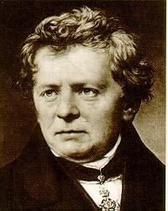
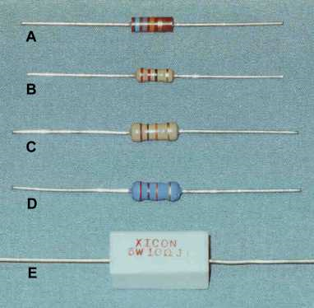
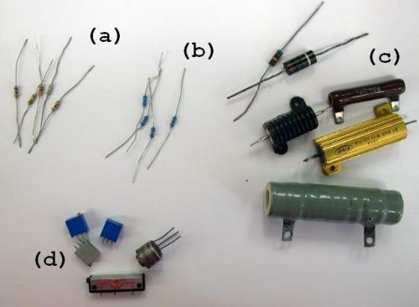
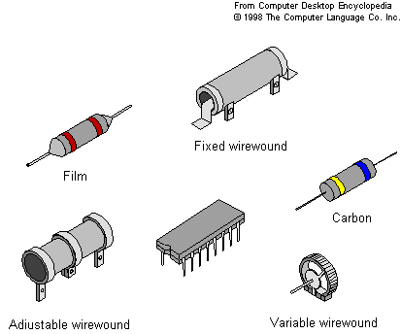
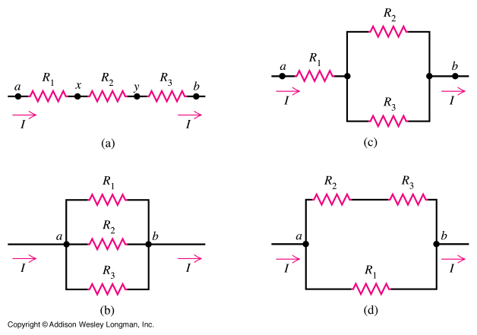
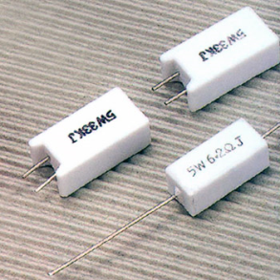
Resistance, Ohm’s Law
Georg Ohm
Physics 1161: Lecture 06
Homework, keep lots of digits!
Notes:
1

Slide 2
Last Time
Capacitors C = Q/V -- definition
  Physical C = ε₀A/d
  Series 1/C_{eq} = 1/C₁ + 1/C₂
  Parallel C_{eq} = C₁ + C₂
  Energy U = 1/2 QV
Today
Resistors R = V/I
  Physical R = ρ L/A
  Series R_{eq} = R₁ + R₂
  Parallel 1/R_{eq} = 1/R₁ + 1/R₂
  Power P = IV

Slide 3
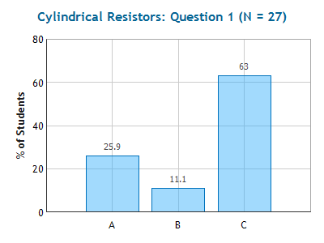
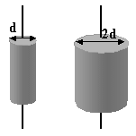
Checkpoint
Cylindrical Resistors 1
1
2
Two cylindrical resistors are made from the same material. They are of equal length but one has twice the diameter of the other.
R₁ > R₂
R₁ = R₂
R₁ < R₂

Slide 4
Simple Circuit
Example
I
ε
R
I
Practice…
  Calculate I when ε=24 Volts and R = 8 Ω
  Ohm’s Law: V =IR
I = V/R
= 3 Amps

Slide 5
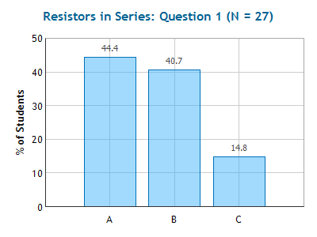
Checkpoint
Resistors in Series
Compare I₁ the current through R₁, with I₁₀ the current through R₁₀.
    I₁ < I₁₀
    I₁ = I₁₀
    I₁ > I₁₀
R₁=1Ω
ε₀
R₁₀=10Ω
Note: I is the same everywhere in this circuit!

Slide 6
Compare V₁ the voltage across R₁, with V₁₀ the voltage across R₁₀.
V₁>V₁₀
V₁=V₁₀
V₁< V₁₀
R₁=1Ω
ε₀
R₁₀=10Ω

Slide 7
Compare V₁ the voltage across R₁, with V₁₀ the voltage across R₁₀.
V₁>V₁₀
V₁=V₁₀
V₁< V₁₀
R₁=1Ω
ε₀
R₁₀=10Ω
V₁ = I₁ R₁ = 1 x I
V₁₀ = I₁₀ R₁₀ = 10 x I

Slide 8
Practice:
Resistors in Series
Example
R₁=1Ω
ε₀
Calculate the voltage across each resistor if the battery has potential V₀= 22 volts.
R₂=10Ω
Simplify (R₁ and R₂ in series):
  R₁₂ = R₁ + R₂
  V₁₂ = V₁ + V₂
  I₁₂ = I₁ = I₂
= 11 Ω
= V₀ = 22 Volts
R₁₂
ε₀
= V₁₂/R₁₂ = 2 Amps
Expand:
  V₁ = I₁R₁
  V₂ = I₂R₂
= 2 x 1 = 2 Volts
= 2 x 10 = 20 Volts
R₁=1Ω
ε₀
Check: V₁ + V₂ = V₁₂ ?
R₂=10Ω
YES!

Slide 9
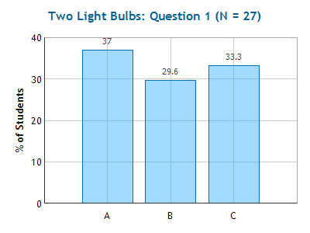
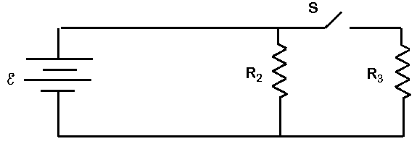
Checkpoint
2 Light Bulbs
What happens to the current through R₂ when the switch is closed?
Increases
Remains Same
Decreases
V₂ = ε = I₂R₂

Slide 10
What happens to the current through the battery when the switch is closed?
Increases
Remains Same
Decreases

Slide 11
What happens to the current through the battery when the switch is closed?
Increases
Remains Same
Decreases

Slide 12
Practice:
Resistors in Parallel
Example
ε
R₂
R₃
Determine the current through the battery.
Let E = 60 Volts, R₂ = 20 Ω and R₃=30 Ω.
Simplify: R₂ and R₃ are in parallel
ε
  1/R₂₃ = 1/R₂ + 1/R₃
  V₂₃ = V₂ = V₃
  I₂₃ = I₂ + I₃
R₂₃
R₂₃ = 12 Ω
= 60 Volts
= V₂₃ /R₂₃ = 5 Amps

Slide 13
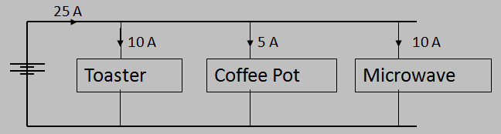
Why is it dangerous to use one power strip to plug in and use simultaneously your microwave, coffee pot, toaster, and hair dryer (current through hair dryer is 10 A)?
The resistance of the kitchen circuit is too high.
The voltage across the kitchen circuit is too high.
The current in the kitchen circuit is too high.

Slide 14
Why is it dangerous to use one power strip to plug in and use simultaneously your microwave, coffee pot, toaster, and hair dryer (current through hair dryer is 10 A)?
The resistance of the kitchen circuit is too high.
The voltage across the kitchen circuit is too high.
The current in the kitchen circuit is too high.

Slide 15
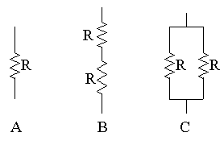
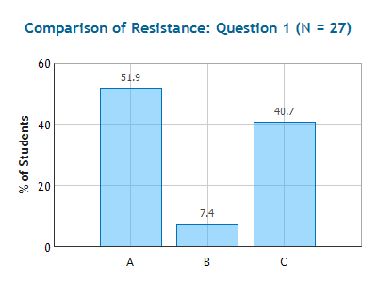
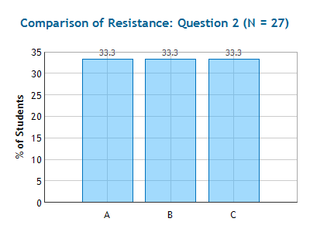
Checkpoint
Comparison of Resistance
1
2
3
R 2R R/2
Which configuration has the smallest resistance?
1
2
3
Which configuration has the largest resistance?
2

Slide 16
Parallel + Series Tests
Resistors R₁ and R₂ are in series if and only if R₁ and R₂ are connected with a single wire (NO branches)
Resistors R₁ and R₂ are in parallel if and only if you can make a loop that has ONLY R₁ and R₂
Same rules apply to capacitors!!

Slide 17
Summary
Series
Parallel
R₁
R₁
R₂
R₂
Wiring
Each resistor on the same wire.
Each resistor on a different wire.
Voltage
Different for each resistor.
V_{total} = V₁ + V₂
Same for each resistor.
V_{total} = V₁ = V₂
Current
Same for each resistor
I_{total} = I₁ = I₂
Different for each resistor
I_{total} = I₁ + I₂
Resistance
Increases
R_{eq} = R₁ + R₂
Decreases
1/R_{eq} = 1/R₁ + 1/R₂

