Slide 1
Physics 1161: Lecture 8
Kirchhoff’s Laws

Slide 2
Kirchhoff’s Rules
Kirchhoff’s Junction Rule:
  Current going in equals current coming out.
Kirchhoff’s Loop Rule:
  Sum of voltage changes around a loop is zero.

Slide 3
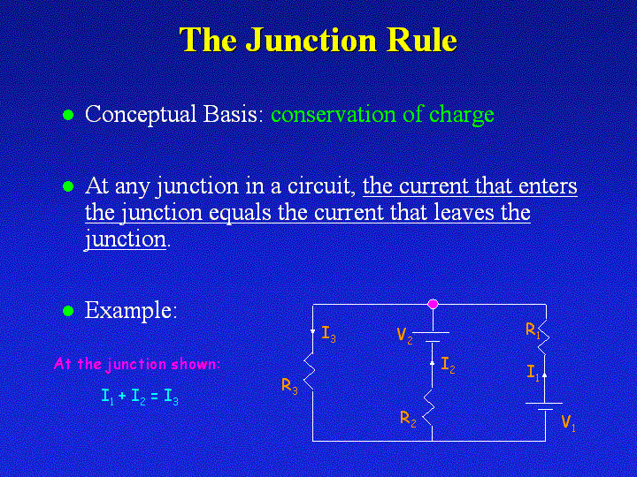

Slide 4
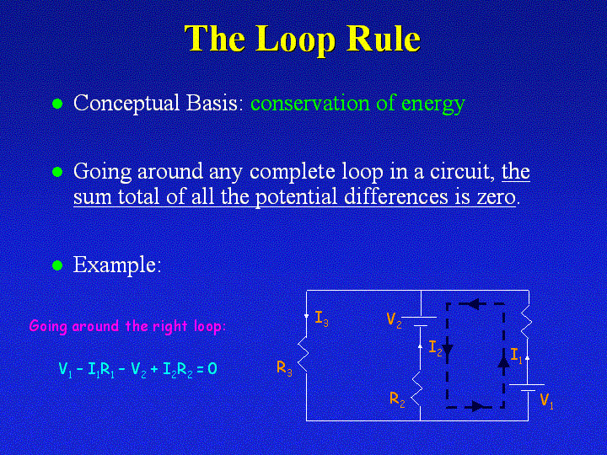

Slide 5
Using Kirchhoff’s Rules
Label all currents
(2) Write down junction equation
I_{in} = I_{out}
(3)Choose loop and direction
  Choose any direction
  You will need one less loop than
  unknown currents
R₁
I₁
A
R₂
ε₃
(4) Write down voltage changes
Be careful about signs
For batteries – voltage change is positive when summing from negative to positive
For resistors – voltage change is negative when summing in the direction of the current
B
ε₁
I₂
I₃
I₄
ε ₂
R₃
R₄
I₅
R₅
Notes:
Have students label I5, since it isn’t shown in their drawing

Slide 6
Loop Rule Practice
Example
R₁=5 Ω
I
B
Find I:
ε₁= 50V
A
R₂=15 Ω
ε₂= 10V
Notes:
Ask if R1 and R2 are in series, parallel.

Slide 7
Loop Rule Practice
Example
R₁=5 Ω
I
B
Find I:
Label currents
Choose loop
Write KLR
ε₁= 50V
A
R₂=15 Ω
ε₂= 10V
+ε₁ - IR₁ - ε₂ - IR₂ = 0
+50 - 5 I - 10 - 15 I = 0
I = +2 Amps

Slide 8
Resistors R₁ and R₂ are
I₁
R₁=10 Ω
In parallel
In series
neither
E₂ = 5 V
I₂
R₂=10 Ω
I_{B}
+
-
E₁ = 10 V

Slide 9
Resistors R₁ and R₂ are
I₁
R₁=10 Ω
In parallel
In series
neither
E₂ = 5 V
I₂
R₂=10 Ω
I_{B}
+
-
E₁ = 10 V
Definition of parallel:
Two elements are in parallel if (and only if) you can make a loop that contains only those two elements.
Upper loop contains R₁ and R₂ but also E₂.

Slide 10
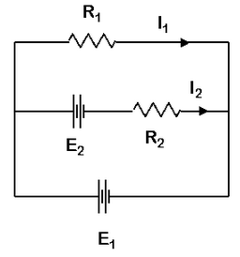
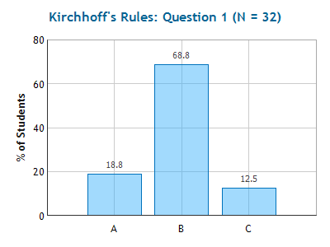
Checkpoint 1
Calculate the current through resistor 1.
1) I₁ = 0.5 A 2) I₁ = 1.0 A 3) I₁ = 1.5 A
⇒ I₁ = E₁ /R₁ = 1A
E₁ - I₁R₁ = 0
Notes:
Note that nothing is in series or in parallel!

Slide 11
How would I₁ change if the switch was opened?
I₁
R=10 Ω
Increase
No change
Decrease
E₂ = 5 V
I₂
R=10 Ω
I_{B}
E₁ = 10 V

Slide 12
How would I₁ change if the switch was opened?
I₁
R=10 Ω
Increase
No change
Decrease
E₂ = 5 V
I₂
R=10 Ω
I_{B}
E₁ = 10 V

Slide 13
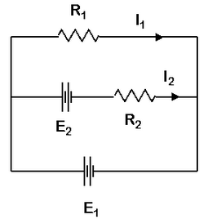
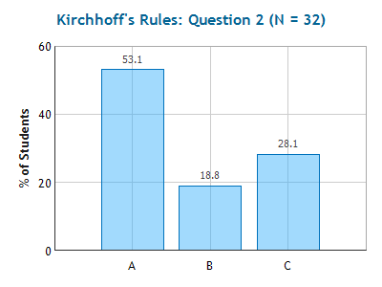
Checkpoint 2
Calculate the current through resistor 2.
I₂ = 0.5 A
I₂ = 1.0 A
I₂ = 1.5 A
E₁ - E₂ - I₂R₂ = 0
⇒ I₂ = 0.5A

Slide 14
Checkpoint 2
How do I know the direction of I₂?
It doesn’t matter. Choose whatever direction
you like. Then solve the equations to find I_{2.}
If the result is positive, then your initial guess
was correct. If result is negative, then actual
direction is opposite to your initial guess.
I₁
R=10 Ω
E₂ = 5 V
I₂
R=10 Ω
-
+
Work through preflight with opposite
sign for I₂?
I_{B}
+
-
E₁ = 10 V
+E₁ - E₂ + I₂R = 0 Note the sign change from last slide
⇒ I₂ = -0.5A Answer has same magnitude as before but opposite sign. That means current goes to the left, as we found before.

Slide 15
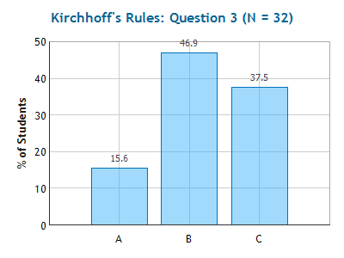
Kirchhoff’s Junction Rule
Current Entering = Current Leaving
I₁ = I₂ + I₃
I₁
I₂
I₃
Checkpoint 3
I₁
R=10 Ω
1) I_{B} = 0.5 A 2) I_{B} = 1.0 A 3) I_{B} = 1.5 A
E = 5 V
I₂
R=10 Ω
I_{B} = I₁ + I₂ = 1.5 A
“The first two can be calculated using V=IR because the voltage and resistance is given, and the current through E1 can be calculated with the help of Kirchhoff's Junction rule, that states whatever current flows into the junction must flow out. So I1 and I2 are added together.”
I_{B}
+
-
E₁ = 10 V

Slide 16
Kirchhoff’s Laws
(1) Label all currents
  Choose any direction
R₁
I₁
A
Write down the junction equation
  I_{in} = I_{out}
R₂
E₃
B
Choose loop and direction
  Your choice!
I₂
E₁
I₃
I₄
E₂
R₃
R₄
Write down voltage changes
Follow any loops
R₅
Solve the equations by substitution or combination .

Slide 17
You try it!
Example
In the circuit below you are given ε₁, ε₂, R₁, R₂ and R₃. Find I₁, I₂ and I₃.
R₁
I₁
I₃
I₂
+
ε₁
R₂
R₃
-
-
ε₂
+
Notes:
1) This will be given on the exam. Comment on 1 equation 2 unknowns. 2 eqs 3 unknowns finally 3 and 3

Slide 18
You try it!
Example
In the circuit below you are given ε₁, ε₂, R₁, R₂ and R₃. Find I₁, I₂ and I₃.

Label all currents (Choose any direction)

2. Write down junction equation


Node: I₁ + I₂ = I₃
3. Choose loop and direction (Your choice!)
Write down voltage changes
Loop 1: +ε₁- I₁R₁ + I₂R₂ = 0
R₁
I₁
I₃
- I₂R₂ - I₃R₃ - ε₂ = 0
I₂

Loop 2:
+
ε₁
Loop 1
R₂
R₃
3 Equations, 3 unknowns the rest is math!
-
Loop 2
-
ε₂
+

Slide 19
Let’s put in actual numbers
Example
In the circuit below you are given ε₁, ε₂, R₁, R₂ and R₃. Find I₁, I₂ and I₃.
5
I₁
I₃
I₂
1. junction: I₃=I₁+I₂
2. left loop: 20 - 5I₁+10I₂ = 0
3. right loop: -2 - 10I₂ - 10I₃ = 0
+
10
20
10
-
-
+
2
solution: substitute Eq.1 for I₃ in Eq. 3:
rearrange: -10I₁ - 20I₂ = 2
rearrange Eq. 2: 5I₁-10I₂ = 20
Now we have 2 eq., 2 unknowns. Continue on next slide

Slide 20
-10I₁-20I₂ = 2
2*(5I₁ - 10I₂ = 20) = 10I₁ – 20I₂ = 40
Now we have 2 eq., 2 unknowns.
Add the equations together:
-40I₂ = 42 I₂ = -1.05 A
note that this means direction of I₂ is opposite to that shown on the previous slide
Plug into left loop equation:
5I₁ -10*(-1.05) = 20
I₁=1.90 A
Use junction equation (eq. 1 from previous page)
I₃=I₁+I₂ = 1.90-1.05
I₃ = 0.85 A

