Slide 1
Physics 1161 Lecture 09
RC Circuits

Slide 2
Time Constant Demo
Example
Each circuit has a 0.5 F capacitor charged to 9 Volts.
When the switch is closed:
Which system will be brightest?
Which lights will stay on longest?
Which lights consume more energy?
1
2
τ = 2RC
τ = RC/2

Slide 3
Time Constant Demo
Example
Each circuit has a 0.5 F capacitor charged to 9 Volts.
When the switch is closed:
2 I=2V/R
Which system will be brightest?
Which lights will stay on longest?
Which lights consume more energy?
1
Same U=1/2 CV²
1
2
τ = 2RC
τ = RC/2

Slide 4
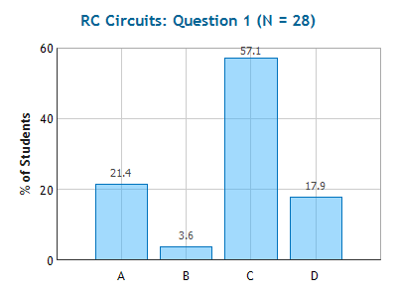
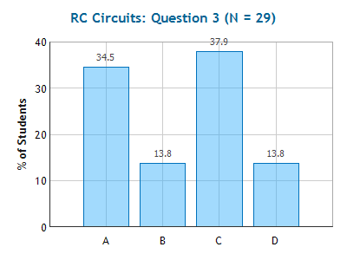
RC Circuits
Checkpoint 1 & 3
Both switches are initially open, and the capacitor is uncharged. What is the current through the battery just after switch S₁ is closed?
+
2R
-
I_{b} = 0
I_{b} = ε /(3R)
I_{b} = ε /(2R)
I_{b} = ε /R
I_{b}
+
+
ε
C
R
-
-
S₂
Both switches are initially open, and the capacitor is uncharged.
What is the current through the battery after switch 1 has been closed a long time?
S₁
I_{b} = 0 2) I_{b} = V/(3R)
3) I_{b} = V/(2R) 4) I_{b} = V/R

Slide 5
Practice!
Example
R
Calculate current immediately after switch is closed:
E
C
-
Calculate current after switch has been closed for 0.5 seconds:
S₁
R=10Ω
C=30 mF
E =20 Volts
Calculate current after switch has been closed for a long time:
Calculate charge on capacitor after switch has been closed for a long time:

Slide 6
Practice
Example
+
R
-
Calculate current immediately after switch is closed:
I
ε - I₀R - q₀/C = 0
+
+
C
ε - I₀R - 0 = 0
-
E
-
I₀ = ε /R
Calculate current after switch has been closed for 0.5 seconds:
S₁
R=10Ω
C=30 mF
E =20 Volts
Calculate current after switch has been closed for a long time:
After a long time current through capacitor is zero!
Calculate charge on capacitor after switch has been closed for a long time:
ε - IR - q∞/C = 0
ε + 0 - q∞ /C = 0
q∞ = εC

Slide 7
Both switches are closed. What is the final charge on the capacitor after the switches have been closed a long time?
+
2R
-
1. Q = 0
2. Q = C ε /3
3. Q = C ε /2
4. Q = C ε
I_{R}
+
+
C
-
R
-
S₁
S₂

Slide 8
Both switches are closed. What is the final charge on the capacitor after the switches have been closed a long time?
+
2R
-
1. Q = 0
2. Q = C ε /3
3. Q = C ε /2
4. Q = C ε
I_{R}
+
+
C
-
R
-
S₁
S₂

Slide 9
Charging: Intermediate Times
Example
Calculate the charge on the capacitor 3×10⁻³ seconds after switch 1 is closed.
R₁ = 20 Ω
R₂ = 40 Ω
ε = 50 Volts
C = 100μF
  q(t) = q∞(1-e^{-t/RC})
R₂
+
-
I_{b}
+
+
ε
C
R₁
-
-
S₂
S₁

Slide 10
Charging: Intermediate Times
Example
Calculate the charge on the capacitor 3×10⁻³ seconds after switch 1 is closed.
R₁ = 20 Ω
R₂ = 40 Ω
ε = 50 Volts
C = 100μF
  q(t) = q∞(1-e^{-t/R2C})
= q∞(1-e^{-3×10-3 /(40×100×10-6))})
= q∞ (0.53)
Recall q∞ = ε C
= (50)(100x10⁻⁶) (0.53)
= 2.7 x10⁻³ Coulombs
R₂
+
-
I_{b}
+
+
ε
C
R₁
-
-
S₂
S₁

Slide 11
RC Circuits: Discharging
R
KLR: ____________
Just after…: ________
  Capacitor is still fully charged
Long time after: ____________
Intermediate (more complex)
  q(t) = q₀ e^{-t/RC}
  I_{c}(t) = I₀ e^{-t/RC}
ε
+
-
I
C
+
-
S₁
S₂
RC
2RC
q
t

Slide 12
RC Circuits: Discharging
R
KLR: q(t) / C - I(t) R = 0
Just after…: q=q₀
  Capacitor is still fully charged
  q₀ / C - I₀ R = 0
  ⇒ I₀ = q₀/(RC)
Long time after: I_{c}=0
  Capacitor is discharged
  q∞ / C = 0 ⇒ q∞ = 0
Intermediate (more complex)
  q(t) = q₀ e^{-t/RC}
  I_{c}(t) = I₀ e^{-t/RC}
ε
+
-
I
C
+
-
S₁
S₂
RC
2RC
q
t

Slide 13
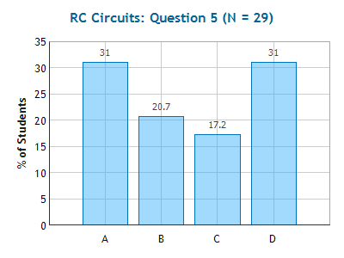
Checkpoint RC Circuits 5
After switch 1 has been closed for a long time, it is opened and switch 2 is closed. What is the current through the right resistor just after switch 2 is closed?
+
2R
-
I_{R} = 0
I_{R} = ε /(3R)
I_{R} = ε /(2R)
I_{R} = ε /R
I_{R}
+
+
+
ε
C
R
-
-
-
KLR: -q₀/C+IR = 0
Recall q is charge on capacitor after charging:
q₀= ε C (since charged w/ switch 2 open!)
- ε + IR = 0
⇒ I = ε /R
S₁
S₂

Slide 14
After being closed for a long time, the switch is opened. What is the charge Q on the capacitor 0.06 seconds after the switch is opened?
0.368 q₀
0.632 q₀
0.135 q₀
0.865 q₀
E = 24 Volts
R = 4 Ω
C = 15 mF
2R
C
R
E
S₁

Slide 15
After being closed for a long time, the switch is opened. What is the charge Q on the capacitor 0.06 seconds after the switch is opened?
0.368 q₀
0.632 q₀
0.135 q₀
0.865 q₀
E = 24 Volts
R = 4 Ω
C = 15 mF
2R
C
R
E
  q(t) = q₀ e^{-t/RC}
= q₀ (e^{-0.06 /(4×(15×10-3))})
S₁
= q₀ (0.368)

