Slide 1

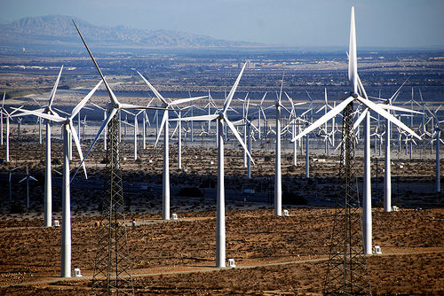
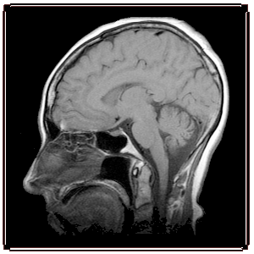
Magnetism
Physics 1161: Lecture 10
Textbook Sections 22-1 – 22-3, 22-8
Notes:
1

Slide 2
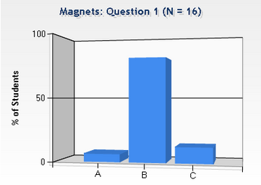
1
Checkpoint
Magnets
Which drawing shows the correct field lines for a bar magnet?
S N
(1) (2) (3)
2
Magnetic field lines are continuous
Arrows go from N to S outside the magnet (S to N inside).
S N
3
S N

Slide 3
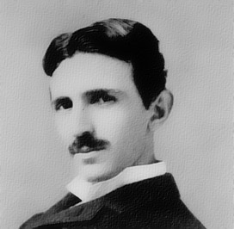
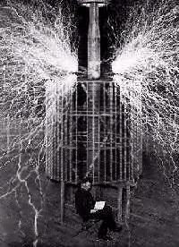
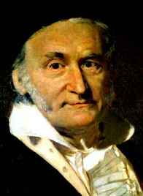
Magnetic Field Units
F = q v x B
SI units: N-s/C-m = Tesla
1 Tesla = 10,000 Gauss
Earth’s magnetic field is approximately 0.5 Gauss
Refrigerator magnets are about 100 Gauss
Superconducting electromagnets can be as much as 40 Tesla
Nikola Tesla
1856- 1943
Carl Friedrich Gauss
1777-1855

Slide 4
Tesla Videos
http://www.youtube.com/watch?v=l0Yb64ieGvQ&feature=youtu.be
http://www.youtube.com/watch?v=hgll-XTqcS4

Slide 5
Direction of Magnetic Force on Moving Charges
Velocity B Force
out of screen right
out of screen left
out of screen up
out of screen down
up
down
left
right
Right Hand Rule
B
Thumb v, Fingers B, palm F
v
F
Negative charge has opposite F!

Slide 6
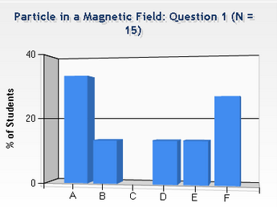
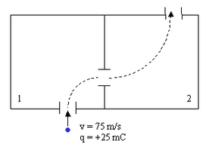
Checkpoint
Particle in a Magnetic Field 1
Each chamber has a unique magnetic field. A positively charged particle enters chamber 1 with velocity 75 m/s up, and follows the dashed trajectory.
What is the direction of the force on the particle just as it enters region 1?
1) up
2) down
3) left
4) right
5) into page
6) out of page
Particle is moving straight upwards then veers to the right.

Slide 7
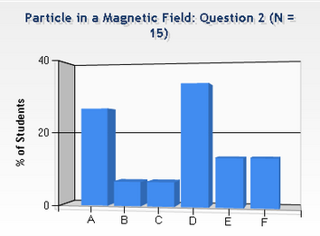
Checkpoint
Particle in a Magnetic Field 2
Each chamber has a unique magnetic field. A positively charged particle enters chamber 1 with velocity 75 m/s up, and follows the dashed trajectory.
What is the direction of the magnetic field in region 1?
1) up
2) down
3) left
4) right
5) into page
6) out of page
v (thumb) points up, F(palm) points right: so B(fingers) must point out.

Slide 8
Each chamber has a unique magnetic field. A positively charged particle enters chamber 2 with velocity 75 m/s to the right, and follows the dashed trajectory.
What is the direction of the magnetic field in region 2?
1. up
2. down
3. left
4. right
5. into page
6. out of page

Slide 9
Each chamber has a unique magnetic field. A positively charged particle enters chamber 2 with velocity 75 m/s to the right, and follows the dashed trajectory.
What is the direction of the magnetic field in region 2?
1. up
2. down
3. left
4. right
5. into page
6. out of page
v (thumb) points right, F(palm) points up, B(fingers) point in.

Slide 10
Magnitude of Magnetic Force on Moving Charges
The magnetic force on a charge depends on the magnitude of the charge, its velocity, and the magnetic field.
F = q v B sin(θ)
  Direction from RHR
    Thumb (__), fingers (__), palm (__)
  Note if v is parallel to B then F = 0
V
θ
B
v
B
F

Slide 11
The three charges below have equal charge and speed, but are traveling in different directions in a uniform magnetic field.
Which particle experiences the greatest magnetic force?
B
1
2
3
All Same
3
2
1

Slide 12
The three charges below have equal charge and speed, but are traveling in different directions in a uniform magnetic field.
Which particle experiences the greatest magnetic force?
B
1
2
3
All Same
3
2
1
F = q v B sin(θ)

Slide 13
The three charges below have equal charge and speed, but are traveling in different directions in a uniform magnetic field.
The force on particle 3 is in the same direction as the force on particle 1.
B
True
False
3
2
1

Slide 14
The three charges below have equal charge and speed, but are traveling in different directions in a uniform magnetic field.
The force on particle 3 is in the same direction as the force on particle 1.
B
True
False
3
2
1
Thumb (v), fingers (B), palm (F)
into page

Slide 15
Electric Force vs Magnetic Force
 | Electric | Magnetic
Source: | Charges | Moving charges
Acts on: | Charges | Moving charges
Magnitude: | F = qE | F = qvB sin
Direction: | Parallel to E | Perpendicular to v & B

Slide 16
Velocity Selector
Example
Determine magnitude and direction of magnetic field such that a positively charged particle with initial velocity v travels straight through and exits the other side.
F_{B}
E
v
F_{E}
Electric force is down, so need magnetic force up.
By RHR, B must be into page
For straight line, need |F_{E} |= |F_{B} |
q E= q v B sin(90)
B = E/v
What direction should B point if you want to select negative charges?
1) Into Page 2) Out of page 3) Left 4) Right
F_{E} would be up so F_{B} must be down.

Slide 17
Motion of Q in uniform B field
Force is perpendicular to B,v
  B does no work! (W=F d cos θ )
  Speed is constant (W=Δ K.E. )
  Circular motion
x x x x x x x
x x x x x x x
v
x x x x x x x
x x x x x x x
x x x x x x x
x x x x x x x
Uniform B into page

Slide 18
Trajectory in Constant B Field
Suppose charge q enters B-field with velocity v as shown below. What will be the path q follows?
x x x x x x
x x x x x x
x x x x x x
x x x x x x
x x x x x x
x x x x x x
B
v
v
q
F
F
R
Force is always ⊥ to velocity and B. What is path?
  Path will be circle. F will be the centripetal force needed to keep the charge in its circular orbit.
  Calculate R:

Slide 19
Radius of Circular Orbit
Lorentz force:
F
=
qvB
x x x x x x
x x x x x x
x x x x x x
x x x x x x
x x x x x x
x x x x x x
centripetal acc:
B
v
v
2
a
=
q
v
F
F
R
Newton's 2nd Law:
R
⇒
v
2
F
=
ma
qvB
=
m
R
⇒
mv
an important result, with useful experimental consequences !
R
=
qB

Slide 20
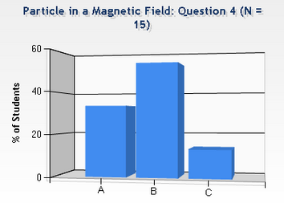
Checkpoint
Particle in a Magnetic Field 4
Each chamber has a unique magnetic field. A positively charged particle enters chamber 1 with velocity v₁= 75 m/s up, and follows the dashed trajectory.
What is the speed of the particle when it leaves chamber 2?
1) v₂ < v₁
2) v₂ = v₁
3) v₂ > v₁

Slide 21
Checkpoint
Particle in a Magnetic Field 4
Each chamber has a unique magnetic field. A positively charged particle enters chamber 1 with velocity v₁= 75 m/s up, and follows the dashed trajectory.
What is the speed of the particle when it leaves chamber 2?
1) v₂ < v₁
2) v₂ = v₁
3) v₂ > v₁
Magnetic force is always perpendicular to velocity, so it changes direction, not speed of particle.
43

Slide 22
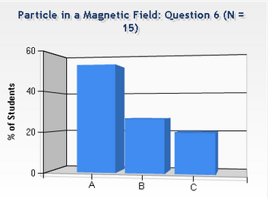
Checkpoint
Particle in a Magnetic Field 6
Each chamber has a unique magnetic field. A positively charged particle enters chamber 1 with velocity v₁= 75 m/s up, and follows the dashed trajectory.
Compare the magnitude of the magnetic field in chambers 1 and 2
1) B₁ > B₂
2) B₁ = B₂
3) B₁ < B₂

Slide 23
Checkpoint
Particle in a Magnetic Field 6
Each chamber has a unique magnetic field. A positively charged particle enters chamber 1 with velocity v₁= 75 m/s up, and follows the dashed trajectory.
Compare the magnitude of the magnetic field in chambers 1 and 2
1) B₁ > B₂
2) B₁ = B₂.
3) B₁ < B₂
Larger B, greater force, smaller R

Slide 24
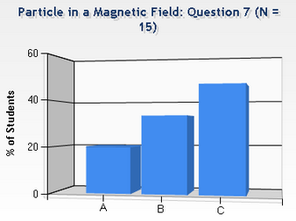
Checkpoint
Particle in a Magnetic Field 7
Each chamber has a unique magnetic field. A positively charged particle enters chamber 1 with velocity v₁= 75 m/s up, and follows the dashed trajectory.
A second particle with mass 2m enters the chamber and follows the same path as the particle with mass m and charge q=25 mC. What is its charge?
1) Q = 12.5 mC
2) Q = 25 mC
3) Q = 50 mC

Slide 25
Checkpoint
Particle in a Magnetic Field 7
Each chamber has a unique magnetic field. A positively charged particle enters chamber 1 with velocity v₁= 75 m/s up, and follows the dashed trajectory.
A second particle with mass 2m enters the chamber and follows the same path as the particle with mass m and charge q=25 mC. What is its charge?
1) Q = 12.5 mC
2) Q = 25 mC
3) Q = 50 mC

