Slide 1
Currents and Magnetism
Physics 1161: Lecture 11
Textbook Sections 22-4 – 22-7
Notes:
1

Slide 2
Force of B-field on Current
Force on 1 moving charge:
  F = q v B sin(θ)
  Out of the page (RHR)
θ
v
+
Force on many moving charges:
  F = (q/t)(vt)B sin(θ)
= I L B sin(θ)
  Out of the page!
B
v
+
+
+
+
I = q/t
L = vt

Slide 3
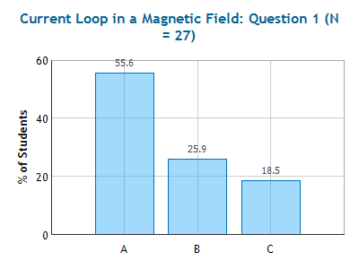
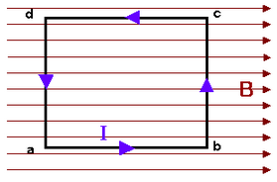
Checkpoint
Current Loop in Magnetic Field 1
A rectangular loop of wire is carrying current as shown. There is a uniform magnetic field parallel to the sides A-B and C-D.
B
θ
I
L
F=ILBsinθ
Here θ = 0.
What is the direction of the force on section A-B of the wire?
force is zero
out of the page
into the page

Slide 4
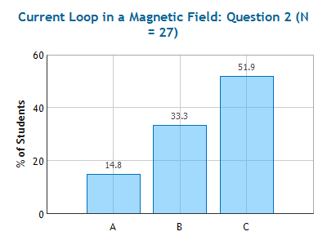
Checkpoint
Current Loop in Magnetic Field 2
A rectangular loop of wire is carrying current as shown. There is a uniform magnetic field parallel to the sides A-B and C-D.
v
F
X
B
Palm into page.
F
What is the direction of the force on section B-C of the wire?
force is zero
out of the page
into the page

Slide 5
Torque on Current Loop in B field
D
C
F
F
•
X
F
B
D
C
A
B
F
I
A
B
The loop will spin in place!
Checkpoint
Current Loop in Magnetic Field 3 & 4
Look from here
Net force on loop is zero.
But the net torque is not!
Notes:
86% got that the net force was zero; 45% said it wouldn’t move -- Could be confusion about move vs spin

Slide 6
Torque on Current Loop in B field
D
C
F
F
•
X
F
W
B
D
C
φ
A
B
F
I
A
B
L
Force on sections B-C and A-D: F =
Torque on loop is τ = 2 x (L/2) F sin(φ) =
(length x width = area) LW = A !
∴ Torque is τ =

Slide 7
Torque on Current Loop in B field
D
C
F
F
•
X
F
W
B
D
C
φ
A
B
F
I
A
B
L
L/2
L/2
Force on sections B-C and A-D: F = IBW
Torque on loop is τ = 2 x (L/2) F sin(φ) = ILWB sin(φ)
(length x width = area) LW = A !
∴ Torque is τ = I A B sin(φ)

Slide 8
Torque on Current Loop
normal
Magnitude:
τ = I A B sinφ
F
D
φ
B
A
C
between normal and B
B
F
Direction:
Torque tries to line up the normal with B!
(when normal lines up with B, φ=0, so τ=0! )
Even if the loop is not rectangular, as long as it is flat:
τ = I A B sinφ.
N
# of loops
(area of loop)

Slide 9
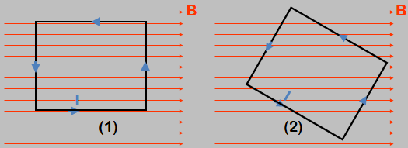
Compare the torque on loop 1 and 2 which have identical area, and current.
τ₁ > τ₂
τ₁ = τ₂
τ₁ < τ₂

Slide 10
Compare the torque on loop 1 and 2 which have identical area, and current.
τ₁ > τ₂
τ₁ = τ₂
τ₁ < τ₂
τ = I A B sinφ
Area points out of page for both!
φ = 90 degrees

Slide 11
Currents Create B Fields
Magnitude:
B
Current I OUT
r
•
r = distance from wire
Lines of B
Right-Hand Rule-2
Thumb: along I
Fingers: curl along B field lines

Slide 12
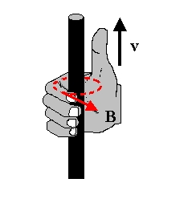
Right Hand Rule 2!
Fingers
give
B!
I
wire

Slide 13
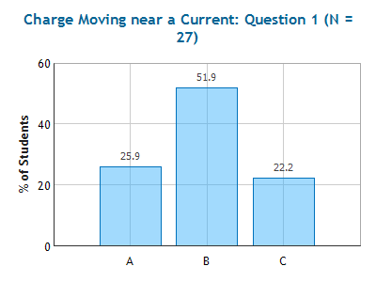
Checkpoint
Charge Moving Near Current
A long straight wire is carrying current from left to right. Near the wire is a charge q with velocity v
v
v
(a)
•
B
•
(b)
•
F
F
r
r
I
Compare magnetic force on q in (a) vs. (b)
(a) has the larger force (b) has the larger force force is the same for (a) and (b)
same
θ is angle between v and B
(θ = 90° in both cases)
same

Slide 14
Two long wires carry opposite current. What is the direction of the magnetic field above, and midway between the two wires carrying current – at the point marked “X”?
x
x
Left
Right
Up
Down
Zero

Slide 15
Two long wires carry opposite current. What is the direction of the magnetic field above, and midway between the two wires carrying current – at the point marked “X”?
B
x
x
Left
Right
Up
Down
Zero

Slide 16
Force between current-carrying wires
I towards us
B
•
•
F
Another I towards us
Conclusion: Currents in same direction attract!
I towards us
B
•
×
F
Another I away from us
Conclusion: Currents in opposite direction repel!
Note: this is different from the Coulomb force between like or unlike charges.

Slide 17
Comparison:
Electric Field vs. Magnetic Field
Electric Magnetic
Source Charges Moving Charges
Acts on Charges Moving Charges
Force F = Eq F = q v B sin(θ)
Direction Parallel E Perpendicular to v,B
Field Lines
Opposites Charges Attract Currents Repel

Slide 18
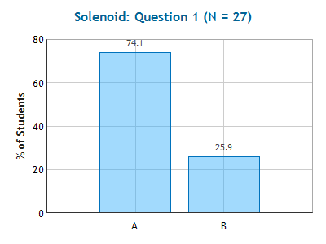
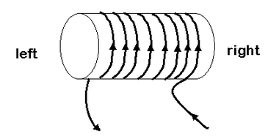
Checkpoint
Solenoid
A solenoid is wrapped with wire carrying a current, as shown in the figure.
What is the direction of the magnetic field produced by the solenoid?
a. into the right end of the solenoid and out of the left end
b. out of the right end of the solenoid and into the left end

Slide 19
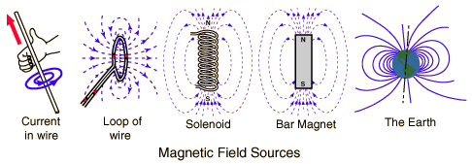
Magnetic Fields of Currents
http://hyperphysics.phy-astr.gsu.edu/hbase/magnetic/magfie.html#c1

Slide 20
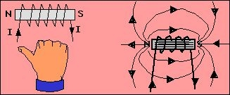
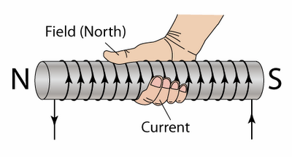
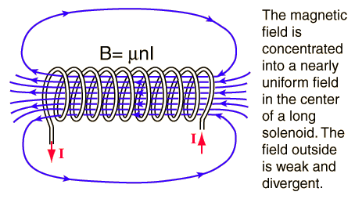
Right Hand Rule 3
Magnetic Field of Solenoid

Slide 21
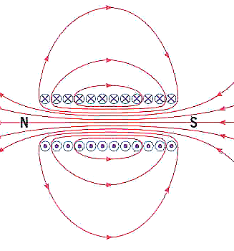
B Field Inside Solenoids
Magnitude of Field anywhere inside of solenoid : B=μ₀ n I
n is the number of turns of wire/meter on solenoid.
μ₀ = 4π x10⁻⁷ T m /A
(Note: N is the total number of turns, n = N / L)
Right-Hand Rule for loop/solenoid
Fingers – curl around coil in direction of conventional (+) current
Thumb - points in direction of B along axis
Magnetic field lines look like bar magnet!
Solenoid has N and S poles!

Slide 22
What is the force between the two solenoids?
Attractive
Zero
Repulsive

Slide 23
What is the force between the two solenoids?
Attractive
Zero
Repulsive
Look at field lines, opposites attract.
Look at currents, same direction attract.

