Slide 1
Induction: Faraday’s Law
Physics 1161: Lecture 12
Changing Magnetic Fields create Electric Fields
Sections 23-1 -- 23-4
Notes:
1

Slide 2
Faraday’s Law
Key to EVERYTHING in E+M
  Generating electricity
  Microphones, Speakers and MP3 Players
  Amplifiers
  Computer disks and card readers
  Ground Fault Interrupters
Changing B creates new E

Slide 3
Magnetic Flux
Faraday’s Law for Coil of N Turns
Lenz’s Law
Induced current is in a direction so that it opposes the change that produces it.

Slide 4
Magnetic Flux
Count number of field lines through loop.
B
Uniform magnetic field, B, passes through a plane surface of area A.
A
Magnetic flux Φ = B A
B
φ
Magnetic flux Φ ≡ B A cos(φ)
normal
A
φ is angle between normal and B
Note: The flux can be negative
(if field lines go thru loop in opposite direction)

Slide 5
Faraday’s Law (EMF Magnitude)
Emf = Change in magnetic Flux/Time
Since Φ= B A cos(φ), 3 things can change Φ

Slide 6
Faraday’s Law (EMF Magnitude)
Emf = Change in magnetic Flux/Time
Since Φ= B A cos(φ), 3 things can change Φ
    Area of loop
    Magnetic field B
    Angle φ between A and B

Slide 7
Lenz’s Law (EMF Direction)
Emf opposes change in flux
If flux increases:
New EMF makes new field opposite to the original field (to oppose the increase)
If flux decreases:
  New EMF makes new field in the same direction as the original field (to oppose the decrease)
Notes:
Put example here for directions

Slide 8
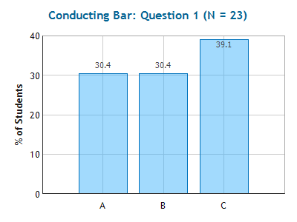
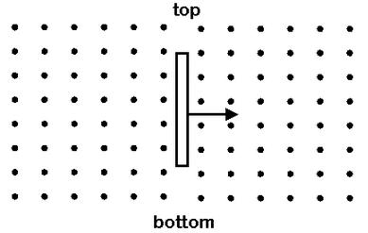
Checkpoint: Conducting Bar
A conducting bar is moving to the right through a magnetic field which points OUT as shown in the diagram.
Which of the following statements is true?
positive charge accumulates at the top of the bar, negative at the bottom
since there is not a complete circuit, no charge accumulates at the bar's ends
negative charge accumulates at the top of the bar, positive at the bottom

Slide 9
Motional EMF circuit
Moving bar acts like battery E = vBL
B
Magnitude of current
-
+
V
I = E /R
= vBL/R
Direction of Current
Clockwise (+ charges go down thru bar, up thru bulb)
Direction of force (F=ILB sin(θ)) on bar due to magnetic field
What changes if B points into page?
To left, slows down

Slide 10
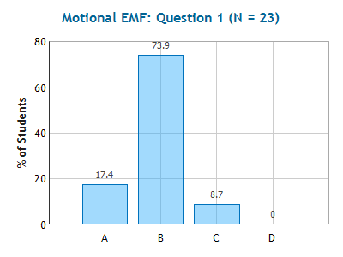
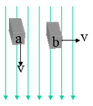
Checkpoint: Motional EMF
Two identical conducting bars (shown in end view) are moving through a vertical magnetic field. Bar (a) is moving vertically and bar (b) is moving horizontally.
Which of the following statements is true?
1. A motional emf exists in the bar for case (a), but not (b).
2. A motional emf exists in the bar for case (b), but not (a).
A motional emf exists in the bar for both cases (a) and (b).
A motional emf exists in the bar for neither cases (a) nor (b).

Slide 11
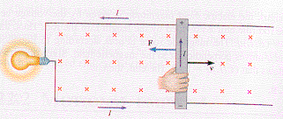
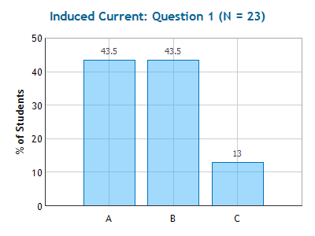
Checkpoint:
Induced Current
Suppose the magnetic field is reversed so that it now points OUT of the page instead of IN as shown in the figure. The motion of the rod is as shown in the figure.
To keep the bar moving at the same speed, the force supplied by the hand will have to:
Increase Stay the Same Decrease
F = ILB sin(θ)
B and v still perpendicular (θ=90), so F=ILB just like before!

Slide 12
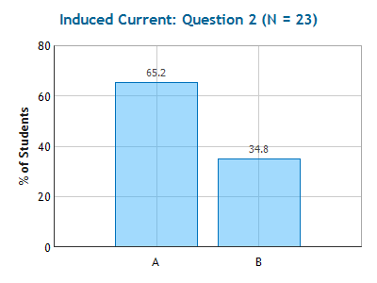
Checkpoint:
Induced Current
Suppose the magnetic field is reversed so that it now points OUT of the page instead of IN as shown in the figure.
To keep the bar moving to the right, the hand will have to supply a force in the opposite direction.
True
False
Current flows in the opposite direction, so force from the B field remains the same!

Slide 13
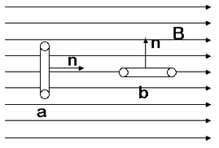
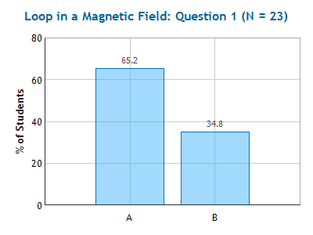
Checkpoint
Loop in a Magnetic Field
A rectangular loop of wire shown in edge view in the figure, is rotating in a magnetic field. (The circles represent the crossections of the wires coming out of and into the page, while the vertical lines correspond to the vertical sections of wire in the rectangle.) The sense of rotation is shown by the short arrows attached to the loop. The loop is shown in two different positions (a) and (b).
In which position does the loop have the largest flux?
Position A
Position B

Slide 14
Lenz’s Law (EMF Direction)
Emf opposes change in flux
If flux increases:
New EMF makes new field opposite to the original field (to oppose the increase)
If flux decreases:
  New EMF makes new field in the same direction as the original field (to oppose the decrease)
Notes:
Put example here for directions

Slide 15
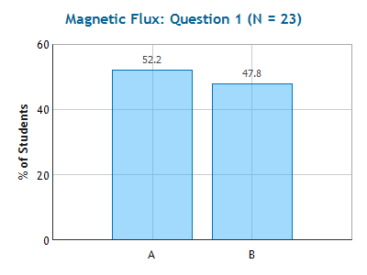
Checkpoint
Magnetic Flux
B
B
n
n
a
a
The magnetic field strength through the loop is cut in half (decreasing the flux). If you wanted to create a second magnetic field to oppose the change in flux, what would be its direction?
Left Right

Slide 16
Checkpoint
Magnetic Flux
B
B
n
n
a
a
The magnetic field strength through the loop is cut in half (decreasing the flux). If you wanted to create a second magnetic field to oppose the change in flux, what would be its direction?
Left Right
The original flux is to the right and decreasing. To oppose the change and keep the total field strength the same, add another field in the same direction.

Slide 17
Which loop has the greatest induced EMF at the instant shown below?
3
W
2
1
v
L
v
v
Loop 1
Loop 2
Loop 3

Slide 18
Which loop has the greatest induced EMF at the instant shown below?
3
W
2
1
v
L
v
v
Loop 1
Loop 2
Loop 3
E ₁ = vBL
1 moves right - gets 4 more field lines.
2 moves down - gets 0 more field lines.
3 moves down - only gets 2 more lines.
E ₂ = 0
E ₃ = vBW
1 is gaining flux fastest!

Slide 19
Change Area II
W
W
vt
V
V
L
I
t=0
Φ₀=BLW
t
Φ_{t}=BL(W+vt)
Φ = B A cos(φ)
EMF Magnitude:
EMF Direction: B is out of page and Φ is increasing so EMF creates B field (inside loop) going into page.

Slide 20
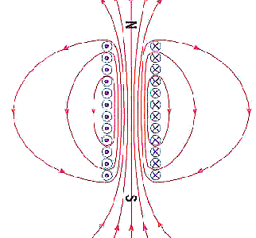
As current is increasing in the solenoid, what direction will current be induced in the ring?
Same as solenoid
Opposite of solenoid
No current

Slide 21
As current is increasing in the solenoid, what direction will current be induced in the ring?
Same as solenoid
Opposite of solenoid
No current
↑ Solenoid current (counter-clockwise)
↑ B-field (upwards) => ↑ Flux thru loop
EMF will create opposite B-field (downwards)
Induced loop current must be clockwise

Slide 22
Which way is the magnet moving if it is inducing a current in the loop as shown?
up
down
S
N
N
S

Slide 23
Which way is the magnet moving if it is inducing a current in the loop as shown?
up
down
S
N
N
S

Slide 24
If the resistance in the wire is decreased, what will happen to the speed of the magnet’s descent?
S
N
It will fall faster
It will fall slower
It will maintain the same speed
N
S

Slide 25
If the resistance in the wire is decreased, what will happen to the speed of the magnet’s descent?
S
N
It will fall faster
It will fall slower
It will maintain the same speed
N
S
larger induced current, stronger magnetic field

Slide 26
Change φ
A flat coil of wire has A=0.2 m² and R=10Ω. At time t=0, it is oriented so the normal makes an angle φ₀=0 w.r.t. a constant B field of 0.12 T. The loop is rotated to an angle of φ=30º in 0.5 seconds. Calculate the induced EMF.
Example
Φ_{i} = B A cos(0)
Φ_{f} = B A cos(30)
B
ε = 6.43x10⁻³ Volts
φ
What direction is the current induced?
n
A
Φ upwards and decreasing. New field will be in same direction (opposes change). Current must be counter clockwise.

Slide 27
Magnetic Flux Examples
Example
A conducting loop is inside a solenoid (B=μ_{o}nI). What happens to the flux through the loop when you…
Increase area of solenoid?
Increase area of loop?
Increase current in solenoid?
Φ ≡ B A cos(φ)
Rotate loop slightly?

Slide 28
Magnetic Flux Examples
Example
A conducting loop is inside a solenoid (B=μ_{o}nI). What happens to the flux through the loop when you…
Increase area of solenoid? No change
Increase area of loop? Increases
Increase current in solenoid? Increases
Φ ≡ B A cos(φ)
Rotate loop slightly? Decreases

Slide 29
Magnetic Flux II
Example
A solenoid (B=μ_{o}nI) is inside a conducting loop. What happens to the flux through the loop when you…
Increase area of solenoid Increases
Increase area of loop No change
Increase current in solenoid Increases
Φ ≡ B A cos(φ)

