Slide 1
Transformers
Physics 1161: Lecture 14
Textbook Section 23-10
Notes:
1

Slide 2
Transformers
Key to efficient power distribution
Increasing current in primary creates an increase in flux through primary and secondary.
iron
ε
∼
V_{p}
V_{s}
R
Same ΔΦ/Δt
N_{P}
N_{S}
(primary)
(secondary)
Energy conservation! I_{p}V_{p} = I_{s}V_{s}

Slide 3
Transformers
Key to Modern electrical system
Starting with 120 volts AC
  Produce arbitrarily small voltages.
  Produce arbitrarily large voltages.
Nearly 100% efficient

Slide 4
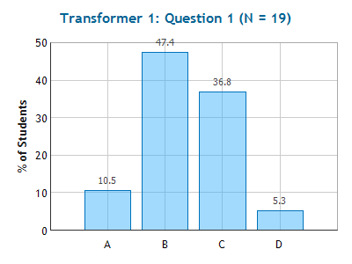
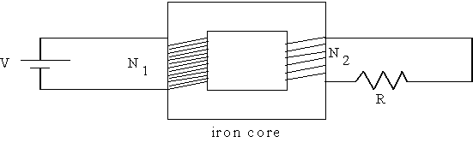
Checkpoint
Transformer 1
The voltage difference across the resistor R is
1. V
2. V N₁/N₂
3. V N₂/N₁
4. 0

Slide 5
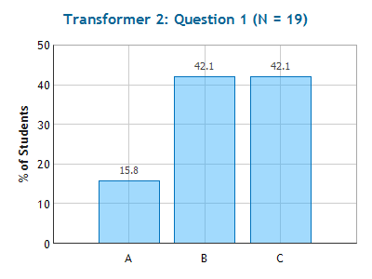
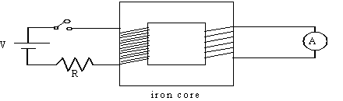
Checkpoint
Transformer 2
When the switch is closed, the ammeter shows
1. I=0
2. I quickly jumps to a non-zero value and then
quickly returns to zero.
3. I is a steady non-zero value.

Slide 6
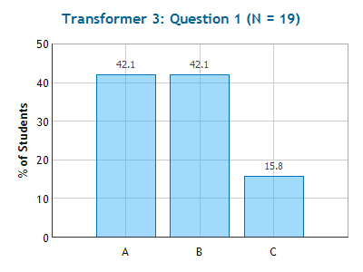
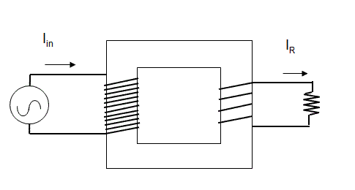
Checkpoint
Transformer 3
How does I_{R} compare to the current that is drawn from the AC source I_{in}?
I_{R} < I_{in}
I_{R} = I_{in}
I_{R} > I_{in}

Slide 7
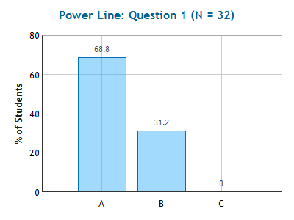
Checkpoint
Power Line
Power is transferred from the power plant to your house through high voltage power lines because:
Generators at power plants operate at high voltages.
It will decrease power losses.
The power company wants to deter people from climbing
the lines.

Slide 8
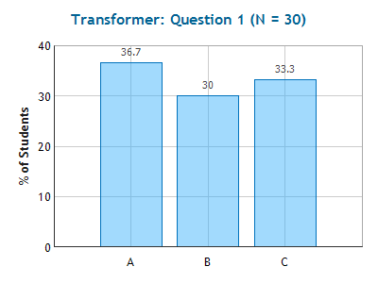
Checkpoint
Transformer
The good news is you are going on a trip to France. The bad news is that in France the outlets have 240 volts. You remember from Phy1151 that you need a transformer, so you wrap 100 turns around the primary. How many turns should you wrap around the secondary if you need 120 volts out to run your hair dryer?
iron
ε
∼
V_{p}
V_{s}
R
1) 50 2) 100 3) 200
N_{P}
N_{S}
(primary)
(secondary)

Slide 9
Checkpoint
Transformer
The good news is you are going on a trip to France. The bad news is that in France the outlets have 240 volts. You remember from Phy1161 that you need a transformer, so you wrap 100 turns around the primary. How many turns should you wrap around the secondary if you need 120 volts out to run your hair dryer?
iron
1) 50 2) 100 3) 200
ε
∼
V_{p}
V_{s}
R
N_{P}
N_{S}
(primary)
(secondary)

Slide 10
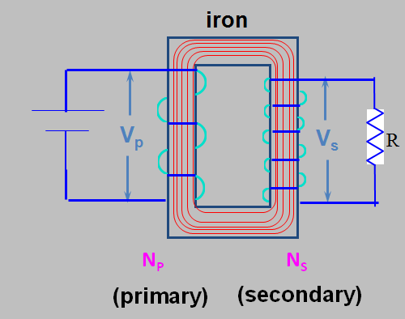
A 12 Volt battery is connected to a transformer that has a 100 turn primary coil, and 200 turn secondary coil. What is the voltage across the secondary after the battery has been connected for a long time?
V_{s} = 0
V_{s} = 6 V
V_{s} = 12 V
V_{s} = 24 V

Slide 11
A 12 Volt battery is connected to a transformer that has a 100 turn primary coil, and 200 turn secondary coil. What is the voltage across the secondary after the battery has been connected for a long time?
V_{s} = 0
V_{s} = 6 V
V_{s} = 12 V
V_{s} = 24 V
Transformers depend on a change in flux so they only work for alternating currents!

Slide 12
In a transformer the side with the most turns always has the larger peak voltage. (T/F)
True
False

Slide 13
In a transformer the side with the most turns always has the larger peak voltage. (T/F)
True
False

Slide 14
In a transformer the side with the most turns always has the larger peak current. (T/F)
True
False

Slide 15
In a transformer the side with the most turns always has the larger peak current. (T/F)
True
False

Slide 16
In a transformer the side with the most turns always dissipates the most power. (T/F)
True
False

Slide 17
In a transformer the side with the most turns always dissipates the most power. (T/F)
True
False

