Slide 1
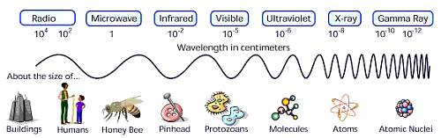
Electromagnetic Waves
Physics 1161: Lecture 15
Textbook Sections 25-1 – 25-5
Notes:
1

Slide 2
Electromagnetic Waves
Generator creates E field up and down.
-
+
Direction wave travels

Slide 3
Electromagnetic Waves
Generator creates E field up and down.
-
-
+
+
Direction wave travels

Slide 4
Electromagnetic Waves
Generator creates E field up and down.
-
+
Direction wave travels

Slide 5
Electromagnetic Waves
Generator creates E field up and down.
Direction wave travels

Slide 6
Electromagnetic Waves
Generator creates E field up and down.
+
-
Direction wave travels

Slide 7
Electromagnetic Waves
Generator creates E field up and down.
+
+
-
-
Direction wave travels

Slide 8
Electromagnetic Waves
Generator creates E field up and down.
+
-
Direction wave travels
Notes:
http://www.colorado.edu/physics/2000/index.pl Electromagnetic Waves applet http://www.colorado.edu/physics/2000/waves_particles/wavpart4.html

Slide 9
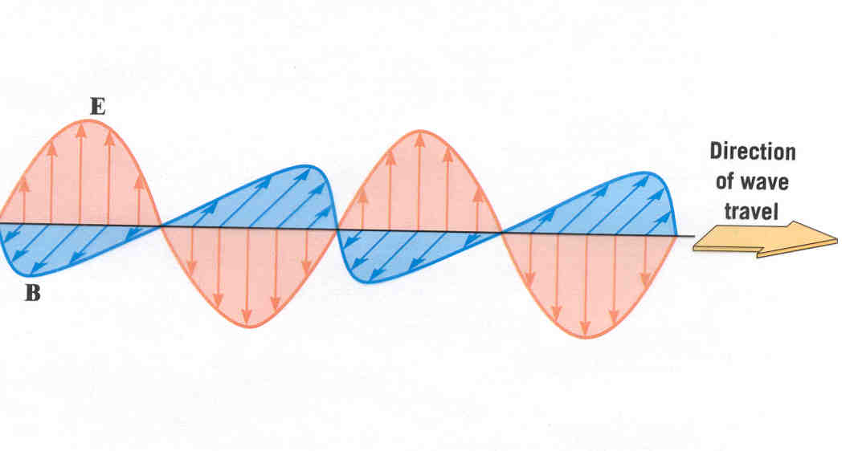
Electromagnetic Waves
+
-
y
x
z

Slide 10
Which direction should I orient my antenna to receive a signal from a vertical transmission tower?
Vertical
Horizontal
45º angle
+
-
Direction wave travels
Alternating E field moves charges up and down thru antenna!

Slide 11
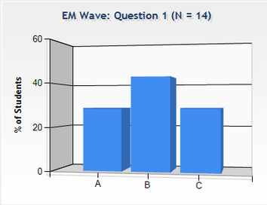
Checkpoint
EM Wave
An electromagnetic wave is travelling along the x-axis, with its electric field oscillating along the y-axis.
In what direction does the magnetic field oscillate?
along the x-axis
along the z-axis
along the y-axis

Slide 12
Electromagnetic Waves
Generator also creates B field into and out of the page!
+
-
y
x
z

Slide 13
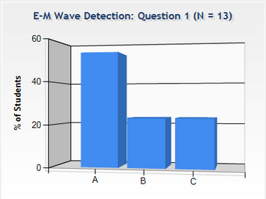
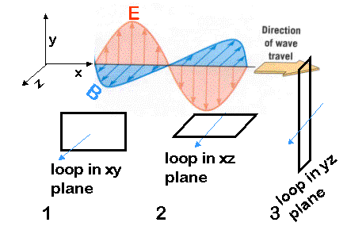
Checkpoint
E-M Wave Detection
Which of the loops will detect the electromagnetic wave?
(1) x-y plane (2) x-z plane (3) y-z plane

Slide 14
Electromagnetic Waves
y
x
z
Transverse (vs. sound waves – longitudinal)
E perpendicular to B and always in phase E & B increase and decrease at same times
Can travel in empty space (sound waves can’t!)
“Speed of light”: v = c = 1/ √(ε₀ μ₀) = 3 x 10⁸ m/s (186,000 miles/second!)
Frequency: f = v/λ = c/λ

Slide 15
Checkpoint
Transverse Waves
Which of the following are transverse waves?
sound
light
radio
X-ray
microwave
“The Wave” (i.e. at football games)

Slide 16
Checkpoint
Transverse Waves
Which of the following are transverse waves?
✗
sound
light
radio
X-ray
microwave
“The Wave” (i.e. at football games)
✓
✓
All but sound!
✓
✓
✓

Slide 17
EM Waves Practice
Example
Shown below is the E field of an EM wave broadcast at 96.1 MHz and traveling to the right.
(1) What is the direction of the magnetic field?
(2) Label the two tic marks on the x axis (in meters).
E
x

Slide 18
EM Waves Practice
Example
Shown below is the E field of an EM wave broadcast at 96.1 MHz and traveling to the right.
(1) What is the direction of the magnetic field?
(2) Label the two tic marks on the x axis (in meters).
Perpendicular to E, v: Into/out of the page
E
x
3.1
6.2

Slide 19
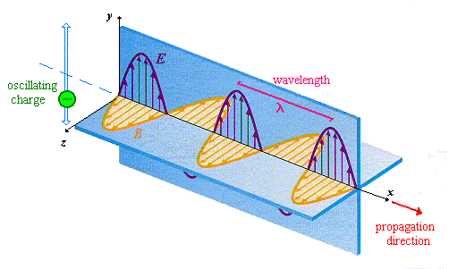
Light -- an Electromagnetic Wave

Slide 20
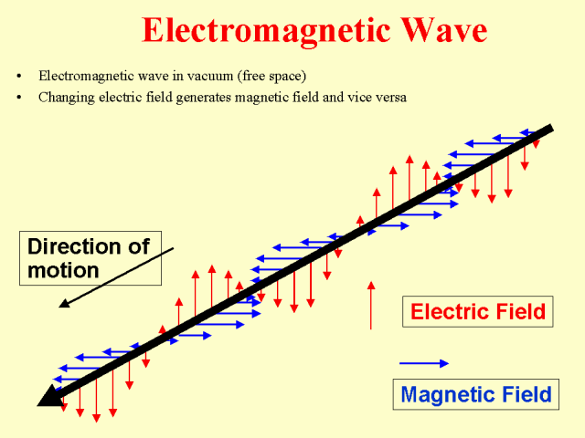
Electromagnetic Wave
Transverse
Traveling oscillating electric field and magnetic field
Can travel through space
Generated by accelerated charges
Emitted by excited atoms when they return to ground state

Slide 21
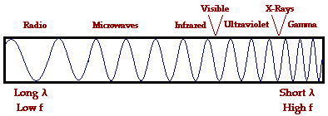
Electromagnetic Spectrum

Slide 22
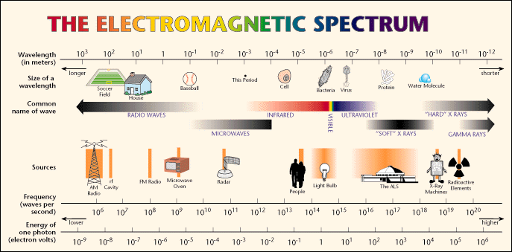

Slide 23
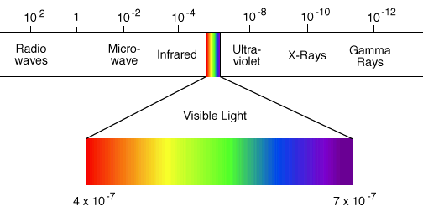
Visible Part of Spectrum
7
4

Slide 24
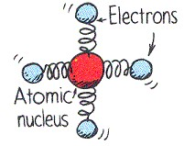
Spring Model
Electrons can be modeled as particles connected to the atomic nucleus by springs
Electrons of atoms in glass have certain natural frequencies of vibration

Slide 25
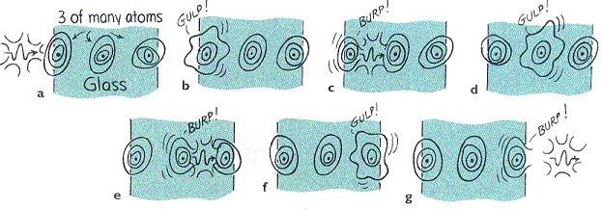
Light Transmission

Slide 26
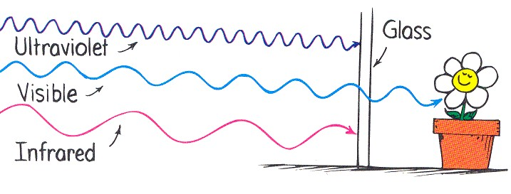
Glass Transparency
Ultraviolet matches natural frequency of electrons in glass
Infrared vibrates entire atom or molecule
Both result in warming of the glass

