Slide 1
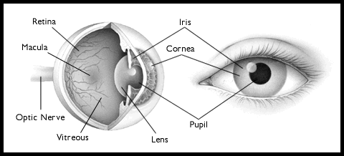
Physics 1161: Lecture 19
Lenses and your EYE
Textbook sections 27-1 – 27-3
Ciliary Muscles
Notes:
1

Slide 2
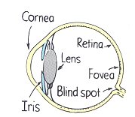
Parts of the Eye

Slide 3
Amazing Eye
One of first organs to develop.
100 million Receptors
  200,000 /mm²
  Sensitive to single photons!
http://hyperphysics.phy-astr.gsu.edu/hbase/vision/retina.html#c2
10 million
6,500 /mm²
Digital Camera
Ciliary Muscles
Notes:
Numbers in red are for a digital camera
Macula/fovea is super sensitive part only sees about 15 degrees
http://hyperphysics.phy-astr.gsu.edu/hbase/vision/retina.html#c2

Slide 4
Which part of the eye does most of the light bending?
Ciliary Muscles
Cornea n= 1.38
Lens n = 1.4
Vitreous n = 1.33
Lens
Cornea
Retina
Cones

Slide 5
Which part of the eye does most of the light bending?
Ciliary Muscles
Cornea n = 1.38
Lens n = 1.4
Vitreous n = 1.33
Lens
Cornea
Retina
Cones
Laser eye surgery changes Cornea
Lens and cornea have similar shape, and index of refraction. Cornea has air/cornea interface 1.38/1, 70% of bending. Lens has Lens/Vitreous interface 1.4/1.33. Lens is important because it can change shape.

Slide 6
Review: Converging Lens Principal Rays
F
Image
P.A.
Object
F
1) Rays parallel to principal axis pass through focal point.
2) Rays through center of lens are not refracted.
3) Rays through F emerge parallel to principal axis.
Image is real, inverted and enlarged
Assumptions:
• monochromatic light incident on a thin lens.
• rays are all “near” the principal axis.

Slide 7
Lens Equation
d_{o}
F
P.A.
Image
Object
F
f
d_{o} = distance object is from lens:
    Positive: object in front of lens
    Negative: object behind lens
d_{i}
Example
d_{i} = distance image is from lens:
    Positive: real image (behind lens)
    Negative: virtual image (in front of lens)
f = focal length lens:
    Positive: converging lens
    Negative: diverging lens

Slide 8
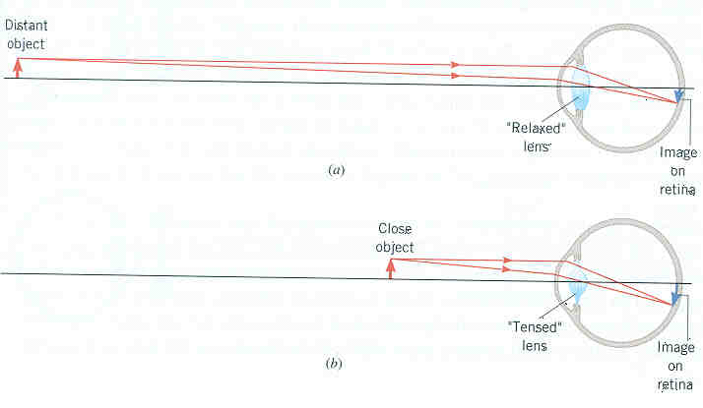
Eye (Relaxed)
Example
25 mm
Determine the focal length of your eye when looking at an object far away.
Object is far away:
Want image at retina:

Slide 9
Eye (Relaxed)
Example
25 mm
Determine the focal length of your eye when looking at an object far away.
Object is far away:
Want image at retina:

Slide 10
Eye (Tensed)
Example
250 mm
25 mm
Determine the focal length of your eye when looking at an object up close (25 cm).
Object is up close:
Want image at retina:

Slide 11
Eye (Tensed)
Example
250 mm
25 mm
Determine the focal length of your eye when looking at an object up close (25 cm).
Object is up close:
Want image at retina:

Slide 12
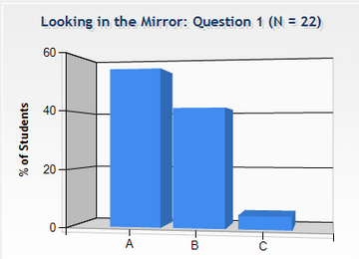
Looking in the Mirror
Checkpoint
A person with normal vision (near point at 26 cm) is standing in front of a plane mirror.
What is the closest distance to the mirror where the person can stand and still see himself in focus?
1) 13 cm
2) 26 cm
3) 52 cm

Slide 13

Looking in the Mirror
Checkpoint
A person with normal vision (near point at 26 cm) is standing in front of a plane mirror.
What is the closest distance to the mirror where the person can stand and still see himself in focus?
26cm
1) 13 cm
2) 26 cm
3) 52 cm
13cm
Image from mirror becomes object for eye!

Slide 14
Near Point, Far Point
Eye’s lens changes shape (changes f )
  Object at any d_{o} can have image be at retina (d_{i} = approx. 25 mm)
Can only change shape so much
“Near Point”
  Closest d_{o} where image can be at retina
  Normally, ~25 cm (if far-sighted then further)
“Far Point”
  Furthest d_{o} where image can be at retina
  Normally, infinity (if near-sighted then closer)

Slide 15
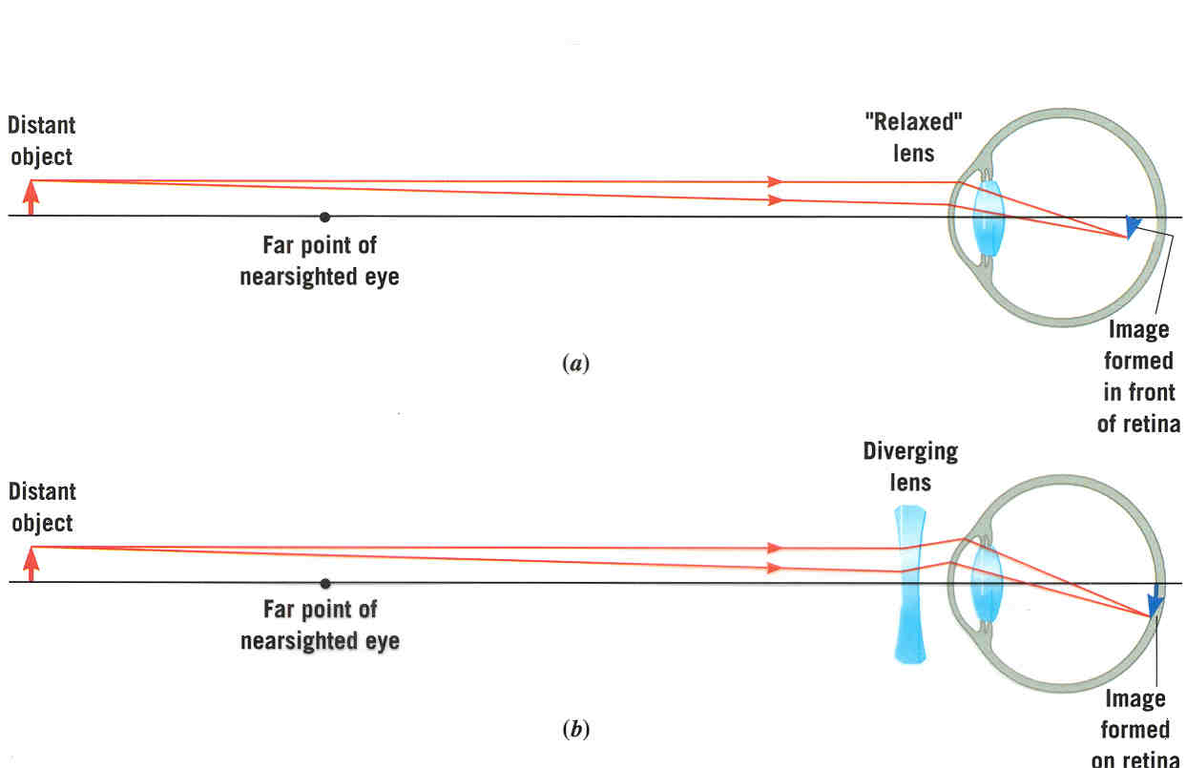
If you are nearsighted...
(far point is too close)
Example
Too far for near-sighted eye to focus
d_{o}
d_{far}
Near-sighted eye can focus on this!
Contacts form virtual image at far point – becomes object for eye.
f_{lens} =
Want to have (virtual) image of distant object, d_{o} = ∞, at the far point, d_{i} = -d_{far}.

Slide 16
If you are nearsighted...
(far point is too close)
Example
Too far for near-sighted eye to focus
d_{o}
d_{far}
Near-sighted eye can focus on this!
Contacts form virtual image at far point – becomes object for eye.
f_{lens} = -50 cm
Want to have (virtual) image of distant object, d_{o} = ∞, at the far point, d_{i} = -d_{far}.

Slide 17
Refractive Power of Lens
Diopter = 1/f
where f is focal length of lens in meters.
Person with far point of 5 meters, would need contacts with focal length –5 meters.
Doctor’s prescription reads:
1/(-5m) = –0.20 Diopters

Slide 18
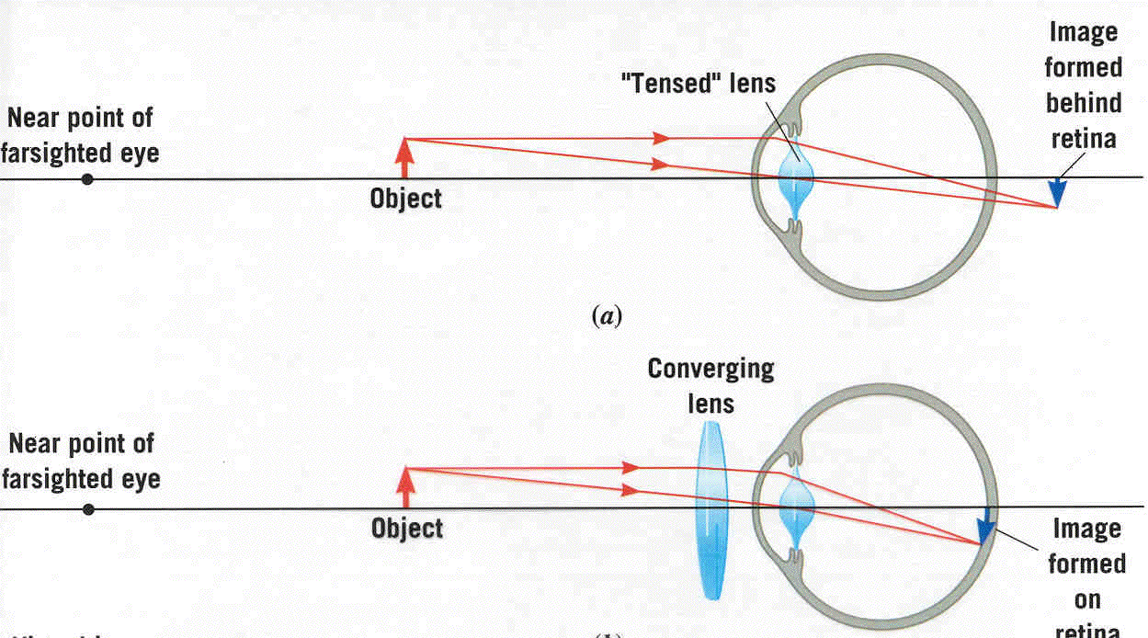
If you are farsighted...
(near point is too far)
Too close for far-sighted eye to focus
Example
d_{o}
d_{near}
Far-sighted eye can focus on this!
Want the near point to be at d_{o}.
Contacts form virtual image at near point – becomes object for eye.
When object is at d_{o}, lens must create an (virtual) image at -d_{near}.
f_{lens} =

Slide 19
If you are farsighted...
(near point is too far)
Too close for far-sighted eye to focus
d_{o}
d_{near}
Far-sighted eye can focus on this!
Example
Want the near point to be at d_{o}.
Contacts form virtual image at near point – becomes object for eye.
When object is at d_{o}, lens must create an (virtual) image at -d_{near}.

Slide 20
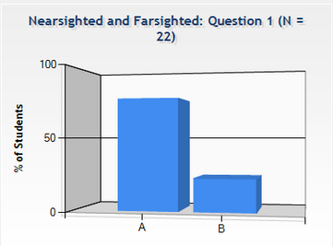
Nearsighted Farsighted
Checkpoint
Two people who wear glasses are camping. One of them is nearsighted and the other is farsighted. Which person’s glasses will be useful in starting a fire with the sun’s rays?
Farsighted
Nearsighted

Slide 21

Nearsighted Farsighted
Checkpoint
Two people who wear glasses are camping. One of them is nearsighted and the other is farsighted. Which person’s glasses will be useful in starting a fire with the sun’s rays?
Farsighted person’s glasses are converging – like magnifying glass!

Slide 22
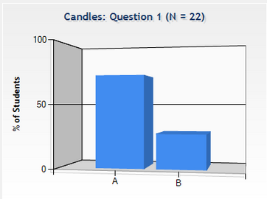
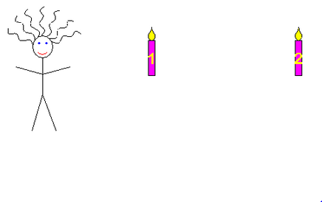
Candles
Checkpoint
Which candle's image takes up more space on the retina of the person in the picture?

Slide 23
Angular Size
Both are same size, but nearer one looks bigger.
θ
θ
θ
θ
Angular size tells you how large the image is on your retina, and how big it appears to be.

Slide 24

Unaided Eye
How big the object looks with unaided eye.
object
h₀
θ
N
Bring object as close as possible (to near point N)
**If θ is small and expressed in radians.

Slide 25
Magnifying Glass
magnifying glass
virtual image
object
h_{i}
h_{o}
d_{o}
d_{i}
Magnifying glass produces virtual image behind object, allowing you to bring object to a closer d_{o}: and larger θ’
Compare to unaided eye: :
Ratio of the two angles is the angular magnification M:

Slide 26
The focal length of the lens of a simple camera is 40 mm. In what direction must the lens be moved to “change the focus of the camera” from a person 25 m away to a person 4.0 m away? i.e. does the image distance increase or decrease?
Away from the film
Towards the film

Slide 27
The focal length of the lens of a simple camera is 40 mm. In what direction must the lens be moved to change the focus of the camera from a person 25 m away to a person 4.0 m away? ? i.e. does the image distance increase or decrease?
Away from the film
Towards the film

