Slide 1
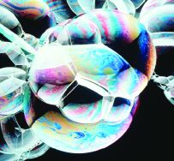
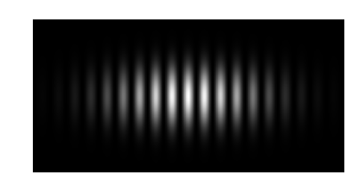
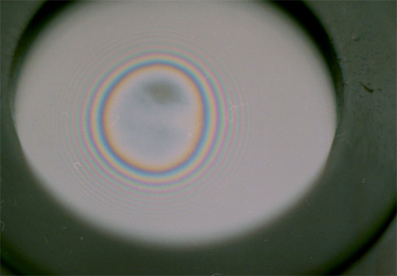
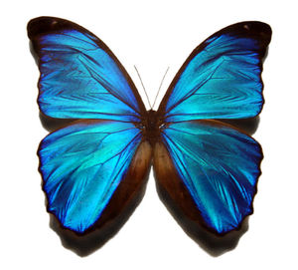
Physics 1161: Lecture 20
Interference
textbook sections 28-1 -- 28-3
Notes:
1

Slide 2
Superposition
Constructive Interference
+1
t
-1
+
+1
In Phase
t
-1
+2
t
-2

Slide 3
Superposition
Destructive Interference
+1
t
-1
+
+1
Out of Phase
180 degrees
t
-1
+2
t
-2

Slide 4
Which type of interference results from the superposition of the two waveforms shown?
Constructive
Destructive
Neither
+
Different f

Slide 5
Which type of interference results from the superposition of the two waveforms shown?
Constructive
Destructive
Neither
+
Different f

Slide 6
Interference for Light …
Can’t produce coherent light from separate sources. (f ≈ 10¹⁴ Hz)
Need two waves from single source taking two different paths
  Two slits
  Reflection (thin films)
  Diffraction*
Two different paths
Interference possible here
Single source

Slide 7
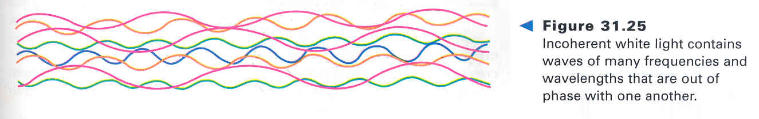
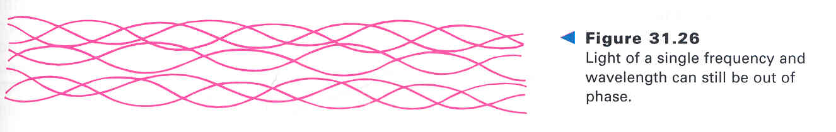
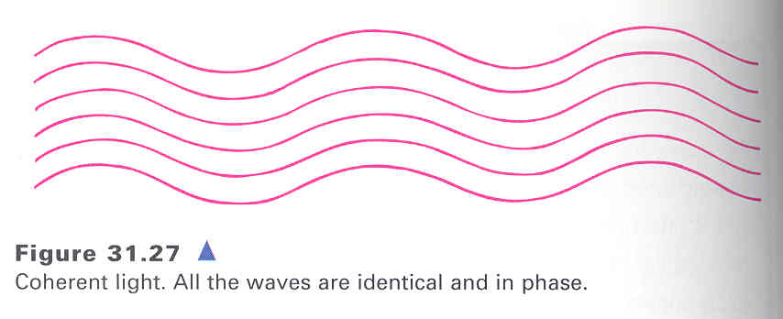
Coherent & Incoherent Light

Slide 8
Double Slit Interference Applets
http://www.walter-fendt.de/ph14e/doubleslit.htm
http://vsg.quasihome.com/interfer.htm

Slide 9
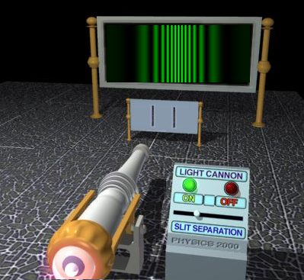
Young’s Double Slit Applet
http://www.colorado.edu/UCB/AcademicAffairs/ArtsSciences/physics/PhysicsInitiative/Physics2000/applets/twoslitsa.html

Slide 10
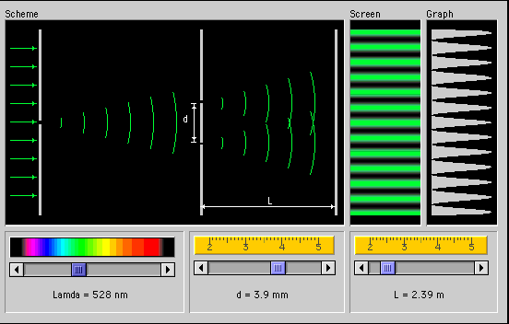
Young’s Double Slit Layout

Slide 11
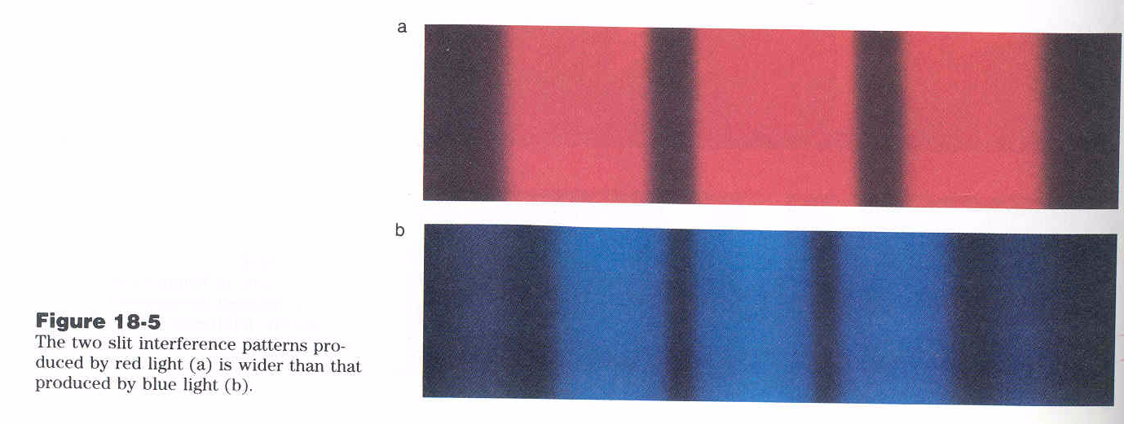
Interference - Wavelength

Slide 12
Light waves from a single source travel through 2 slits before meeting at the point shown on the screen. The interference will be:
Constructive
Destructive
It depends on L
2 slits-separated by d
d
Single source of monochromatic light λ
L
Screen a distance L from slits

Slide 13
Light waves from a single source travel through 2 slits before meeting at the point shown on the screen. The interference will be:
Constructive
Destructive
It depends on L
2 slits-separated by d
d
Single source of monochromatic light λ
L
The rays start in phase, and travel the same distance, so they will arrive in phase.
Screen a distance L from slits

Slide 14
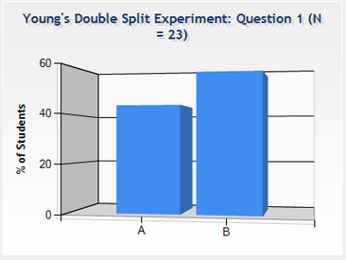
Young’s Double Slit
Checkpoint
The experiment is modified so that one of the waves has its phase shifted by ½ λ. Now, the interference will be:
The pattern of maxima and minima is the same for original and modified experiments.
Maxima and minima for the unmodified experiment now become minima and maxima for the modified experiment.
½ λ shift
d
Single source of monochromatic light λ
L
2 slits-separated by d
Screen a distance L from slits
Notes:
60% got this correct

Slide 15
Young’s Double Slit
Checkpoint
The experiment is modified so that one of the waves has its phase shifted by ½ λ. Now, the interference will be:
The pattern of maxima and minima is the same for original and modified experiments.
Maxima and minima for the unmodified experiment now become minima and maxima for the modified experiment.
½ λ shift
d
Single source of monochromatic light λ
For example at the point shown, he rays start out of phase and travel the same distance, so they will arrive out of phase.
L
2 slits-separated by d
Screen a distance L from slits
Notes:
60% got this correct

Slide 16
Young’s Double Slit Concept
At points where the difference in path length is 0, λ,2λ, …, the screen is bright. (constructive)
d
At points where the difference in path
length is
the screen is dark. (destructive)
Single source of monochromatic light λ
L
2 slits-separated by d
Screen a distance L from slits

Slide 17
Young’s Double Slit Key Idea
L
Two rays travel almost exactly the same distance. (screen must be very far away: L >> d)
Bottom ray travels a little further.
Key for interference is this small extra distance.

Slide 18
Young’s Double Slit Quantitative
d
d
Path length difference =
d sin θ
Constructive interference
Destructive interference
where m = 0, or 1, or 2, ...
Need λ < d

Slide 19
Young’s Double Slit Quantitative
L
y
d
A little geometry…
sin(θ) ≈ tan(θ) = y/L
Constructive interference
Destructive interference
where m = 0, or 1, or 2, ...

Slide 20
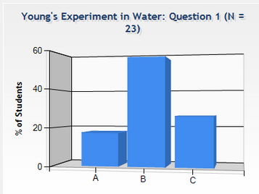
Young’s Double Slit Under Water
Checkpoint
L
y
d
When this Young’s double slit experiment is placed under water, how does the pattern of minima and maxima change?
1) the pattern stays the same
2) the maxima and minima occur at smaller angles
3) the maxima and minima occur at larger angles

Slide 21
Young’s Double Slit Under Water
Checkpoint
L
y
d
When this Young’s double slit experiment is placed under water, how does the pattern of minima and maxima change?
1) the pattern stays the same
2) the maxima and minima occur at smaller angles
3) the maxima and minima occur at larger angles
…wavelength is shorter under water.

Slide 22
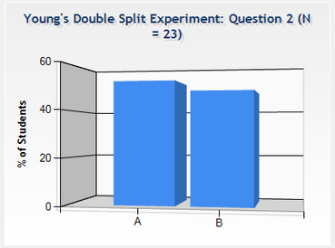
Young’s Double Slit
Checkpoint
In Young’s double slit experiment, is it possible to see interference maxima when the distance between slits is smaller than the wavelength of light?
1) Yes 2) No

Slide 23
Young’s Double Slit
Checkpoint
In Young’s double slit experiment, is it possible to see interference maxima when the distance between slits is smaller than the wavelength of light?
1) Yes 2) No
Need: d sin θ = m λ
=> sin θ = m λ / d
If λ > d then λ / d > 1
so sin θ > 1
Not possible!

Slide 24
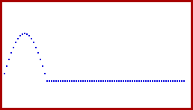
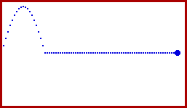
Reflections at Boundaries
Slow Medium
to
Fast Medium
Fast Medium
to
Slow Medium
Free End Reflection
No phase change
Fixed End Reflection
180º phase change

Slide 25
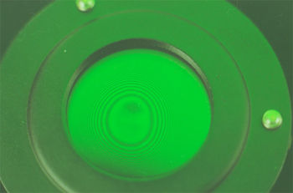
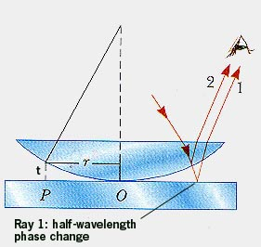
Newton’s Rings

Slide 26
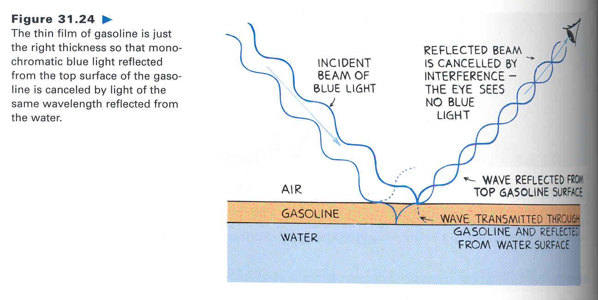
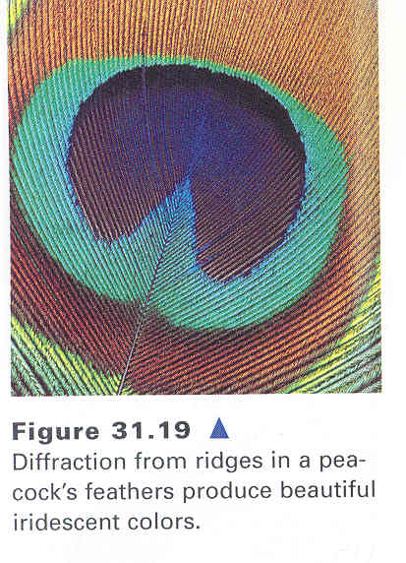
Iridescence

Slide 27
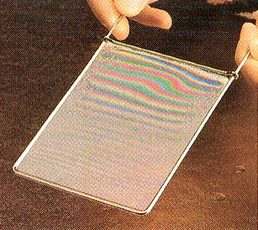
Iridescence

Slide 28
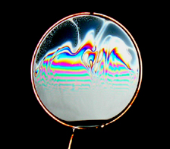
Soap Film Interference
This soap film varies in thickness and produces a rainbow of colors.
The top part is so thin it looks black.
All colors destructively interfere there.

Slide 29
Thin Film Interference
1
2
n₀=1.0 (air)
t
n₁ (thin film)
n₂
Get two waves by reflection from the two different interfaces.
Ray 2 travels approximately 2t further than ray 1.

Slide 30
Reflection + Phase Shifts
Incident wave
Reflected wave
n₁
n₂
Upon reflection from a boundary between two transparent materials, the phase of the reflected light may change.
If n₁ > n₂ - no phase change upon reflection.
If n₁ < n₂ - phase change of 180º upon reflection. (equivalent to the wave shifting by λ/2.)

Slide 31
Thin Film Summary
Determine δ, number of extra wavelengths for each ray.
1
2
n = 1.0 (air)
t
n₁ (thin film)
n₂
This is important!
Note: this is wavelength in film! (λ_{film}= λ_{o}/n₁)
Reflection
Distance
Ray 1: δ₁ = 0 or ½
Ray 2: δ₂ = 0 or ½
+ 2 t/ λ_{film}
If |(δ₂ – δ₁)| = 0, 1, 2, 3 …. (m) constructive
If |(δ₂ – δ₁)| = ½ , 1 ½, 2 ½ …. (m + ½) destructive

Slide 32
Thin Film Practice
Example
1
2
n = 1.0 (air)
t
n_{glass} = 1.5
n_{water}= 1.3
Blue light (λ_{ο} = 500 nm) incident on a glass (n_{glass} = 1.5) cover slip (t = 167 nm) floating on top of water (n_{water} = 1.3).
Is the interference constructive or destructive or neither?
δ₁ =
δ₂ =
Phase shift = δ₂ – δ₁ =

Slide 33
Thin Film Practice
Example
1
2
n = 1.0 (air)
t
n_{glass} = 1.5
n_{water}= 1.3
Blue light (λ_{ο} = 500 nm) incident on a glass (n_{glass} = 1.5) cover slip (t = 167 nm) floating on top of water (n_{water} = 1.3).
Is the interference constructive or destructive or neither?
Reflection at air-film interface only
δ₁ = ½
δ₂ = 0 + 2t / λ_{glass} = 2t n_{glass}/ λ₀= 1
Phase shift = δ₂ – δ₁ = ½ wavelength

Slide 34
Blue light λ = 500 nm incident on a thin film (t = 167 nm) of glass on top of plastic. The interference is:
1
2
n=1 (air)
t
n_{glass} =1.5
n_{plastic}=1.8
Constructive
Destructive
Neither

Slide 35
Blue light λ = 500 nm incident on a thin film (t = 167 nm) of glass on top of plastic. The interference is:
Constructive
Destructive
Neither
1
2
n=1 (air)
t
n_{glass} =1.5
n_{plastic}=1.8
δ₁ = ½
δ₂ = ½ + 2t / λ_{glass} = ½ + 2t n_{glass}/ λ₀= ½ + 1
Phase shift = δ₂ – δ₁ = 1 wavelength

Slide 36
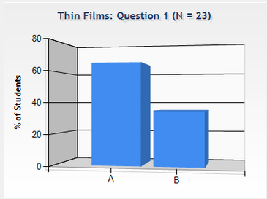
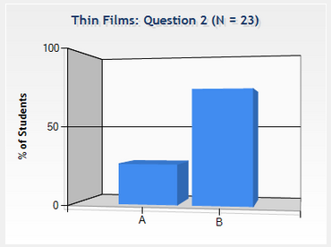
Thin Films
Checkpoint
A thin film of gasoline (n_{gas}=1.20) and a thin film of oil (n_{oil}=1.45) are floating on water (n_{water}=1.33). When the thickness of the two films is exactly one wavelength…
n_{air}=1.0
t = λ
n_{gas}=1.20
n_{oil}=1.45
n_{water}=1.3
The gas looks:
bright
dark
The oil looks:
bright
dark

Slide 37
Thin Films
Checkpoint
A thin film of gasoline (n_{gas}=1.20) and a thin film of oil (n_{oil}=1.45) are floating on water (n_{water}=1.33). When the thickness of the two films is exactly one wavelength…
n_{air}=1.0
t = λ
n_{gas}=1.20
n_{oil}=1.45
n_{water}=1.3
The gas looks:
bright
dark
The oil looks:
bright
dark
δ_{1,gas} = ½
δ_{2,gas} = ½ + 2
δ_{1,oil} = ½
δ_{2,oil} = 2
| δ_{2,gas} – δ_{1,gas} | = 2
| δ_{2,oil} – δ_{1,oil} | = 3/2
constructive
destructive

