Slide 1

Diffraction, Gratings, Resolving Power
Physics 1161: Lecture 21
Textbook sections 28-4 – 28-6

Slide 2
Recall
Interference (at least 2 coherent waves)
  Constructive (full wavelength difference)
  Destructive (½ wavelength difference)
Light (1 source, but different paths)
  Thin Films
  Double/multiple slit
  Diffraction/single slit (today)

Slide 3
Young’s Double Slit Review
L
d
= d sinθ
Path length difference
d
1)
Which condition gives destructive interference?
2)
where m = 0, or 1, or 2, ...

Slide 4
Multiple Slits
(Diffraction Grating – N slits with spacing d)
L
1
d
2
3
d
4
= d sinθ
=λ
Path length difference 1-2
d
Path length difference 1-3
=2λ
= 2d sinθ
= 3d sinθ
=3λ
Path length difference 1-4
Constructive interference for all paths when…

Slide 5
Multiple Slits
(Diffraction Grating – N slits with spacing d)
L
1
d
2
3
d
4
= d sinθ
= λ
Path length difference 1-2
d
Path length difference 1-3
= 2λ
= 2d sinθ
= 3λ
= 3d sinθ
Path length difference 1-4
Constructive interference for all paths when

Slide 6
Three Rays
Checkpoint
L
1
d
2
3
d
All 3 rays are interfering constructively at the point shown. If the intensity from ray 1 is I₀ , what is the combined intensity of all 3 rays?
1) I₀ 2) 3 I₀ 3) 9 I₀
When rays 1 and 2 are interfering destructively, is the intensity
from the three rays a minimum?
1) Yes 2) No

Slide 7
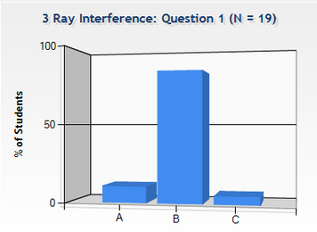
Three Rays
Checkpoint
L
1
d
2
3
d
All 3 rays are interfering constructively at the point shown. If the intensity from ray 1 is I₀ , what is the combined intensity of all 3 rays? 1) I₀ 2) 3 I₀ 3) 9 I₀
Each slit contributes amplitude E_{o} at screen. E_{tot} = 3 E_{o}. But I α E². I_{tot} = (3E₀)² = 9 E₀² = 9 I₀

Slide 8
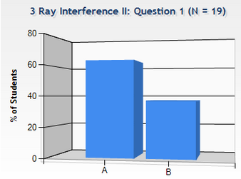
Three Rays
Checkpoint
L
1
d
2
3
d
these add to zero
this one is still there!
When rays 1 and 2 are interfering destructively, is the intensity from the three rays a minimum? 1) Yes 2) No
Rays 1 and 2 completely cancel, but ray 3 is still there. Expect intensity I = 1/9 I_{max}

Slide 9
Three slit interference
9I₀
I₀

Slide 10
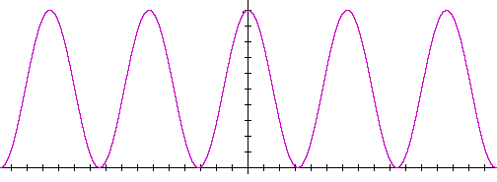
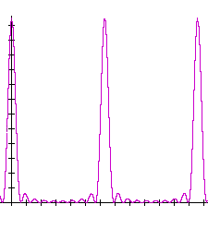
Multiple Slit Interference
(Diffraction Grating)
Peak location depends on wavelength!
For many slits, maxima are still at
As no. of slits increases – bright fringes become narrower and brighter.
2 slits (N=2)
10 slits (N=10)
intensity
intensity
0
λ
2λ
0
λ
2λ
Notes:
Here do demo using diffraction grating for red and green laser

Slide 11
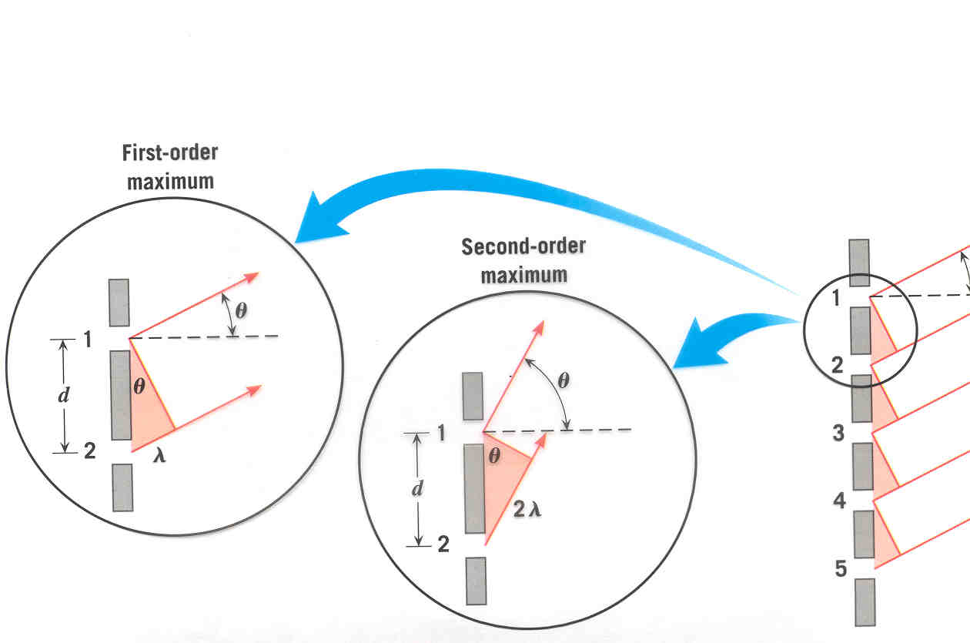
Diffraction Grating
N slits with spacing d
θ
* screen VERY far away
Constructive Interference Maxima are at:
Same as for Young’s Double Slit !

Slide 12
Diffraction Rays
Wall
shadow
bright
This is not what is actually seen!
Screen with opening (or obstacle without screen)
Notes:
Can do ripple tank demo here. Not great.

Slide 13
Diffraction/ Huygens
Every point on a wave front acts as a source of tiny wavelets that move forward.
•
Light waves originating at different points within opening travel different distances to wall, and can interfere!
•
We will see maxima and minima on the wall.

Slide 14
Central maximum
1st minima

Slide 15
Single Slit Diffraction
1
2
1′
W
2′
When rays 1 and 1′
interfere destructively.
Rays 2 and 2′ also start W/2 apart and have the same path length difference.
Under this condition, every ray originating in top half of slit interferes destructively with the corresponding ray originating in bottom half.
1st minimum at: sin θ = λ/w

Slide 16
Single Slit Diffraction
1
2
1′
2′
w
When rays 1 and 1′
will interfere destructively.
Rays 2 and 2′ also start w/4 apart and have the same path length difference.
Under this condition, every ray originating in top quarter of slit interferes destructively with the corresponding ray originating in second quarter.
2nd minimum at sin θ = 2λ/w

Slide 17
Single Slit Diffraction Summary
Condition for halves of slit to destructively interfere
Condition for quarters of slit to destructively interfere
Condition for sixths of slit to destructively interfere
All together…
(m=1, 2, 3, …)
THIS FORMULA LOCATES MINIMA!!
Narrower slit => broader pattern
Note: interference only occurs when w > λ

Slide 18
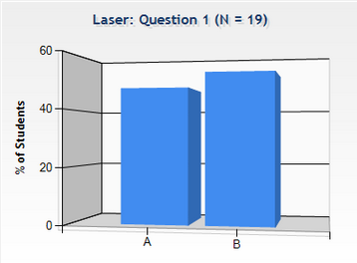
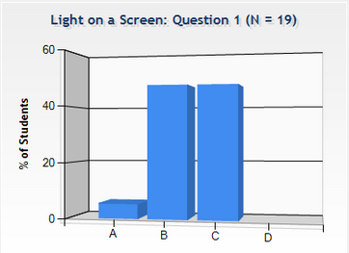
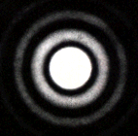
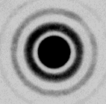
Laser & Light on a Screen
Checkpoint
A laser is shone at a screen through a very small hole. If you make the hole even smaller, the spot on the screen will get:
(1) Larger (2) Smaller
Which drawing correctly depicts the pattern of light on the screen?
(1)
(2)
(3)
(4)

Slide 19
Light on a Screen
Checkpoint
A laser is shone at a screen through a very small hole. If you make the hole even smaller, the spot on the screen will get:
(1) Larger (2) Smaller
Which drawing correctly depicts the pattern of light on the screen?
(1)
(2)
(3)
(4)

Slide 20
Diffraction from Circular Aperture
Central maximum
1st diffraction minimum
θ
Diameter D
light
Maxima and minima will be a series of bright and dark rings on screen
First diffraction minimum is at:

Slide 21
Diffraction from Circular Aperture
Central maximum
1st diffraction minimum
θ
Diameter D
light
Maxima and minima will be a series of bright and dark rings on screen
First diffraction minimum is at

Slide 22
Intensity from Circular Aperture
I
First diffraction minimum

Slide 23
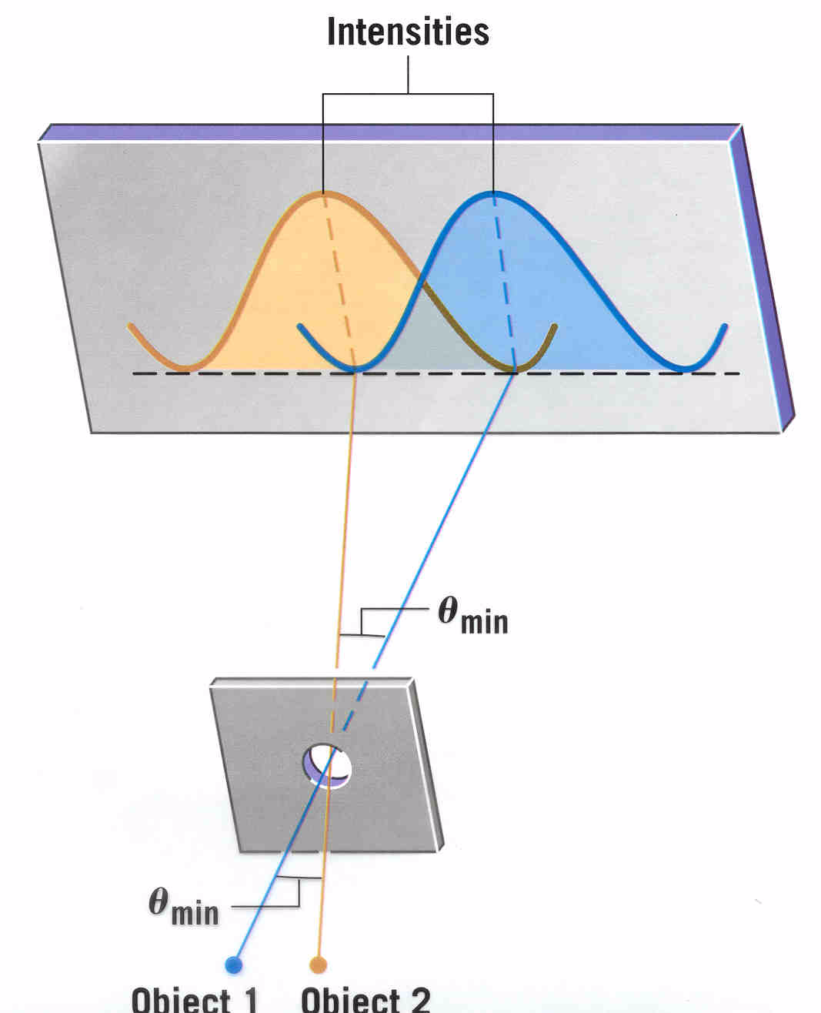
These objects are just resolved
Two objects are just resolved when the maximum of one is at the minimum of the other.

Slide 24
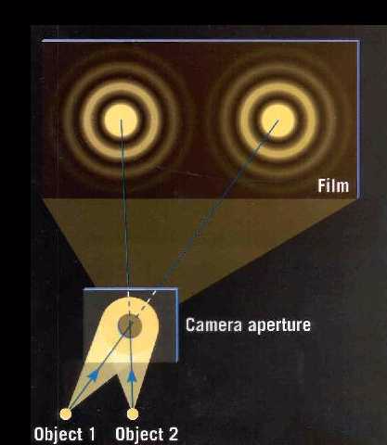
Resolving Power
To see two objects distinctly, need θ_{objects} » θ_{min}
θ_{objects}
θ_{objects} is angle between objects and aperture:
θ_{min}
tan θ_{objects} ≈ d/y
θ_{min} is minimum angular separation that aperture can resolve:
D
sin θ_{min} ≈ θ_{min} = 1.22 λ/D
y
d
Improve resolution by increasing θ_{objects} or decreasing θ_{min}

Slide 25
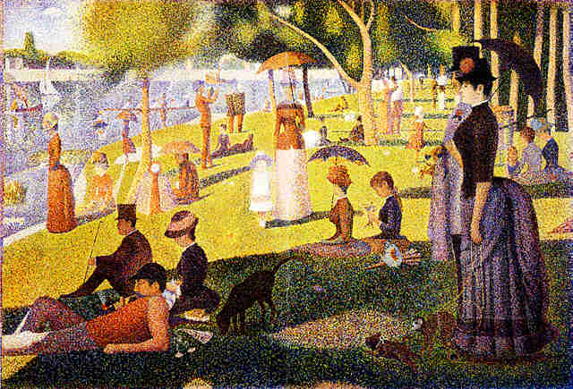
Pointillism – Georges Seurat

Slide 26
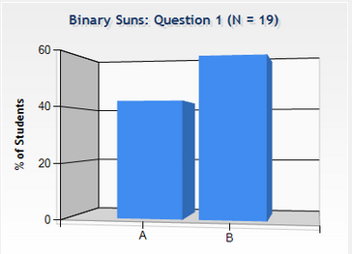
Binary Suns
Checkpoint
Astronaut Joe is standing on a distant planet with binary suns. He wants to see them but knows it’s dangerous to look straight at them. So he decides to build a pinhole camera by poking a hole in a card. Light from both suns shines through the hole onto a second card.
But when the camera is built, Astronaut Joe can only see one spot on the second card! To see the two suns clearly, should he make the pinhole larger or smaller?
To see the two suns clearly, should he make the pinhole larger or smaller?
larger smaller

Slide 27
Binary Suns
Checkpoint
Want θ_{objects} > θ_{min}
Decrease θ_{min} = 1.22λ / D
Increase D !
Astronaut Joe is standing on a distant planet with binary suns. He wants to see them but knows it’s dangerous to look straight at them. So he decides to build a pinhole camera by poking a hole in a card. Light from both suns shines through the hole onto a second card. But when the camera is built, Astronaut Joe can only see one spot on the second card! To see the two suns clearly, should he make the pinhole larger or smaller?
To see the two suns clearly, should he make the pinhole larger or smaller?
larger smaller

Slide 28
How does the maximum resolving power of your eye change when the brightness of the room is decreased.
Increases
Remains constant
Decreases

Slide 29
How does the maximum resolving power of your eye change when the brightness of the room is decreased.
Increases
Remains constant
Decreases
When the light is low, your pupil dilates (D can increase by factor of 10!) But actual limitation is due to density of rods and cones, so you don’t notice an effect!

Slide 30
Recap.
Interference: Coherent waves
  Full wavelength difference = Constructive
  ½ wavelength difference = Destructive
Multiple Slits
  Constructive d sin(θ) = m λ (m=1,2,3…)
  Destructive d sin(θ) = (m + 1/2) λ 2 slit only
  More slits = brighter max, darker mins
Huygens’ Principle: Each point on wave front acts as coherent source and can interfere.
Single Slit:
  Destructive: w sin(θ) = m λ (m=1,2,3…)
  Resolution: Max from 1 at Min from 2
opposite!

