Slide 1
Part 1
Blackbody Radiation
Photoelectric Effect
Wave-Particle Duality
Physics 1161: Lecture 22
sections 30-1 – 30-4
Notes:
1

Slide 2
Everything comes unglued
The predictions of “classical physics” (Newton’s laws and Maxwell’s equations) are sometimes WRONG.
  classical physics says that an atom’s electrons should fall into the nucleus and STAY THERE. No chemistry, no biology can happen.
  classical physics says that toaster coils radiate an infinite amount of energy: radio waves, visible light, X-rays, gamma rays,…

Slide 3
The source of the problem
It’s not possible, even “in theory” to know everything about a physical system.
  knowing the approximate position of a particle corrupts our ability to know its precise velocity (“Heisenberg uncertainty principle”)
Particles exhibit wave-like properties.
  interference effects!

Slide 4
Quantum Mechanics!
At very small sizes the world is VERY different!
  Energy can come in discrete packets
  Everything is probability; very little is absolutely certain.
  Particles can seem to be in two places at same time.
  Looking at something changes how it behaves.

Slide 5
Blackbody Radiation
Hot objects glow (toaster coils, light bulbs, the sun).
As the temperature increases the color shifts from Red to Blue.
The classical physics prediction was completely wrong! (It said that an infinite amount of energy should be radiated by an object at finite temperature.)
Notes:
Note humans are ‘hot’ 300K so we emit light, just not much in the visible spectrum. Try infrared.

Slide 6
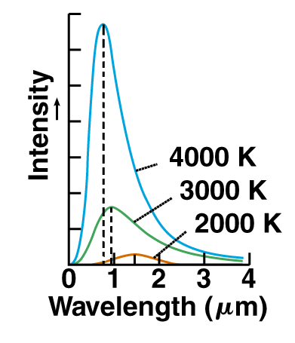
Blackbody Radiation Spectrum
Visible Light: ~0.4μm to 0.7μm
Higher temperature: peak intensity at shorter λ
Notes:
Note humans are ‘hot’ 300K so we emit light, just not much in the visible spectrum. Try infrared.

Slide 7
Blackbody Radiation:
First evidence for Q.M.
Max Planck found he could explain these curves if he assumed that electromagnetic energy was radiated in discrete chunks, rather than continuously.
The “quanta” of electromagnetic energy is called the photon.
Energy carried by a single photon is
E = hf = hc/
Planck’s constant: h = 6.626 X 10⁻³⁴ Joule sec
Notes:
Note humans are ‘hot’ 300K so we emit light, just not much in the visible spectrum. Try infrared.

Slide 8
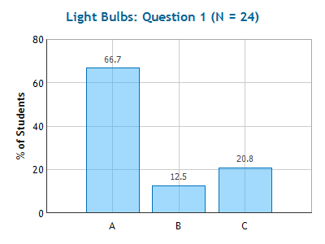
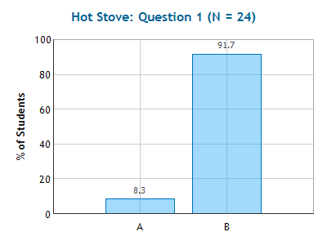
Light Bulbs & Stove
Checkpoints
A series of lights are colored red, yellow, and blue.
Which of the following statements is true?
Red photons have the least energy; blue the most.
Yellow photons have the least energy; red the most.
Blue photons have the least energy; yellow the most.
Which is hotter?
(1) stove burner glowing red
(2) stove burner glowing orange

Slide 9
Light Bulbs & Stove
Checkpoints
A series of lights are colored red, yellow, and blue.
Which of the following statements is true?
Red photons have the least energy; blue the most.
Yellow photons have the least energy; red the most.
Blue photons have the least energy; yellow the most.
E = hf = hc/λ
Which is hotter?
(1) stove burner glowing red
(2) stove burner glowing orange
Hotter stove emits higher-energy photons
(shorter wavelength = orange)

Slide 10
Three light bulbs with identical filaments are manufactured with different colored glass envelopes: one is red, one is green, one is blue. When the bulbs are turned on, which bulb’s filament is hottest?
Red
Green
Blue
Same
λ_{max}

Slide 11
Three light bulbs with identical filaments are manufactured with different colored glass envelopes: one is red, one is green, one is blue. When the bulbs are turned on, which bulb’s filament is hottest?
Red
Green
Blue
Same
λ_{max}
Colored bulbs are identical on the inside – the glass is tinted to absorb all of the light, except the color you see.

Slide 12
A red and green laser are each rated at 2.5mW. Which one produces more photons/second?
Red
Green
Same

Slide 13
A red and green laser are each rated at 2.5mW. Which one produces more photons/second?
Red
Green
Same
Red light has less energy/photon so if they both have the same total energy, red has to have more photons!

Slide 14
Wien’s Displacement Law
To calculate the peak wavelength produced at any particular temperature, use Wien’s Displacement Law:
T · λ_{peak} = 0.2898*10⁻² m·K
temperature in Kelvin!

Slide 15
Blackbody Radiation Spectrum
Visible Light: ~0.4μm to 0.7μm
Higher temperature: peak intensity at shorter λ
Notes:
Note humans are ‘hot’ 300K so we emit light, just not much in the visible spectrum. Try infrared.

Slide 16
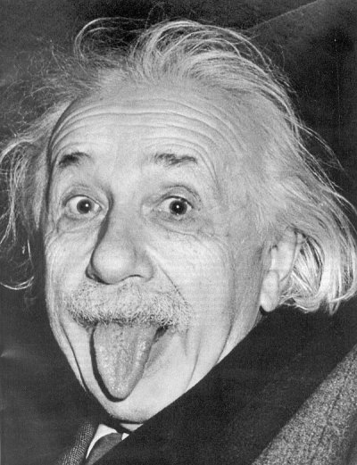
For which work did Einstein receive the Nobel Prize?
Special Relativity E = mc²
General Relativity Gravity bends Light
Photoelectric Effect Photons
Einstein didn’t receive a Nobel prize.

Slide 17
For which work did Einstein receive the Nobel Prize?
Special Relativity E = mc²
General Relativity Gravity bends Light
Photoelectric Effect Photons
Einstein didn’t receive a Nobel prize.

Slide 18
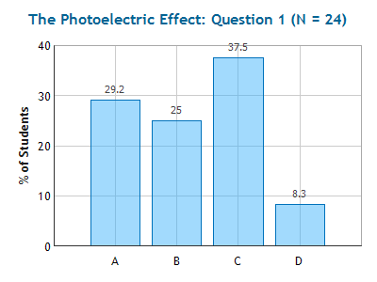
Photoelectric Effect
Checkpoint
In the photoelectric effect, suppose that the intensity of light is increased, while the frequency is kept constant and above the threshold frequency f₀.
Which of the following increases?
Maximum KE of emitted electrons
Number of electrons emitted per second
Both of the above
None of the above

Slide 19
Photoelectric Effect
Light shining on a metal can “knock” electrons out of atoms.
Light must provide energy to overcome Coulomb attraction of electron to nucleus
Light Intensity gives power/area (i.e. Watts/m²)
  Recall: Power = Energy/time (i.e. Joules/sec.)

Slide 20
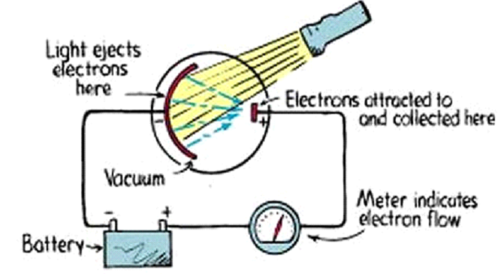
Photoelectric Effect

Slide 21
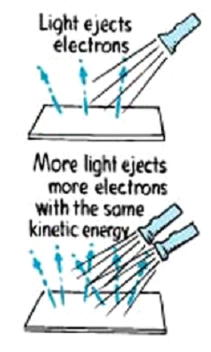
Light Intensity
Kinetic energy of ejected electrons is independent of light intensity
Number of electrons ejected does depend on light intensity

Slide 22
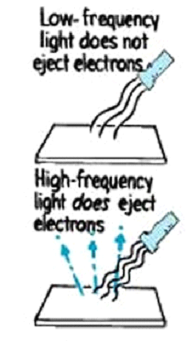
Threshold Frequency
Glass is not transparent to ultraviolet light
Light in visible region is lower frequency than ultraviolet
There is minimum frequency necessary to eject electrons

Slide 23
Difficulties With Wave Explanation
effect easy to observe with violet or ultraviolet (high frequency) light but not with red (low frequency) light
rate at which electrons ejected proportional to brightness of light
The maximum energy of ejected electrons NOT affected by brightness of light
electron's energy depends on light’s frequency

Slide 24
Photoelectric Effect Summary
Each metal has “Work Function” (W₀) which is the minimum energy needed to free electron from atom.
Light comes in packets called Photons
  E = h f h=6.626 X 10⁻³⁴ Joule sec
  h=4.136 X 10⁻¹⁵ eV sec
Maximum kinetic energy of released electrons
  hf = KE + W₀

Slide 25
If hf for the light incident on a metal is equal to the work function, what will the kinetic energy of the ejected electron be?
the kinetic energy would be negative
the kinetic energy would be zero
the kinetic energy would be positive
no electrons would be released from the metal

Slide 26
If hf for the light incident on a metal is less than the work function, what will the kinetic energy of the ejected electron be?
the kinetic energy would be negative
the kinetic energy would be zero
the kinetic energy would be positive
no electrons would be released from the metal

Slide 27
If hf for the light incident on a metal is less than the work function, what will the kinetic energy of the ejected electron be?
the kinetic energy would be negative
the kinetic energy would be zero
the kinetic energy would be positive
no electrons would be released from the metal

Slide 28
Photoelectric: summary table
Wave Particle Result
Increase Intensity
  Rate Increase Increase Increase
  KE Increase Unchanged Unchanged
Increase Frequency
  Rate Unchanged Increase Increase
  KE Unchanged Increase Increase
Light is composed of particles: photons

Slide 29
Is Light a Wave or a Particle?
Wave
  Electric and Magnetic fields act like waves
  Superposition, Interference and Diffraction
Particle
  Photons
  Collision with electrons in photo-electric effect
Both Particle and Wave !

Slide 30
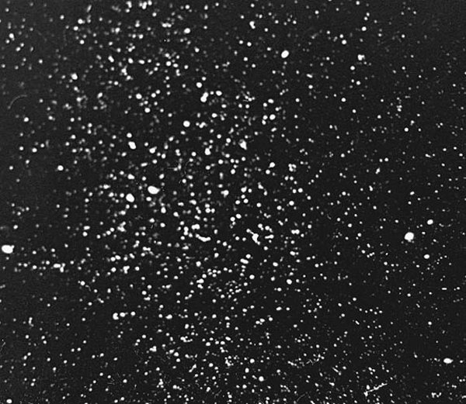
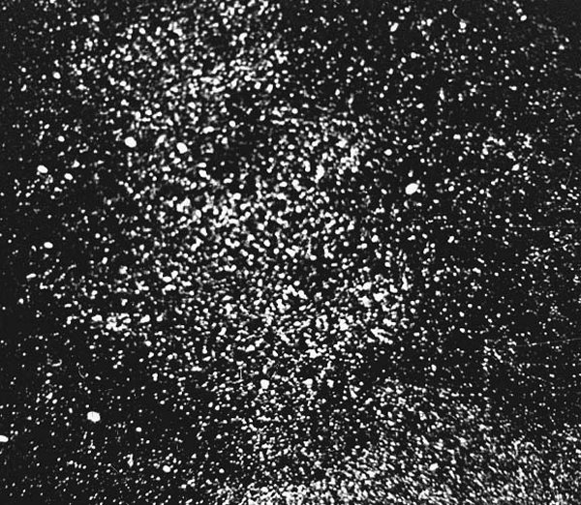
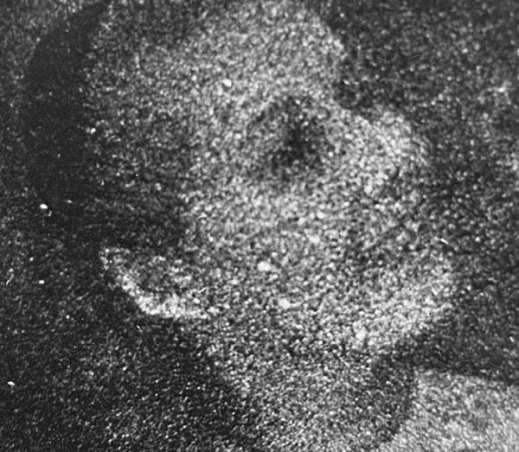



The approximate numbers of photons at each stage are
(a) 3 × 103, (b) 1.2 × 104, (c) 9.3 × 104, (d) 7.6 × 105, (e) 3.6 × 106, and (f) 2.8 × 107.

Slide 31
Are Electrons Particles or Waves?
Particles, definitely particles.
You can “see them”.
You can “bounce” things off them.
You can put them on an electroscope.
How would know if electron was a wave?
Look for interference!

Slide 32
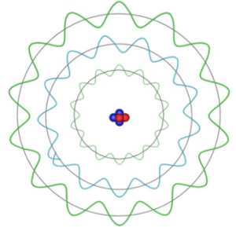
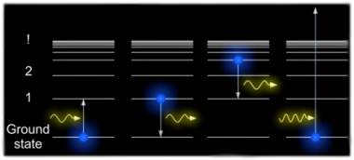
De Broglie Waves, Uncertainty, and Atoms
Physics 1161: Lecture 22 Part 2
sections 30.5 – 30.7
Notes:
1

Slide 33
Compton Scattering
This experiment really shows photon momentum!
P_{incoming photon} + 0 = P_{outgoing photon} + P_{electron}
Electron at rest
Outgoing photon has momentum p′ and wavelength λ′
Incoming photon has momentum, p, and wavelength λ
Recoil electron carries some momentum and KE
Energy of a photon

Slide 34
Photons with equal energy and momentum hit both sides of a metal plate. The photon from the left sticks to the plate, the photon from the right bounces off the plate. What is the direction of the net impulse on the plate?
Left
Right
Zero

Slide 35
Photons with equal energy and momentum hit both sides of a metal plate. The photon from the left sticks to the plate, the photon from the right bounces off the plate. What is the direction of the net impulse on the plate?
Left
Right
Zero
Photon that sticks has an impulse p
Photon that bounces has an impulse 2p!

Slide 36
De Broglie Waves
De Broglie postulated that it holds for any object with momentum- an electron, a nucleus, an atom, a baseball,…...
Explains why we can see interference and diffraction for material particles like electrons!!

Slide 37
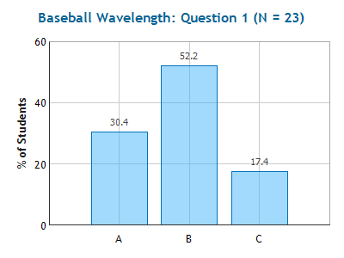
Baseball Wavelength
Checkpoint
Which baseball has the longest De Broglie wavelength?
(1) A fastball (100 mph)
(2) A knuckleball (60 mph)
(3) Neither - only curveballs have a wavelength

Slide 38
Baseball Wavelength
Checkpoint
Which baseball has the longest De Broglie wavelength?
(1) A fastball (100 mph)
(2) A knuckleball (60 mph)
(3) Neither - only curveballs have a wavelength
Lower momentum gives higher wavelength.
p=mv, so slower ball has smaller p.

Slide 39
A stone is dropped from the top of a building. What happens to the de Broglie wavelength of the stone as it falls?
1. It decreases.
It increases.
It stays the same.

Slide 40
A stone is dropped from the top of a building. What happens to the de Broglie wavelength of the stone as it falls?
1. It decreases.
It increases.
It stays the same.
Speed, v, and momentum, p=mv, increase.

Slide 41
Comparison:
Wavelength of Photon vs. Electron
Example
Say you have a photon and an electron, both with 1 eV of energy. Find the de Broglie wavelength of each.
Photon with 1 eV energy:
Equations are different - be careful!
Electron with 1 eV kinetic energy:
Big difference!
Solve for

Slide 42
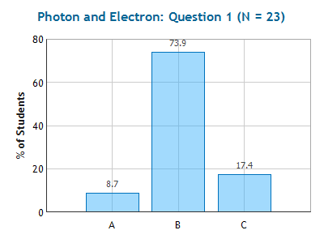
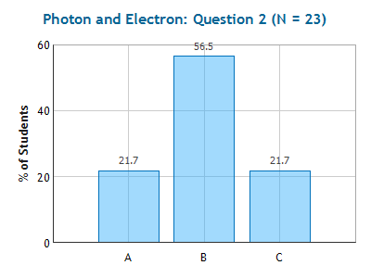
Photon & Electron
Checkpoints
Photon A has twice as much momentum as Photon B. Compare their energies.
E_{A} = E_{B}
E_{A} = 2 E_{B}
E_{A} = 4 E_{B}
Electron A has twice as much momentum as Electron B. Compare their energies.
E_{A} = E_{B}
E_{A} = 2 E_{B}
E_{A} = 4 E_{B}

Slide 43
Photon & Electron
Checkpoints
Photon A has twice as much momentum as Photon B. Compare their energies.
E_{A} = E_{B}
E_{A} = 2 E_{B}
E_{A} = 4 E_{B}
and
so
double p then double E
Electron A has twice as much momentum as Electron B. Compare their energies.
E_{A} = E_{B}
E_{A} = 2 E_{B}
E_{A} = 4 E_{B}
double p then quadruple E

Slide 44
Compare the wavelength of a bowling ball with the wavelength of a golf ball, if each has 10 Joules of kinetic energy.
λ_{bowling} > λ_{golf}
λ_{bowling} = λ_{golf}
3. λ_{bowling} < λ_{golf}

Slide 45
Compare the wavelength of a bowling ball with the wavelength of a golf ball, if each has 10 Joules of kinetic energy.
λ_{bowling} > λ_{golf}
λ_{bowling} = λ_{golf}
3. λ_{bowling} < λ_{golf}

Slide 46
Heisenberg Uncertainty Principle
Rough idea: if we know momentum very precisely, we lose knowledge of location, and vice versa.
If we know the momentum p, then we know the wavelength λ, and that means we’re not sure where along the wave the particle is actually located!
y
λ

Slide 47
Heisenberg Test
Number of electrons arriving at screen
w
p
θ
electron beam
Δy = w
= λ/sinθ
screen
y
p
Δp_{y} = p sinθ
θ
x
Use de Broglie λ

Slide 48
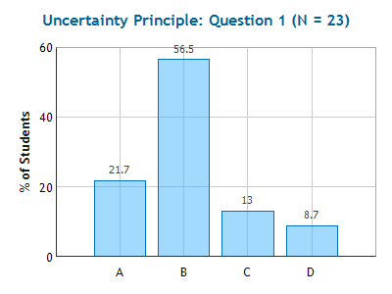
to be precise...
Of course if we try to locate the position of the particle along the x axis to Δx we will not know its x component of momentum better than Δp_{x}, where
and the same for z.
Uncertainty Principle
Checkpoint
According to the H.U.P., if we know the x-position of a particle, we can not know its:
(1) Y-position (2) x-momentum
(3) y-momentum (4) Energy
Notes:
51% correct

Slide 49
to be precise...
Of course if we try to locate the position of the particle along the x axis to Δx we will not know its x component of momentum better than Δp_{x}, where
and the same for z.
Uncertainty Principle
Checkpoint
According to the H.U.P., if we know the x-position of a particle, we can not know its:
(1) Y-position (2) x-momentum
(3) y-momentum (4) Energy
Notes:
51% correct

Slide 50
Early Model for Atom
Plum Pudding
  positive and negative charges uniformly distributed throughout the atom like plums in pudding
+
+
-
-
-
-
+
+
But how can you look inside an atom 10⁻¹⁰ m across?
Light (visible) λ = 10⁻⁷ m
Electron (1 eV) λ = 10⁻⁹ m
Helium atom λ = 10⁻¹¹ m

Slide 51
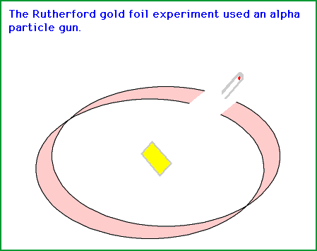
Rutherford Scattering
Scattering He⁺⁺ nuclei (alpha particles) off of gold. Mostly go through, some scattered back!
(Alpha particles = He⁺⁺)
Only something really small (i.e. nucleus) could scatter the particles back!
Atom is mostly empty space with a small (r = 10⁻¹⁵ m) positively charged nucleus surrounded by cloud of electrons (r = 10⁻¹⁰ m)

Slide 52


Atomic Scale
Kia – Sun Chips Model
  Nucleons (protons and neutrons) are like Kia Souls (2000 lb cars)
  Electrons are like bags of Sun Chips (1 lb objects)
  Sun Chips are orbiting the cars at a distance of a few miles
(Nucleus) BB on the 50 yard line with the electrons at a distance of about 50 yards from the BB
Atom is mostly empty space
Size is electronic

Slide 53
Recap
Photons carry momentum p=h/λ
Everything has wavelength λ=h/p
Uncertainty Principle ΔpΔx > h/(2π)
Atom
  Positive nucleus 10⁻¹⁵ m
  Electrons “orbit” 10⁻¹⁰ m
  Classical E+M doesn’t give stable orbit
  Need Quantum Mechanics!

