Slide 1
Introduction to Mirrors
Physics 1161: Lecture 16
Notes:
1

Slide 2
Light incident on an object
Absorption
Reflection (bounces)**
  See it
  Mirrors
Refraction (bends)
  Lenses
Often some of each
Everything true for wavelengths << object size

Slide 3

Law of Reflection Animation
θ_{i} = θ_{r}

Slide 4
Reflection
Angle of incidence = Angle of reflection
θ_{i} = θ_{r}
(Angles between light beam and normal)
θ_{i}
θ_{r}
Notes:
Before this slide, bounce pass basket ball

Slide 5

Diffuse Reflection

Slide 6
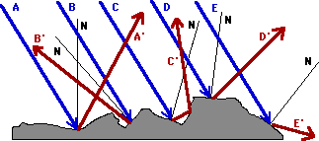
Diffuse Reflection

Slide 7

Image Location

Slide 8

Flat Mirror Summary
Image appears:
  Upright
  Same size
  Located same distance from, but behind, mirror
  Facing opposite direction: Left/Right inverted
  Virtual Image: Light rays don’t actually intersect at image location.
Checkpoint
Why do ambulances have “AMBULANCE” written backwards?
Notes:
Might change Virtual Image definition “Light rays don’t actually intersect at image location.”

Slide 9

Flat Mirror Summary
Image appears:
  Upright
  Same size
  Located same distance from, but behind, mirror
  Facing opposite direction: Left/Right inverted
  Virtual Image: Light rays don’t actually intersect at image location.
Checkpoint
Why do ambulances have “AMBULANCE” written backwards?
So you can read it in your rear-view mirror!

Slide 10
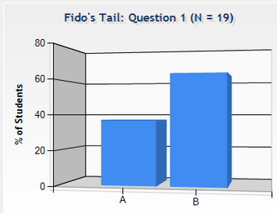


Checkpoint
Fido’s Tail
Can you see Fido’s tail in mirror?
Yes No
mirror
(You)
(Fido)

Slide 11
Checkpoint
Fido’s Tail
Can you see Fido’s tail in mirror?
No!
mirror
You need light rays from the tail to bounce off mirror and reach your eye!
(You)
(Fido)

Slide 12
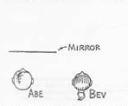
Abe and Bev both look in a plane mirror directly in front of Abe. Abe can see himself while Bev cannot see herself. Can Abe see Bev (and can Bev see Abe)?
Yes
No

Slide 13
Abe and Bev both look in a plane mirror directly in front of Abe. Abe can see himself while Bev cannot see herself. Can Abe see Bev (and can Bev see Abe)?
Yes
No

Slide 14
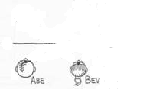
Mirror Images
Abe and Bev both look in a plane mirror directly in front of Abe. Abe can see himself while Bev cannot see herself. Can Abe see Bev (and can Bev see Abe)?
1. Extend edges of mirror with dashed lines.
2. Draw in the images.
3. Connect images and observers with lines of sight.
4. If the connecting lines intersect with the mirror (not the extension of the mirror), they can see each other.
Abe sees himself & Bev
Bev sees Abe but not herself

Slide 15
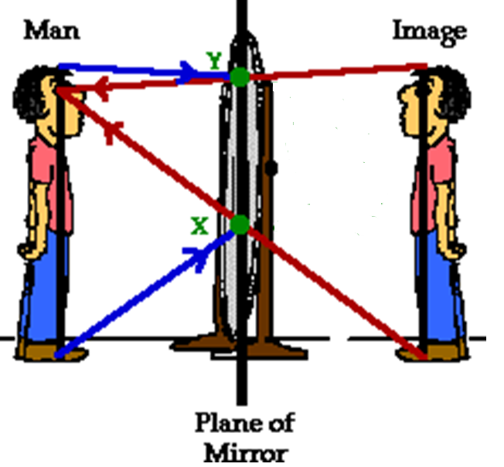
A man stands in front of a mirror. How tall does the mirror have to be so that he can see himself entirely?
Same as his height
Less than his height but more than half his height
Half his height
Less than half his height
Any size will do

Slide 16
A man stands in front of a mirror. How tall does the mirror have to be so that he can see himself entirely?
Same as his height
Less than his height but more than half his height
Half his height
Less than half his height
Any size will do

Slide 17
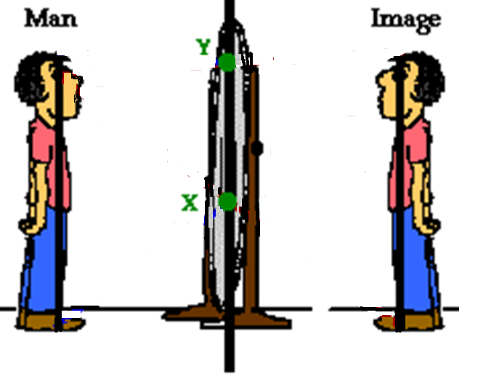
How Big Must the Mirror Be?
Light from feet striking mirror at X reflects to eyes.
Man sees image of his feet by looking toward point X
Only this part
of mirror is
needed
Light from top of head striking mirror at Y reflects to eyes
Man sees image of top of head by looking toward point Y
Mirror only needs to be half his height

Slide 18
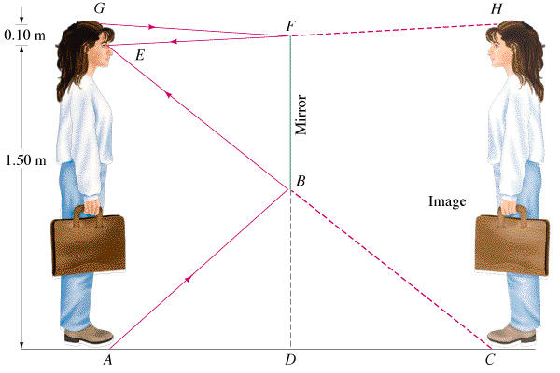
Does this depend on the person’s distance from the mirror?
NO
Yes
Depends on the mirror
Depends on the person

Slide 19
Does this depend on the person’s distance from the mirror?
NO
Yes
Depends on the mirror
Depends on the person

Slide 20
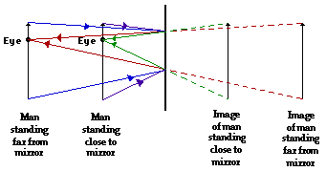
Distance from Mirror Irrelevant

Slide 21
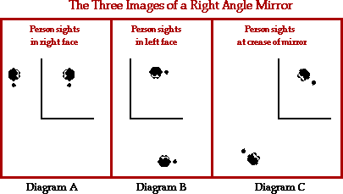
Right Angle Mirror

Slide 22
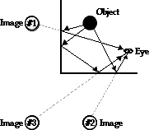
Right Angle Mirror
Formation of primary and secondary images

Slide 23
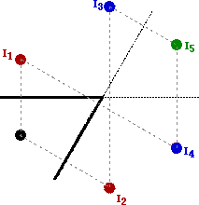
Kaleidoscope
Angles smaller than 90º produce more than 3 images

Slide 24
Kaleidoscope Applets
Hinged Mirror Applet
Image Formation Applet

Slide 25
Reflection Applets
Plane Mirror Image Applets
Double Mirror Images
Hinged Mirror Applet
Rainbow Applets

Slide 26
You hold a hand mirror 0.5 m in front of you and look at your reflection in a full-length mirror 1 m behind you. How far in back of the big mirror do you see the image of your face?
1.0 m
0.5 m
0.5 m
1.0 m
1.5 m
2.0 m
2.5 m

Slide 27
You hold a hand mirror 0.5 m in front of you and look at your reflection in a full-length mirror 1 m behind you. How far in back of the big mirror do you see the image of your face?
1.0 m
0.5 m
0.5 m
1.0 m
1.5 m
2.0 m
2.5 m

Slide 28
Curved mirrors
A Spherical Mirror: section of a sphere.
Concave mirror
light ray
R
•
principal axis
C
R
Convex mirror
light ray
R
•
principal axis
C
C = Center of curvature
In front of concave mirror, behind convex mirror.

Slide 29
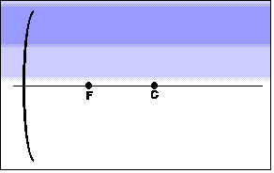
Three Useful Rays
Ray parallel to the axis reflects through the focus.
Ray through the focus reflects parallel to the axis.
Ray through the center of curvature reflects back on itself.

Slide 30
Concave Mirror
R
Principal Axis
Focus
f=R/2
Rays are bent towards the principal axis.
Rays parallel to principal axis and near the principal axis (“paraxial rays”) all reflect so they pass through the “Focus” (F).
The distance from F to the center of the mirror is called the “Focal Length” (f).

Slide 31
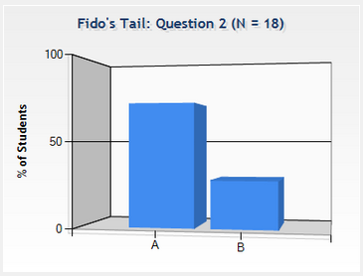
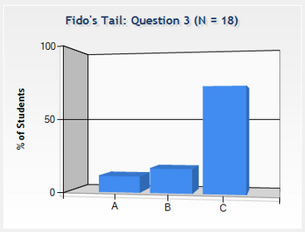
Checkpoints
What kind of spherical mirror can be used to start a fire?
concave
convex
How far from the paper to be ignited should the mirror be held?
farther than the focal length
closer than the focal length
at the focal length

Slide 32
Checkpoints
What kind of spherical mirror can be used to start a fire?
concave
convex
How far from the paper to be ignited should the mirror be held?
farther than the focal length
closer than the focal length
at the focal length

Slide 33

Concave Mirror
F
Principal Axis
F
Rays traveling through focus before hitting mirror are reflected parallel to Principal Axis.
Rays traveling parallel to Principal Axis before hitting mirror are reflected through focus

Slide 34
Convex Mirror
R
Principal Axis
Focus
f=-R/2
Rays are bent away from the principal axis.
Rays parallel to principal axis and near the principal axis (“paraxial rays”) all reflect so they appear to originate from the “Focus” (F).
The distance from F to the center of the mirror is called the “Focal Length” (f).

Slide 35
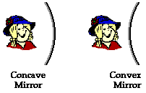

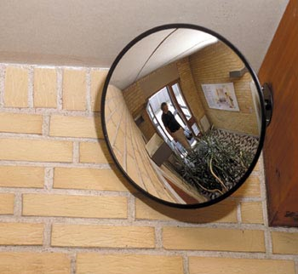
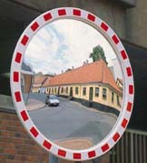
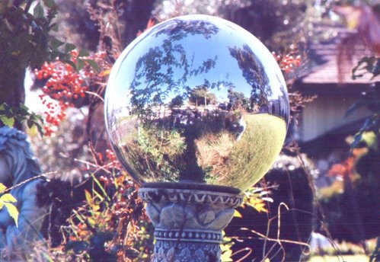
Types of Curved Mirrors
A concave mirror is silvered on the inside of the sphere.
A concave mirror is also called a converging mirror because it converges parallel light.
A convex mirror is silvered on the outside of the bowl.
A convex mirror is also called a diverging mirror because it diverges parallel light.

Slide 36
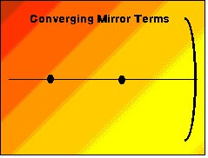
Concave Mirror Terms & Formulas
Axis
Center of Curvature
Radius of Curvature
Focus
Focal Length

Slide 37
Checkpoint
Which ray is NOT correct?
p.a.
1)
R
f
2)
3)

Slide 38
Checkpoint
Which ray is NOT correct?
Ray through center should reflect back on self.
p.a.
1)
R
f
2)
3)

Slide 39
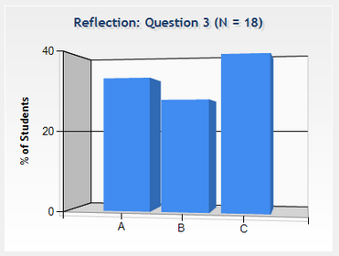



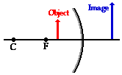
Checkpoint
The image produced by a concave mirror of a real object is:
Always Real
Always Virtual
Sometimes Real, Sometimes Virtual

Slide 40
Example
A 4.00-cm tall light bulb is placed a distance of 45.7 cm from a concave mirror having a focal length of 15.2 cm. Determine the image distance and the image size.
C
F
Object
Image

Slide 41
Where in front of a concave mirror should you place an object so that the image is virtual?
Close to mirror
Far from mirror
Either close or far
Not Possible

Slide 42
Where in front of a concave mirror should you place an object so that the image is virtual?
Close to mirror
Far from mirror
Either close or far
Not Possible

Slide 43
3 Cases for Concave Mirrors
Upright
Enlarged
Virtual
C
F
Inside F
Object
Image
Inverted
Enlarged
Real
Image
C
F
Between C&F
Object
Inverted
Reduced
Real
C
F
Past C
Object
Image

Slide 44
Example
Solving Equations
A candle is placed 6 cm in front of a convex mirror with focal length f=-3 cm. Determine the image location.
Determine the magnification of the candle.
If the candle is 9 cm tall, how tall does the image candle appear to be?

Slide 45
Example
Solving Equations
A candle is placed 6 cm in front of a convex mirror with focal length f=-3 cm. Determine the image location.
Determine the magnification of the candle.
If the candle is 9 cm tall, how tall does the image candle appear to be?
Diverging mirror!
d_{i} = - 2 cm (behind mirror)
Virtual Image!
m = + 1/3
h_{i} = + 3 cm
Image is Upright!

Slide 46
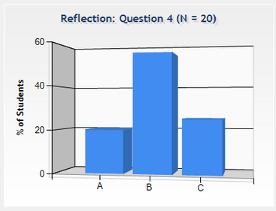
Checkpoint
The image produced by a convex mirror of a real object is ?
Always real
Always virtual
Sometimes real and sometimes virtual

