Slide 1
Refraction & Lenses
Physics 1161: Lecture 17
Textbook sections 26-3 – 26-5, 26-8
Notes:
1

Slide 2
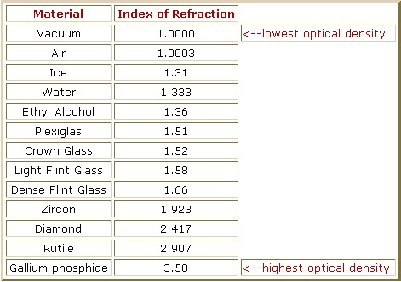
Indices of Refraction

Slide 3
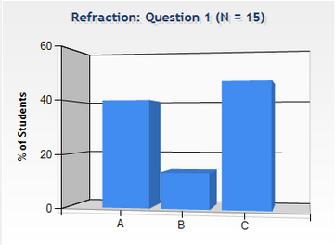
Checkpoint
Refraction
When light travels from one medium to another the speed changes v=c/n, but the frequency is constant. So the light bends:
n₁
θ₁
1) n₁ > n₂
2) n₁ = n₂
3) n₁ < n₂
θ₂
n₂
Compare n₁ to n₂.

Slide 4
Which of the following is correct?
Checkpoint
Refraction
n₁ sin(θ₁)= n₂ sin(θ₂)
n₁
θ₁
θ₂
n₂
Compare n₁ to n₂.
1) n₁ > n₂
2) n₁ = n₂
3) n₁ < n₂
θ₁ < θ₂
sinθ₁ < sinθ₂
n₁ > n₂

Slide 5
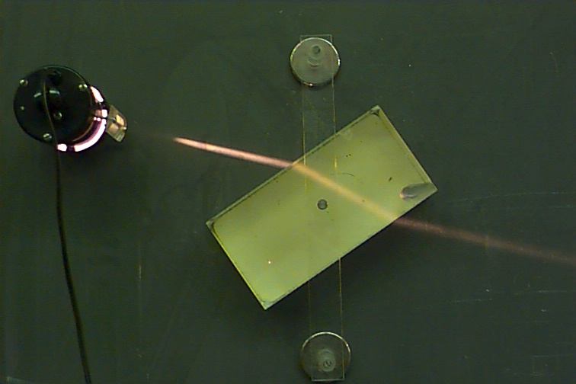
FST & SFA
A ray of light crossing the boundary from a fast medium to a slow medium bends toward the normal. (FST)
A ray of light crossing the boundary from a slow medium to a fast medium bends away from the normal. (SFA)

Slide 6
Example
Snell’s Law Practice
Usually, there is both reflection and refraction!
A ray of light traveling through the air (n=1) is incident on water (n=1.33). Part of the beam is reflected at an angle θ_{r} = 60. The other part of the beam is refracted. What is θ₂?
θ₁
θ_{r}
n₁
n₂
normal

Slide 7
Example
Snell’s Law Practice
Usually, there is both reflection and refraction!
A ray of light traveling through the air (n=1) is incident on water (n=1.33). Part of the beam is reflected at an angle θ_{r} = 60. The other part of the beam is refracted. What is θ₂?
θ₁ =θ_{r} =60
θ₁
θ_{r}
sin(60) = 1.33 sin(θ₂)
n₁
θ₂ = 40.6 degrees
n₂
normal

Slide 8
Refraction Applets
Applet by Molecular Expressions -- Florida State University
Applet by Fu-Kwung Hwang, National Taiwan Normal University

Slide 9
Parallel light rays cross interfaces from air into two different media, 1 and 2, as shown in the figures below. In which of the media is the light traveling faster?
Medium 1
Medium 2
Both the same
air
air
1
2

Slide 10
Parallel light rays cross interfaces from air into two different media, 1 and 2, as shown in the figures below. In which of the media is the light traveling faster?
Medium 1
Medium 2
Both the same
air
air
1
2
The greater the difference in the speed of light between the two media, the greater the bending of the light rays.

Slide 11
Parallel light rays cross interfaces from medium 1 into medium 2 and then into medium 3. What can we say about the relative sizes of the indices of refraction of these media?
1
1. n₁ > n₂ > n₃
2. n₃ > n₂ > n₁
3. n₂ > n₃ > n₁
4. n₁ > n₃ > n₂
5. none of the above
2
3

Slide 12
Parallel light rays cross interfaces from medium 1 into medium 2 and then into medium 3. What can we say about the relative sizes of the indices of refraction of these media?
1
1. n₁ > n₂ > n₃
2. n₃ > n₂ > n₁
3. n₂ > n₃ > n₁
4. n₁ > n₃ > n₂
5. none of the above
2
3
Rays are bent toward the normal when crossing into #2, so n₂ > n₁. But rays are bent away from the normal when going into #3, so n₃ < n₂. How to find the relationship between #1 and #3? Ignore medium #2! So the rays are bent away from the normal if they would pass from #1 directly into #3. Thus, we have: n₂ > n₁ > n₃ .

Slide 13
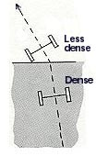
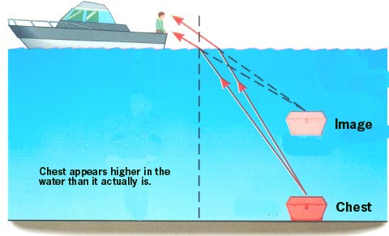
Apparent Depth
Light exits into
medium (air)
of lower index
of refraction,
and turns left.

Slide 14
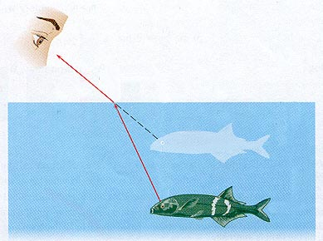
Spear-Fishing
Spear-fishing is made more difficult by the bending of light.
To spear the fish in the figure, one must aim at a spot in front of the apparent location of the fish.

Slide 15
Apparent Depth
Apparent depth:
n₂
n₁
d′
apparent fish
d
actual fish
50

Slide 16
To spear a fish, should you aim directly at the image, slightly above, or slightly below?
1. aim directly at the image
2. aim slightly above
3. aim slightly below

Slide 17
To spear a fish, should you aim directly at the image, slightly above, or slightly below?
1. aim directly at the image
2. aim slightly above
3. aim slightly below
Due to refraction, the image will appear higher than the actual fish, so you have to aim lower to compensate.

Slide 18
To shoot a fish with a laser gun, should you aim directly at the image, slightly above, or slightly below?
1. aim directly at the image
2. aim slightly above
3. aim slightly below
light from fish
laser beam
The light from the laser beam will also bend when it hits the air-water interface, so aim directly at the fish.

Slide 19
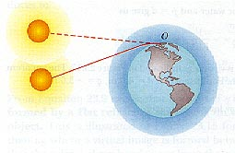
Delayed Sunset
The sun actually falls below below the horizon
It "sets", a few seconds before we see it set.

Slide 20
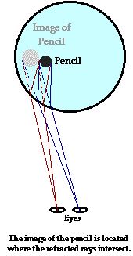
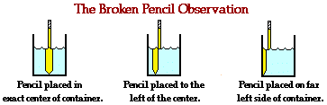
Broken Pencil
Notes:
In this case, the only light which undergoes refraction is the light which travels from the submerged portion of the pencil, through the water, across the boundary, into the air, and ultimately to the eye. At the boundary, this ray refracts. The eye-brain interaction cannot account for the refraction of light. The brain judges the image location to be the location where light rays appear to originate from. This image location is the location where either reflected or refracted rays intersect. The eye and brain assume that light travels in a straight line and then extends all incoming rays of light backwards until they intersect. Light rays from the submerged portion of the pencil will intersect in a different location than light rays from the portion of the pencil which extends above the surface of the water. For this reason, the submerged portion of the pencil appears to be in a different location than the portion of the pencil which extends above the water.

Slide 21
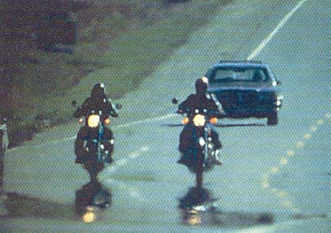
Water on the Road Mirage

Slide 22
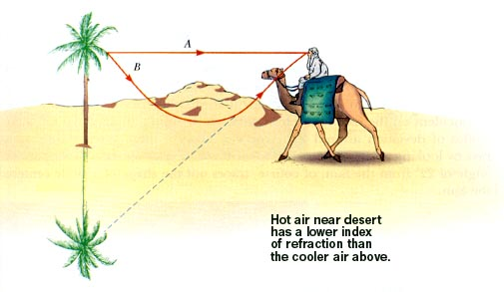
Palm Tree Mirage

Slide 23
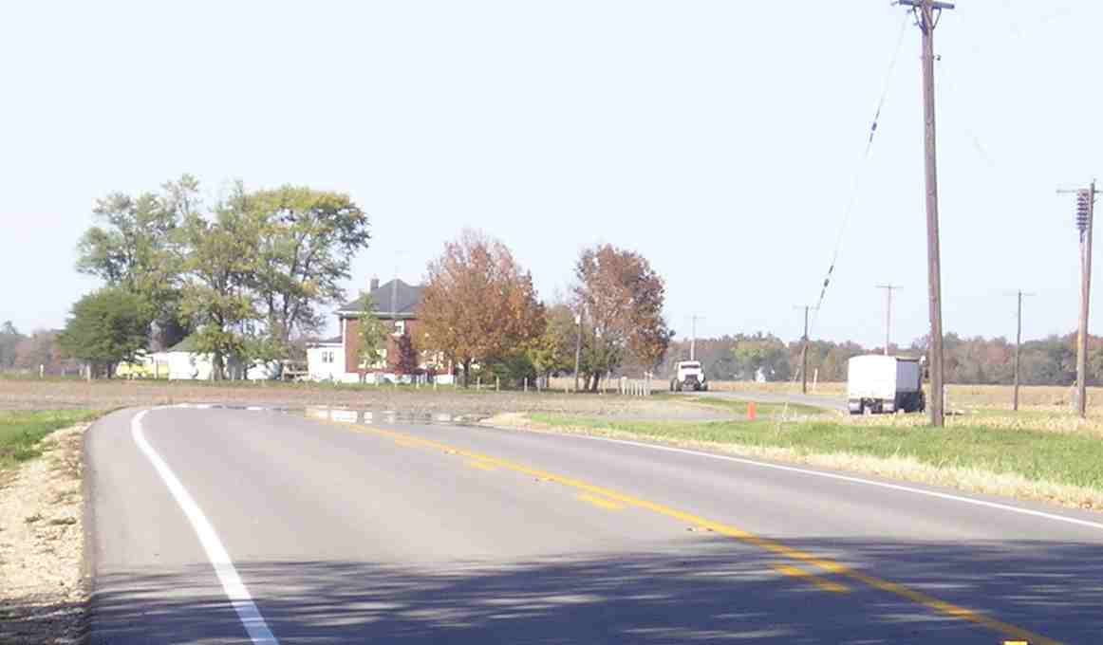
Mirage Near Dana – Home of Ernie Pyle

Slide 24
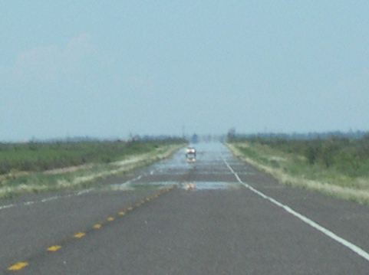
Texas Mirage

Slide 25
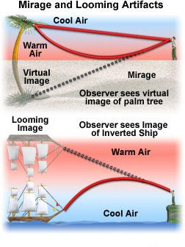

Slide 26
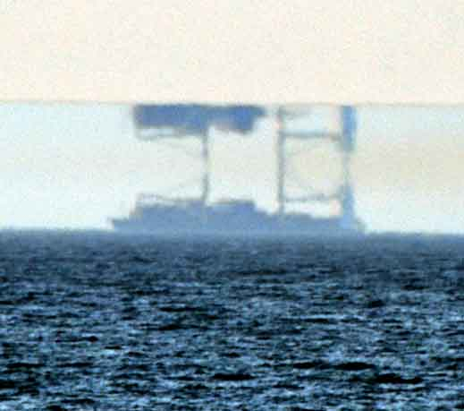
Looming

Slide 27
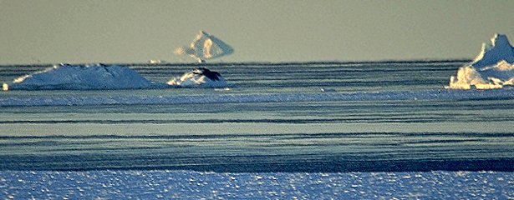
Antarctic Looming

Slide 28
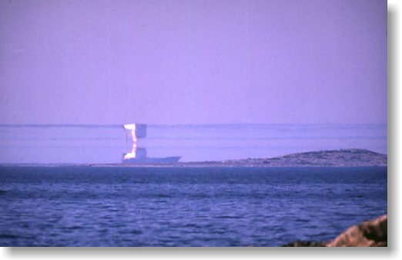
Looming

Slide 29
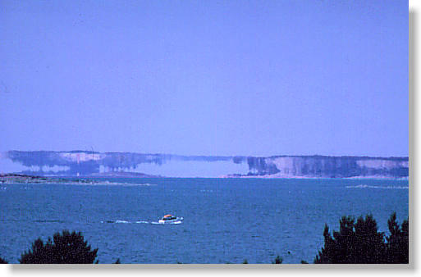
Looming

Slide 30
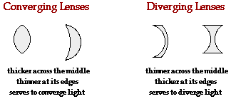
Types of Lenses

Slide 31
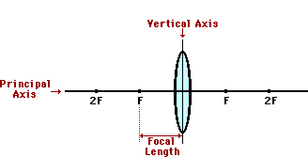
Lens Terms

Slide 32
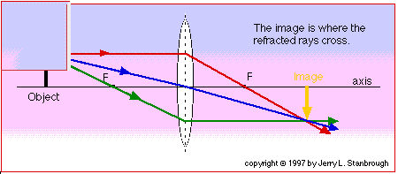
Three Rays to Locate Image
Ray parallel to axis bends through the focus.
Ray through the focus bends parallel to axis.
Ray through center of lens passes straight through.

Slide 33
Characterizing the Image
Images are characterized in the following way
  Virtual or Real
  Upright or Inverted
  Reduced, Enlarged, Same Size

Slide 34
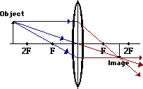
Object Beyond 2f
Image is
  Real
  Inverted
  Reduced

Slide 35
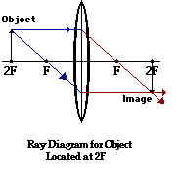
Object at 2f
Image is
  Real
  Inverted
  Same size

Slide 36
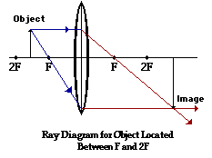
Object Between 2f and f
Image is
  Real
  Inverted
  Enlarged

Slide 37
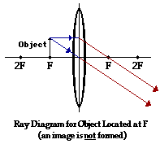
Object at F
No Image is Formed!

Slide 38
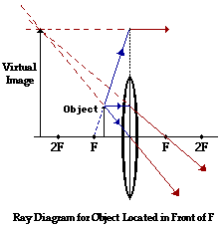
Object Closer than F
Image is
  Virtual
  Upright
  Enlarged

Slide 39
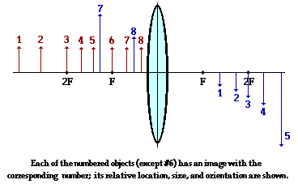
Converging Lens Images

Slide 40
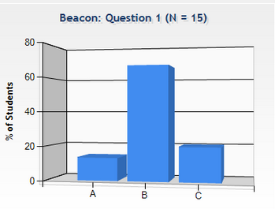
Beacon
Checkpoint
A beacon in a lighthouse is to produce a parallel beam of light. The beacon consists of a bulb and a converging lens. Where should the bulb be placed?
Outside the focal point
At the focal point
Inside the focal point

Slide 41
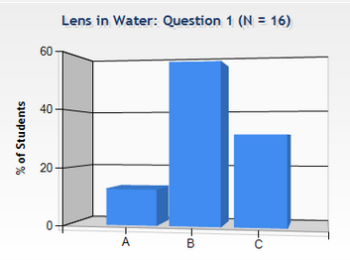
Lens in Water
Checkpoint
Focal point determined by geometry and Snell’s Law:
n₁ sin(θ₁) = n₂ sin(θ₂)
P.A.
n₁<n₂
F
Fat in middle = Converging
Thin in middle = Diverging
Larger n₂/n₁ = more bending, shorter focal length.
n₁ = n₂ => No Bending, f = infinity
Lens in water has _________ focal length!

Slide 42
Lens in Water
Checkpoint
Focal point determined by geometry and Snell’s Law: n₁ sin(θ₁) = n₂ sin(θ₂)
P.A.
n₁<n₂
F
Fat in middle = Converging
Thin in middle = Diverging
Larger n₂/n₁ = more bending, shorter focal length.
n₁ = n₂ => No Bending, f = infinity
Lens in water has larger focal length!

Slide 43
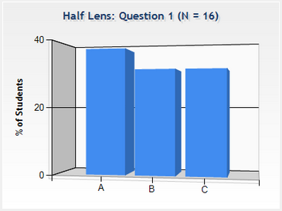
Half Lens
Checkpoint
A converging lens is used to project a real image onto a screen. A piece of black tape is then placed over the upper half of the lens.
1. Only the lower half will show on screen
2. Only the upper half will show on screen
3. The whole object will still show on screen
How much of the image appears on the screen?

Slide 44
Half Lens
Checkpoint
A converging lens is used to project a real image onto a screen. A piece of black tape is then placed over the upper half of the lens.

Slide 45
Half Lens
Checkpoint
Still see entire image (but dimmer)!

Slide 46
Two very thin converging lenses each with a focal length of 20 cm are are placed in contact. What is the focal length of this compound lens?
10 cm
20 cm
40 cm

Slide 47
Two very thin converging lenses each with a focal length of 20 cm are are placed in contact. What is the focal length of this compound lens?
10 cm
20 cm
40 cm

Slide 48
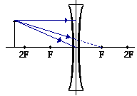
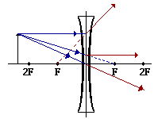
Concave (Diverging) Lens
Ray parallel to axis refracts as if it comes from the first focus.
Ray which lines up with second focus refracts parallel to axis.
Ray through center of lens doesn’t bend.

Slide 49

Image Formed by Concave Lens
Image is always
  Virtual
  Upright
  Reduced

Slide 50
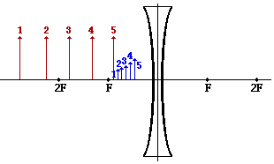
Concave Lens Image Distance
As object distance decreases
  Image distance decreases
  Image size increases

Slide 51
Image Characteristics
CONVEX LENS – IMAGE DEPENDS ON OBJECT POSITION
  Beyond F: Real; Inverted; Enlarged, Reduced, or Same Size
  Closer than F: Virtual, Upright, Enlarged
  At F: NO IMAGE
CONCAVE LENS – IMAGE ALWAYS SAME
  Virtual
  Upright
  Reduced

Slide 52

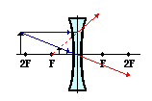
Lens Equations
d_{o}
d_{i}
convex: f > 0; concave: f < 0
d_{o} > 0 if object on left of lens
d_{i} > 0 if image on right of lens otherwise d_{i} < 0
h_{o} & h_{i} are positive if above principal axis; negative below

Slide 53
Which way should you move object so image is real and diminished?
Closer to the lens
Farther from the lens
A converging lens can’t create a real, diminished image.
F
P.A.
Object
F

Slide 54
Which way should you move object so image is real and diminished?
Closer to the lens
Farther from the lens
A converging lens can’t create a real, diminished image.
F
P.A.
Object
F

Slide 55
3 Cases for Converging Lenses
Past 2F
Inverted
Reduced
Real
This could be used in a camera. Big object on small film
Image
Object
Between
F & 2F
Inverted
Enlarged
Real
This could be used as a projector. Small slide on big screen
Image
Object
Inside F
Upright
Enlarged
Virtual
This is a magnifying glass
Image
Object

Slide 56
Diverging Lens Principal Rays
Example
F
P.A.
Object
F
1) Rays parallel to principal axis pass through focal point.
2) Rays through center of lens are not refracted.
3) Rays toward F emerge parallel to principal axis.
Image is (always true): Real or Imaginary
Upright or Inverted
Reduced or Enlarged

Slide 57
Diverging Lens Principal Rays
Example
F
P.A.
Object
F
Image
1) Rays parallel to principal axis pass through focal point.
2) Rays through center of lens are not refracted.
3) Rays toward F emerge parallel to principal axis.
Image is virtual, upright and reduced.

Slide 58
Which way should you move the object to cause the image to be real?
Closer to the lens
Farther from the lens
Diverging lenses can’t form real images
F
P.A.
Object
F

Slide 59
Which way should you move the object to cause the image to be real?
Closer to the lens
Farther from the lens
Diverging lenses can’t form real images
F
P.A.
Object
F

Slide 60
Multiple Lenses
Image from lens 1 becomes object for lens 2
Example
1
2
f₁
f₂
Complete the Rays to locate the final image.

Slide 61
Multiple Lenses
Image from lens 1 becomes object for lens 2
Example
1
2
f₁
f₂

Slide 62
Multiple Lenses: Magnification
d_{o} = 15 cm
1
2
L = 42 cm
d_{i} = 8.6 cm
f₁
f₂
f₁ = 10 cm
f₂ = 5 cm
Example
d_{i} = 30 cm
d_{o}=12 cm
Net magnification:
m_{net} = m₁ m₂

