Slide 1


Models of the Atom
Physics 1161: Lecture 23
Sections 31-1 – 31-6
Notes:
1

Slide 2
Bohr model works, approximately
Hydrogen-like energy levels (relative to a free electron that wanders off):
Energy of a Bohr orbit
Typical hydrogen-like radius (1 electron, Z protons):
Radius of a Bohr orbit

Slide 3
A single electron is orbiting around a nucleus with charge +3. What is its ground state (n=1) energy? (Recall for charge +1, E= -13.6 eV)
1) E = 9 (-13.6 eV)
2) E = 3 (-13.6 eV)
3) E = 1 (-13.6 eV)

Slide 4
A single electron is orbiting around a nucleus with charge +3. What is its ground state (n=1) energy? (Recall for charge +1, E= -13.6 eV)
1) E = 9 (-13.6 eV)
2) E = 3 (-13.6 eV)
3) E = 1 (-13.6 eV)
3²/1 = 9
Note: This is LOWER energy since negative!

Slide 5
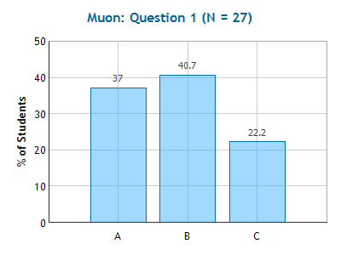
Muon
Checkpoint
Bohr radius
If the electron in the hydrogen atom was 207 times heavier (a muon), the Bohr radius would be
207 Times Larger
Same Size
207 Times Smaller
(Z =1 for hydrogen)

Slide 6
Muon
Checkpoint
Bohr radius
If the electron in the hydrogen atom was 207 times heavier (a muon), the Bohr radius would be
207 Times Larger
Same Size
207 Times Smaller
This “m” is electron mass, not proton mass!

Slide 7
Transitions + Energy Conservation
Each orbit has a specific energy:
E_{n}= -13.6 Z²/n²
Photon emitted when electron jumps from high energy to low energy orbit. Photon absorbed when electron jumps from low energy to high energy:
| E₁ – E₂ | = h f = h c / λ
http://www.colorado.edu/physics/2000/quantumzone/bohr2.html
Notes:
http://www.colorado.edu/physics/2000/quantumzone/bohr2.html

Slide 8
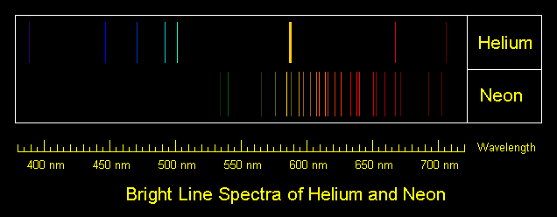

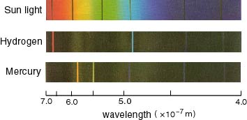
Line Spectra
elements emit a discrete set of wavelengths which show up as lines in a diffraction grating.

Slide 9
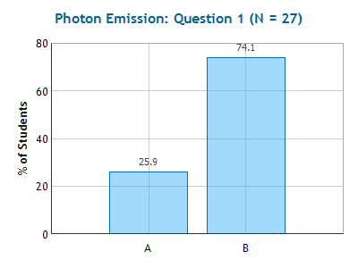
Photon Emission
Checkpoint
Electron A falls from energy level n=2 to energy level n=1 (ground state), causing a photon to be emitted.
Electron B falls from energy level n=3 to energy level n=1 (ground state), causing a photon to be emitted.
n=3
Which photon has more energy?
n=2
Photon A
Photon B
A
B
n=1

Slide 10
Photon Emission
Checkpoint
Electron A falls from energy level n=2 to energy level n=1 (ground state), causing a photon to be emitted.
Electron B falls from energy level n=3 to energy level n=1 (ground state), causing a photon to be emitted.
n=3
Which photon has more energy?
n=2
Photon A
Photon B
A
B
n=1

Slide 11
Spectral Line Wavelengths
Example
Calculate the wavelength of photon emitted when an electron in the hydrogen atom drops from the n=2 state to the ground state (n=1).
n=3
E₂= -3.4 eV
n=2
E₁= -13.6 eV
n=1

Slide 12
Compare the wavelength of a photon produced from a transition from n=3 to n=2 with that of a photon produced from a transition n=2 to n=1.
λ₃₂ < λ₂₁
λ₃₂ = λ₂₁
λ₃₂ > λ₂₁
n=3
n=2
n=1

Slide 13
Compare the wavelength of a photon produced from a transition from n=3 to n=2 with that of a photon produced from a transition n=2 to n=1.
λ₃₂ < λ₂₁
λ₃₂ = λ₂₁
λ₃₂ > λ₂₁
n=3
n=2
n=1
E₃₂ < E₂₁ so λ₃₂ > λ₂₁

Slide 14
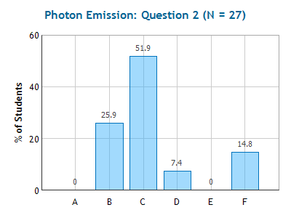
Photon Emission
Checkpoint
The electrons in a large group of hydrogen atoms are excited to the n=3 level. How many spectral lines will be produced?
(1) (2) (3)
(4) (5) (6)
n=3
n=2
n=1
Notes:
57% got this correct.

Slide 15
Photon Emission
Checkpoint
The electrons in a large group of hydrogen atoms are excited to the n=3 level. How many spectral lines will be produced?
(1) (2) (3)
(4) (5) (6)
n=3
n=2
n=1
Notes:
57% got this correct.

Slide 16
Bohr’s Theory & Heisenberg Uncertainty Principle
Checkpoints
So what keeps the electron from “sticking” to the nucleus?
Centripetal Acceleration
Pauli Exclusion Principle
Heisenberg Uncertainty Principle
To be consistent with the Heisenberg Uncertainty Principle, which of these properties can not be quantized (have the exact value known)? (more than one answer can be correct)
Electron Orbital Radius
Electron Energy
Electron Velocity
Electron Angular Momentum
Would know location
Would know momentum

Slide 17
Quantum Mechanics
Predicts available energy states agreeing with Bohr.
Don’t have definite electron position, only a probability function.
Orbitals can have 0 angular momentum!
Each electron state labeled by 4 numbers:
  n = principal quantum number (1, 2, 3, …)
  l = angular momentum (0, 1, 2, … n-1)
  m_{l} = component of l (-l < m_{l} < l)
  m_{s} = spin (-½ , +½)
Quantum Numbers
Notes:
Compare states with seats in auditorium n=row, l=seat ml=??? Ms=male/female

Slide 18
Summary
Bohr’s Model gives accurate values for electron energy levels...
But Quantum Mechanics is needed to describe electrons in atom.
Electrons jump between states by emitting or absorbing photons of the appropriate energy.
Each state has specific energy and is labeled by 4 quantum numbers (next time).

Slide 19
Bohr’s Model
Mini Universe
Coulomb attraction produces centripetal acceleration.
  This gives energy for each allowed radius.
Spectra tells you which radii orbits are allowed.
  Fits show this is equivalent to constraining angular momentum L = mvr = n h

Slide 20
Bohr’s Derivation 1
Circular motion
Total energy
Quantization of angular momentum:

Slide 21
Bohr’s Derivation 2
Use
in
“Bohr radius”
Substitute for r_{n} in
Note:
r_{n} has Z
E_{n} has Z²

Slide 22

Quantum Numbers
Each electron in an atom is labeled by 4 #’s
n = Principal Quantum Number (1, 2, 3, …)
Determines energy
ℓ = Orbital Quantum Number (0, 1, 2, … n-1)
Determines angular momentum
m_{ℓ} = Magnetic Quantum Number (ℓ , … 0, … -ℓ )
Component of ℓ
m_{s} = Spin Quantum Number (+½ , -½)
“Up Spin” or “Down Spin”

Slide 23
Nomenclature
“Shells”
“Subshells”
n=1 is “K shell”
ℓ =0 is “s state”
n=2 is “L shell”
ℓ =1 is “p state”
n=3 is “M shell”
ℓ =2 is “d state”
n=4 is “N shell”
ℓ =3 is “f state”
n=5 is “O shell”
ℓ =4 is “g state”
Example
1 electron in ground state of Hydrogen:
n=1, ℓ =0 is denoted as: 1s¹
n=1
ℓ =0
1 electron

Slide 24
Quantum Numbers
Example
How many unique electron states exist with n=2?
ℓ = 0 :
m_{ℓ} = 0 : m_{s} = ½ , -½ 2 states
2s²
ℓ = 1 :
m_{ℓ} = +1: m_{s} = ½ , -½ 2 states
m_{ℓ} = 0: m_{s} = ½ , -½ 2 states
m_{ℓ} = -1: m_{s} = ½ , -½ 2 states
2p⁶
There are a total of 8 states with n=2

Slide 25
How many unique electron states exist with n=5 and m_{l} = +3?
2
3
4
5

Slide 26
How many unique electron states exist with n=5 and m_{l} = +3?
Only
ℓ = 3 and ℓ = 4
have m_{ℓ} = +3
2
3
4
5
ℓ = 0 : m_{ℓ} = 0
ℓ = 1 : m_{ℓ} = -1, 0, +1
ℓ = 2 : m_{ℓ} = -2, -1, 0, +1, +2
ℓ = 3 : m_{ℓ} = -3, -2, -1, 0, +1, +2, +3
m_{s} = ½ , -½ 2 states
ℓ = 4 : m_{ℓ} = -4, -3, -2, -1, 0, +1, +2, +3, +4
m_{s} = ½ , -½ 2 states
There are a total of 4 states with n=5, m_{ℓ} = +3

Slide 27
Pauli Exclusion Principle
In an atom with many electrons only one electron is allowed in each quantum state (n, ℓ,m_{ℓ},m_{s}).
This explains the periodic table!
Notes:
Note it isn’t electron charge that keeps them from being in the same state!

Slide 28
What is the maximum number of electrons that can exist in the 5g (n=5, ℓ = 4) subshell of an atom?

Slide 29
What is the maximum number of electrons that can exist in the 5g (n=5, ℓ = 4) subshell of an atom?
m_{ℓ} = -4 : m_{s} = ½ , -½ 2 states
m_{ℓ} = -3 : m_{s} = ½ , -½ 2 states
m_{ℓ} = -2 : m_{s} = ½ , -½ 2 states
m_{ℓ} = -1 : m_{s} = ½ , -½ 2 states
m_{ℓ} = 0 : m_{s} = ½ , -½ 2 states
18 states
m_{ℓ} = +1: m_{s} = ½ , -½ 2 states
m_{ℓ} = +2: m_{s} = ½ , -½ 2 states
m_{ℓ}= +3: m_{s} = ½ , -½ 2 states
m_{ℓ} = +4: m_{s} = ½ , -½ 2 states

Slide 30
Electron Configurations
Atom Configuration
H 1s¹
He 1s²
1s shell filled
(n=1 shell filled - noble gas)
Li 1s²2s¹
Be 1s²2s²
2s shell filled
B 1s²2s²2p¹
etc
(n=2 shell filled - noble gas)
Ne 1s²2s²2p⁶
2p shell filled
s shells hold up to 2 electrons
p shells hold up to 6 electrons

Slide 31
Sequence of Shells
Sequence of shells: 1s,2s,2p,3s,3p,4s,3d,4p…..
4s electrons get closer to nucleus than 3d
19
K
20
Ca
21
Sc
22 Ti
23 V
24 Cr
25 Mn
26 Fe
27 Co
28 Ni
29 Cu
30 Zn
4s
3d
4p
In 3d shell we are putting electrons into ℓ = 2; all atoms in middle are strongly magnetic.
Angular momentum
Large magnetic moment
Loop of current

Slide 32
Sodium
Example
Single outer electron
Na 1s²2s²2p⁶ 3s¹
Neon - like core
Many spectral lines of Na are outer electron making transitions
Yellow line of Na flame test is 3p 3s
www.WebElements.com

Slide 33
Summary
Each electron state labeled by 4 numbers:
  n = principal quantum number (1, 2, 3, …)
  ℓ = angular momentum (0, 1, 2, … n-1)
  m_{ℓ} = component of ℓ (-ℓ < m_{ℓ} < ℓ)
  m_{s} = spin (-½ , +½)
Pauli Exclusion Principle explains periodic table
Shells fill in order of lowest energy.

