Slide 1
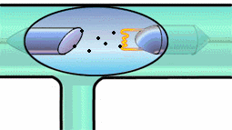

X-rays & LASERs
Physics 1161: Lecture 24
Section 31-7

Slide 2


X-Rays
Photons with energy in approx range 100eV to 100,000eV.
This large energy means they go right through you (except for your bones).
What are the wavelengths?
.01 nm to 10 nm

Slide 3
X-Ray Production
How do you produce 100 eV photons?
Black Body Radiation
  Would require temperature over 10 times hotter than surface of sun
Excitation of outer electrons
  Typically have energy around 10 eV
Radioactive Decays
  Hard to turn on/off

Slide 4
Electron Tubes
Accelerate an electron through a voltage difference to give it some energy...
Example
An electron is accelerated through a potential difference of 70,000 V. How much energy does it emerge with?
Recall: U = qV
KE = U = (1 e⁻) (70,000 V)
= 70,000 eV
= 1.6 x 10⁻¹⁹ C
= 11.2 x 10⁻¹⁴ J
U of voltage gap becomes K.E. for electron.

Slide 5
From Electrons to X-Rays
Now take these high energy electrons (up to 100,000 eV) and slam them into heavy atoms - any element.
2 kinds of X-Rays are produced:
  “Bremsstrahlung”
  “Characteristic”

Slide 6
Bremsstrahlung X-Rays
Electron hits atom and slows down, losing kinetic energy.
  Energy emitted as photon
Electron hitting atom makes many photons (X-Rays), all with different energy.
  Many different wavelengths.
intensity
λ₀
λ
If all of electron’s energy is lost to a single photon, photon has maximum energy (minimum wavelength).
  Minimum X-Ray wavelength = λ_{o}.
Notes:
Students should sketch graph.

Slide 7
Bremsstrahlung Practice
Example
An electron is accelerated through 50,000 volts
What is the minimum wavelength photon it can produce when striking a target?
Minimum wavelength Maximum energy
Electron loses ALL of its energy in one collision and emits one photon.
hc = 1240 eV·nm or 1.99*10^-25 J·m
intensity
λ
λ₀

Slide 8
Characteristic X-Rays
Electron knocks one of the two K shell (ground state) electrons out of an atom.
L (n=2) or higher shell electron falls down to K shell (ground state) and x-ray photon is emitted
Characteristic x-ray nomenclature
n=1 “K shell”
n=2 “L shell”
n=3 “M shell”
e⁻
e⁻
e⁻
L shell (n=2)
e⁻
e⁻
K shell (n=1)
e⁻
(high energy electron)

Slide 9
Characteristic X-Rays
Electron knocks one of the two K shell (ground state) electrons out of an atom.
L (n=2) or higher shell electron falls down to K shell (ground state) and x-ray photon is emitted
e⁻
L shell (n=2)
Characteristic x-ray nomenclature
n=1 “K shell” n=2 “L shell” n=3 “M shell”
e⁻
e⁻
e⁻
L shell electron falls down
e⁻
e⁻
K shell (n=1)
e⁻
X-Ray photon emitted
“K_{α} X-ray” (n=2 n=1 transition)

Slide 10
K_{β} X-Rays
K_{α} X-rays come from n=2 n=1 transition.
What about n=3 n=1 transition?
Not as likely, but possible. Produces K_{β} X-Rays!
K_{β} X-Rays are higher energy (lower λ) than K_{α}. (and lower intensity)
K_{α}
K_{β}
intensity
λ
Different elements have different Characteristic X-Rays

Slide 11
All Together Now...
Brehmsstrahlung X-Rays and Characteristic X-Rays both occur at the same time.
intensity
λ
K_{α}
K_{β}
λ₀
intensity
intensity
λ
λ
K_{α}
K_{β}
intensity
λ

Slide 12
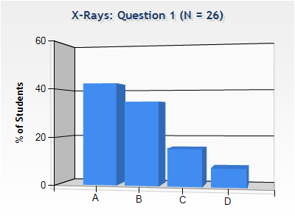
X-Rays
Checkpoint
K_{α}
K_{β}
K_{α}
K_{β}
intensity
intensity
λ
λ
λ₀
λ₀
These two plots correspond to X-Ray tubes that:
(1) Are operating at different voltages
(2) Contain different elements
(3) Both
(4) Neither

Slide 13
X-Rays
Checkpoint
K_{α}
K_{β}
K_{α}
K_{β}
intensity
intensity
λ
λ
λ₀
λ₀
These two plots correspond to X-Ray tubes that:
(1) Are operating at different voltages
(2) Contain different elements
(3) Both
(4) Neither
K_{α} and K_{β} are the same
λ_{o} is different

Slide 14
Which graph corresponds to the tube being operated at the higher voltage?
Top
Bottom
K_{α}
K_{β}
intensity
λ
K_{α}
intensity
K_{β}
λ

Slide 15
Which graph corresponds to the tube being operated at the higher voltage?
K_{α} and K_{β} are the same for each!
Higher voltage means higher energy deceleration x-ray photon can be produced, or smaller maximum wavelength, λ₀.
Top
Bottom
K_{α}
K_{β}
intensity
λ
K_{α}
intensity
K_{β}
λ

Slide 16
LASER
A device which produces light or some other form of electromagnetic radiation that is monochromatic (of a single wavelength), coherent (in step), and contained in narrow beam
Light
Amplification by
Stimulated
Emission of
Radiation

Slide 17
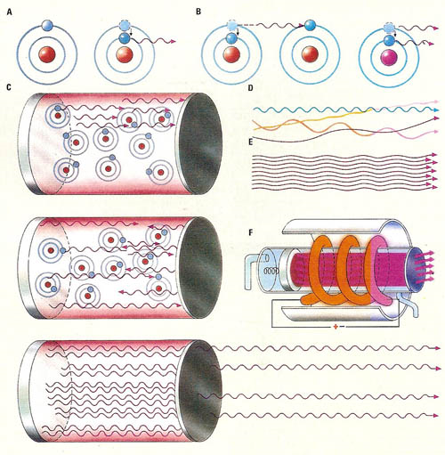
Laser Operation

Slide 18

Laser
A laser is a device that creates and amplifies a narrow, intense beam of coherent light.
In a ruby laser, light from the flash lamp, in what is called "optical pumping", excites the molecules in the ruby rod, and they bounce back and forth between two mirrors until coherent light escapes from the cavity.

