Slide 1

Nuclear Binding, Radioactivity
Physics 1161: Lecture 25
Sections 32-1 – 32-9
Notes:
1

Slide 2
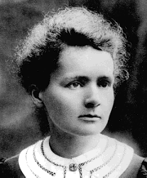
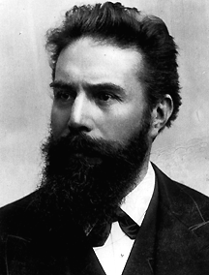
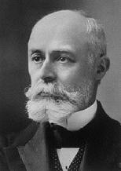
Radioactivity
Polonium and radium
X-Rays
emitted
by cathode
ray tube
Marie Curie
1867 - 1934
Wilhelm Roentgen
1845 - 1923
Spontaneous emission of radiation from the nucleus of an unstable isotope.
Uranium
produced
X-rays
Antoine Henri Becquerel
1852 - 1908

Slide 3
Nuclear Physics
A
Z
Nucleus = Protons+ Neutrons
nucleons
Z = proton number (atomic number)
Gives chemical properties (and name)
N = neutron number
A = nucleon number (atomic mass number)
Gives you mass density of element
A=N+Z
Periodic_Table

Slide 4
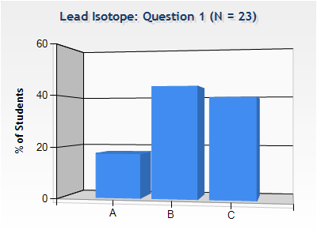
Lead Isotope
Checkpoint
A material is known to be an isotope of lead, although the particular isotope is not known. Which of the following can be specified?
The atomic mass number
The neutron number
The number of protons
Chemical properties (and name) determined by number of protons (Z)
Z=82

Slide 5
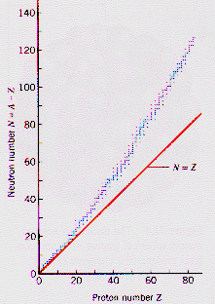
# protons = # neutrons
But protons repel one another (Coulomb Force) and when Z is large it becomes harder to put more protons into a nucleus without adding even more neutrons to provide more of the Strong Force. For this reason, in heavier nuclei N>Z.

Slide 6
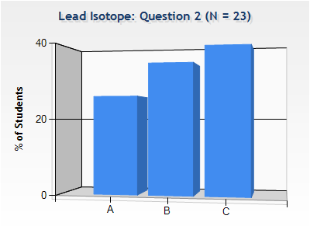
Lead Isotope
Checkpoint
Where does the energy released in the nuclear reactions of the sun come from?
covalent bonds between atoms
binding energy of electrons to the nucleus
binding energy of nucleons

Slide 7
Strong Nuclear Force
Acts on Protons and Neutrons
Strong enough to overcome Coulomb repulsion
Acts over very short distances
  Two atoms don’t feel force
Notes:
What keeps protons together?

Slide 8
Strong Nuclear Force
Hydrogen atom: Binding energy =13.6eV
(of electron to nucleus)
Coulomb force
proton
electron
neutron
proton
Simplest Nucleus: Deuteron=neutron+proton
Very strong force
Binding energy of deuteron = or 2.2Mev! That’s around 200,000 times bigger!

Slide 9
Binding Energy
Einstein’s famous equation E = m c²
Example
Proton: mc² = 938.3MeV
Adding these, get 1877.8MeV
Neutron: mc²= 939.5MeV
Difference is Binding energy, 2.2MeV
Deuteron: mc² =1875.6MeV
M_{Deuteron} = M_{Proton} + M_{Neutron} – |Binding Energy|

Slide 10
Binding Energy Plot
Iron (Fe) has the most binding energy/nucleon. Lighter have too few nucleons, heavier have too many.
10
Fission
BINDING ENERGY in MeV/nucleon
Fission = Breaking large atoms into small
Fusion
Fusion = Combining small atoms into large

Slide 11
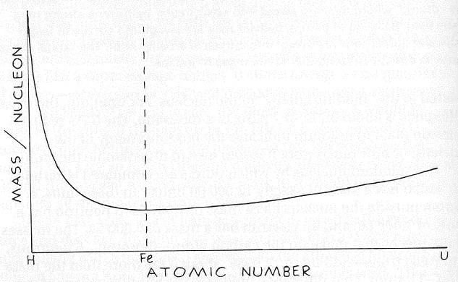
Mass/Nucleon vs Atomic Number
Fusion
Fission

Slide 12
E = mc²
E: energy
m: mass
c: speed of light
c = 3 x 10⁸ m/s

Slide 13
E = mc²
Mass can be converted to energy
Energy can be converted to mass
Mass and energy are the same thing
The total amount of mass plus energy in the universe is constant

Slide 14
Mass Defect in Fission
When a heavy element (one beyond Fe) fissions, the resulting products have a combined mass which is less than that of the original nucleus.

Slide 15
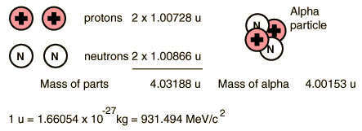
Mass Defect of Alpha Particle
Mass difference = 0.0304 u
Binding energy = 28.3 MeV
Fusion product has less mass than the sum of the parts.

Slide 16
Which of the following is most correct for the total binding energy of an Iron atom (Z=26)?
9 MeV
234 MeV
270 MeV
504 Mev
BINDING ENERGY in MeV/nucleon

Slide 17
Which of the following is most correct for the total binding energy of an Iron atom (Z=26)?
9 MeV
234 MeV
270 MeV
504 Mev
BINDING ENERGY in MeV/nucleon
For Fe, B.E./nucleon ≈ 9MeV
has 56 nucleons
Total B.E ≈ 56x9=504 MeV

Slide 18
3 Types of Radioactivity
B field into screen
Radioactive sources
detector
α particles: nucleii
Easily Stopped
β⁻ particles: electrons
Stopped by metal
γ : photons (more energetic than x-rays) penetrate!

Slide 19
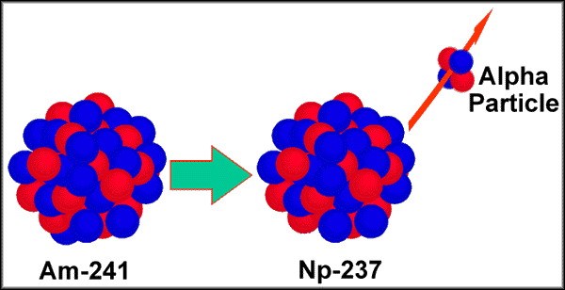
Alpha Decay
Alpha decay occurs when there are too many protons in the nucleus which cause excessive electrostatic repulsion.
An alpha particle is ejected from the nucleus.
An alpha particle is 2 protons and 2 neutrons.
An alpha particle is also a helium nucleus.
Alpha particle symbol:

Slide 20
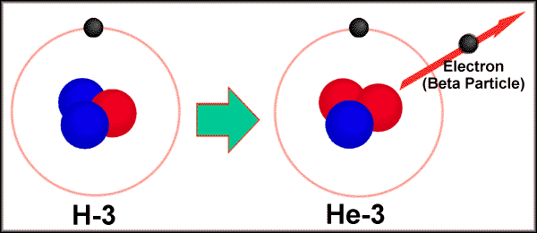
Beta Decay
Beta decay occurs when neutron to proton ratio is too big
A neutron is turned into a proton and electron and an antineutrino
The electron and the antineutrino are emitted

Slide 21
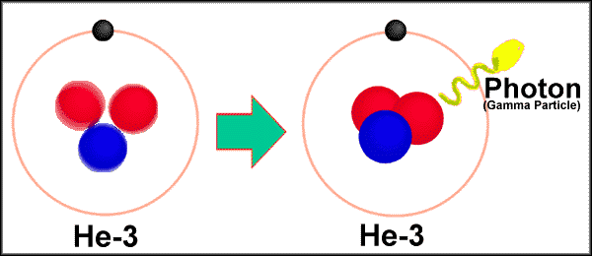
Gamma Decay
Gamma decay occurs when the nucleus is at too high an energy
Nucleus falls down to a lower energy level
High energy photon – gamma ray - is emitted

Slide 22
Decay Rules
Example
Nucleon Number is conserved.
Atomic Number (charge) is conserved.
Energy and momentum are conserved.
α: example
recall
238 = 234 + 4 Nucleon number conserved
92 = 90 + 2 Charge conserved
β: example
Needed to conserve energy and momentum.
γ: example

Slide 23
A nucleus undergoes α decay. Which of the following is FALSE?
Nucleon number decreases by 4
Neutron number decreases by 2
Charge on nucleus increases by 2

Slide 24
A nucleus undergoes α decay. Which of the following is FALSE?
Nucleon number decreases by 4
Neutron number decreases by 2
Charge on nucleus increases by 2
α decay is the emission of
A decreases by 4
Z decreases by 2
(charge decreases!)

Slide 25
The nucleus undergoes decay. Which of the following is true?
The number of protons in the daughter nucleus increases by one.
The number of neutrons in the daughter nucleus increases by one.
decay involves emission of an electron:
creation of a charge -e.
In fact, inside the nucleus, and
the electron and neutrino “escape.”

Slide 26
Radioactive Decay
4.5 x 10⁹ yr half-life
24 day half-life
1.17 min half-life
250,000 yr half-life

Slide 27
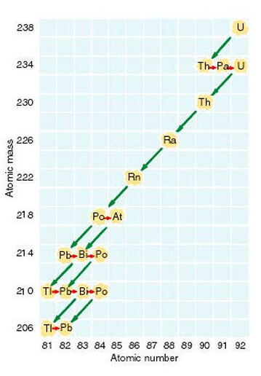
U 238 Decay
Decay Series

Slide 28
Nuclear Decay Links
http://physics.bu.edu/cc104/uudecay.html
http://www.physics.umd.edu/lecdem/honr228q/notes/U238scheme.gif
http://www.physics.umd.edu/lecdem/honr228q/notes/fourdecschemes.gif

Slide 29
Which of the following decays is NOT allowed?

Slide 30
Which of the following decays is NOT allowed?
238 = 234 + 4
92 = 90 + 2
214 = 210 + 4
84 = 82 + 2
14 = 14+0
6 <> 7+0
40 = 40+0+0
19 = 20-1+0

Slide 31
Decays per second, or “activity”:
If the number of radioactive nuclei present is cut in half, how does the activity change?
No. of nuclei present
decay constant
It remains the same
It is cut in half
It doubles

Slide 32
Decays per second, or “activity”
Start with 16 ¹⁴C atoms.
After 6000 years, there are only 8 left.
How many will be left after another 6000 years?
No. of nuclei present
decay constant
0
4
6
Every 6000 years ½ of atoms decay

Slide 33
Decay Function
time

Slide 34
Radioactivity Quantitatively
Decays per second, or “activity”
No. of nuclei present
decay constant
Survival:
No. of nuclei present at time t
No. we started with at t=0
Instead of base e we can use base 2:
where
Half life
Then we can write

Slide 35
Carbon Dating
Cosmic rays cause transmutation of Nitrogen to Carbon-14
C-14 is radioactive with a half-life of 5730 years
  It decays back to Nitrogen by beta decay
The ratio of C-12 (stable) atoms to C-14 atoms in our atmosphere is fairly constant – about 10¹²/1
This ratio is the same in living things that obtain their carbon from the atmosphere

Slide 36
You are radioactive!
Example
One in 8.3x10¹¹ carbon atoms is ¹⁴C which β⁻ decays with a ½ life of 5730 years. Determine # of decays/gram of Carbon.

Slide 37
Carbon Dating
We just determined that living organisms should have a decay rate of about 0.23 decays/ gram of carbon.
The bones of an ice man are found to have a decay rate of 0.115 decays/gram. We can estimate he died about 6000 years ago.
Example

Slide 38
Summary
Nuclear Reactions
  Nucleon number conserved
  Charge conserved
  Energy/Momentum conserved
  α particles = nuclei
  β⁻ particles = electrons
  γ particles = high-energy photons
Decays
  Half-Life is time for ½ of atoms to decay
Survival:

Slide 39
Mass/Nucleon vs Atomic Number
Fusion
Fusion
Fission
Fission

Slide 40
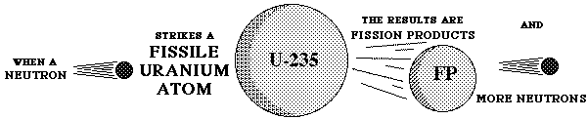
U-235 -- Fissile

Slide 41
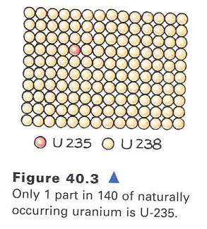
Abundance of U-235

Slide 42

U-235 Fission by
Neutron Bombardment

Slide 43
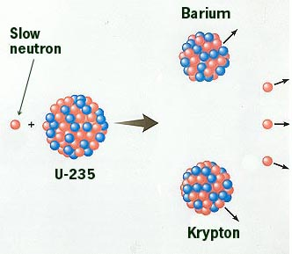
Possible U-235 Fission

Slide 44
How Stuff Works Site
Visit the How Stuff Works Site to learn more details about nuclear energy

Slide 45
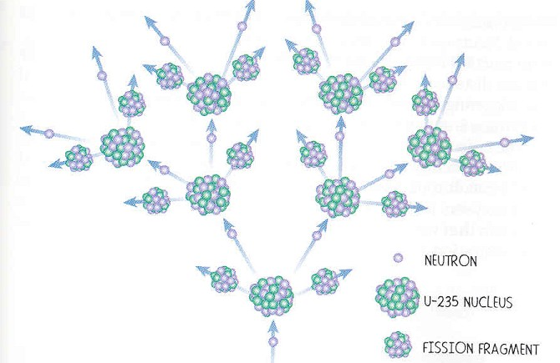
Chain Reaction

Slide 46
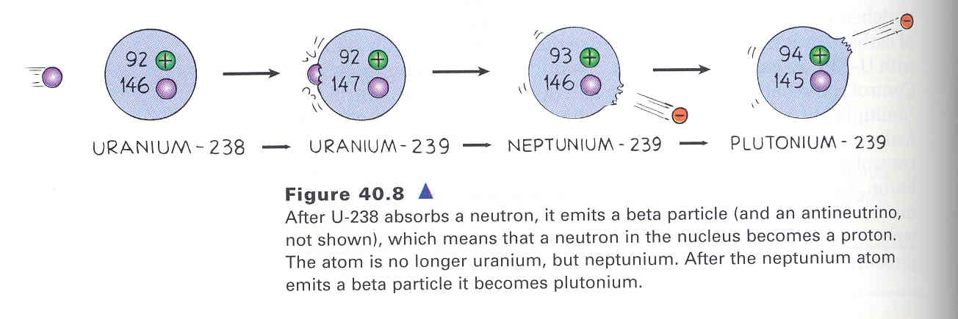
Plutonium Production

Slide 47
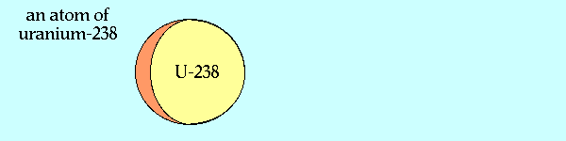
U-238 – Not Fissile

Slide 48
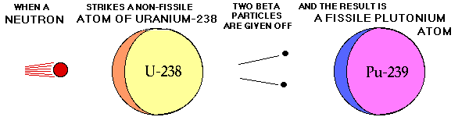
Breeder Reaction

Slide 49
Breeder Reactor
Small amounts of Pu-239 combined with U-238
Fission of Pu frees neutrons
These neutrons bombard U-238 and produce more Pu-239 in addition to energy

