Slide 1
Temperature, Heat, and Expansion

Slide 2
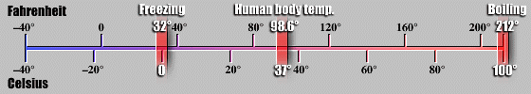
Temperature
Most materials expand when heated
Liquid thermometers based on mercury or alcohol expansion are common
Temperature is related to the random motion of atoms and molecules in a substance.
temperature is proportional to the average “translational” kinetic energy of molecular motion

Slide 3
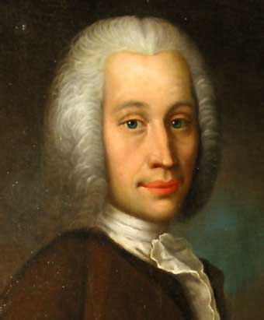
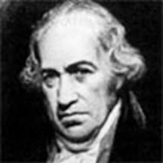
Fahrenheit & Celsius
Gabriel Daniel Fahrenheit
1686 -- 1736
Anders Celsius
1701-1744

Slide 4
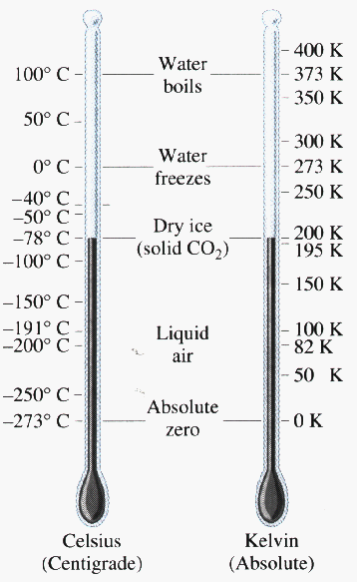
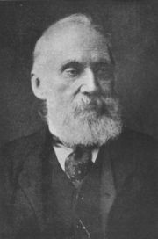
Kelvin Scale
William Thomson
(Lord Kelvin)
1824 -- 1907

Slide 5
Heat
energy transferred from one thing to another because of a temperature difference between the things is called heat
Heat is energy in transit – matter does NOT contain heat

Slide 6
Internal Energy
Internal energy -- grand total of all energies inside a substance.
  translational kinetic energy of jostling molecules in a substance
  rotational kinetic energy of molecules
  kinetic energy due to internal movements of atoms within molecules
  potential energy due to the forces between molecules.
So a substance does not contain heat—it contains internal energy.

Slide 7
Temperature vs Internal Energy
Which has more internal energy?
There is more molecular kinetic energy in the container filled with warm water than in the small cupful of higher temperature water.

Slide 8
Heat in Joules
heat is the flow of energy from one thing to another due to a temperature difference
heat is measured in joules
1 Joule = energy required (or work done) in lifting 1 N (100 grams) 1 meter.

Slide 9
Definition of calorie
in the US, calorie is more common
calorie is defined as the amount of heat required to change the temperature of 1 gram of water by 1 Celsius degree
1 calorie = 4.184 J

Slide 10
calorie vs Calorie
the peanut contains 10 Calories
it releases 10,000 calories (or 41,840 joules) of energy when burned or consumed
1 Calorie = 1 kilocalorie

Slide 11
Question
An iron thumbtack and a big iron bolt are removed from a hot oven. They are red hot and have the same temperature. When dropped into identical containers of water of equal temperature, which one raises the water temperature more?

Slide 12
Specific Heat Capacity
The specific heat capacity (or just specific heat) of any substance is defined as the quantity of heat required to change the temperature of a unit mass of the substance by 1 degree.
It is like thermal inertia
Water has a much higher capacity for storing energy than all but a few uncommon materials

Slide 13
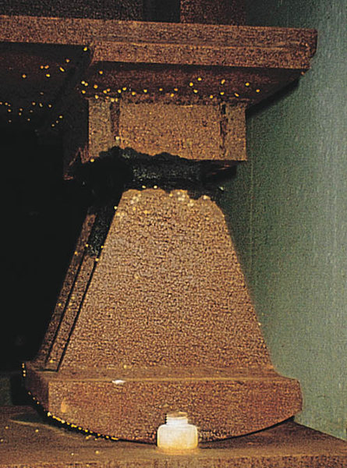

Thermal Expansion

Slide 14
Expansion Curve of Water
As the temperature of water initially at 0°C rises, the simultaneous collapse of ice crystals and increase in molecular motion produce the overall effect of water being most dense at 4°C.

Slide 15
Freezing Lakes
As water cools, it sinks until the entire pond is 4°C. Then, as water at the surface is cooled further, it floats on top and can freeze. Once ice is formed, temperatures lower than 4°C can extend down into the pond.

