Slide 1
Color & Vision

Slide 2
Parts of the Eye

Slide 3
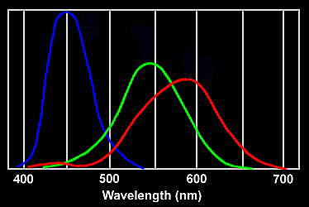
3 types of cones in retina
Each responds more strongly to wavelength for which it is named
As the cones are stimulated in different proportions, our visual system constructs the colors we see.

Slide 4
Color Links
Color Mixing – Truscio
Color Tutorial – Jewitt
Physics Classroom – Color
Colors of Light Song
Physics 2000
Color Java Applets
Ishihara Test for Color Blindness

Slide 5

Primary Light Colors and Color Addition
Complementary Colors

Slide 6
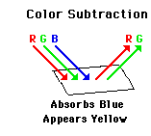
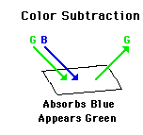
Color Subtraction

Slide 7
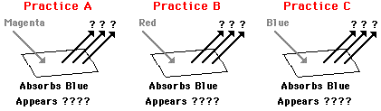
Color Subtraction Practice
Magenta light shines on a sheet of paper containing a yellow pigment. Determine the appearance of the paper.
Yellow light shines on a sheet of paper containing a blue pigment. Determine the appearance of the paper.

Slide 8
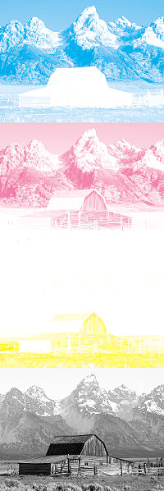

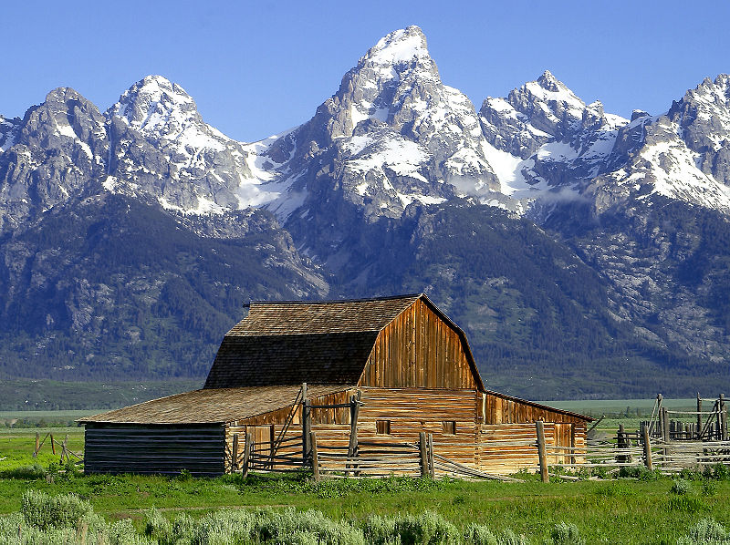
4 Color Printing

Slide 9
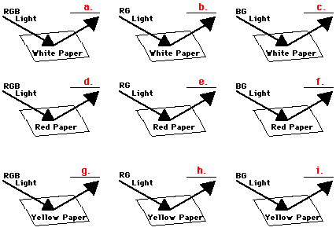
Pigments

Slide 10
Mixing Pigments
Suppose an object is permeated by a mixture of two or more pigments and illuminated with white light. Complete the table.
Pigment One | Pigment Two | Colors Reflected | Color Observed
Cyan | Magenta
Magenta | Yellow
Cyan | Yellow
Cyan, Magenta | Yellow

Slide 11
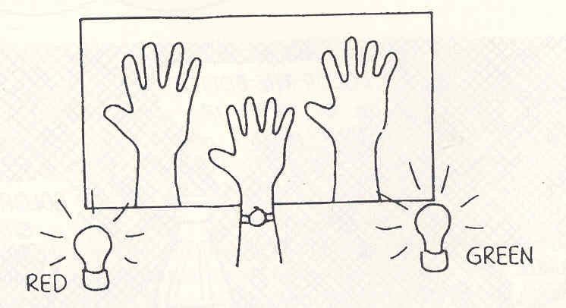
Color Shadows – 2 Lights

Slide 12
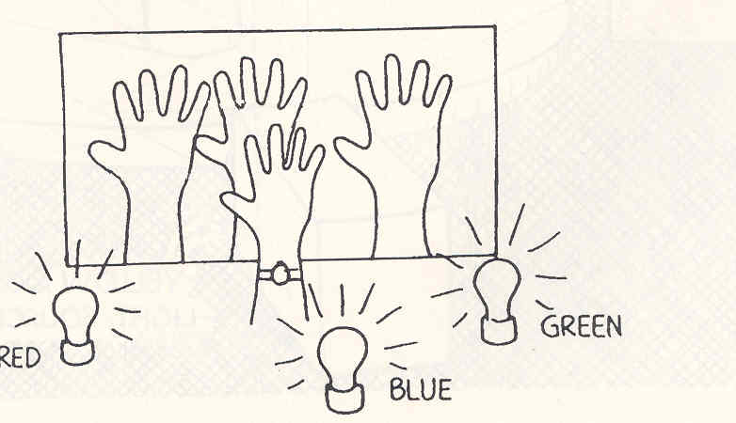
Color Shadows – 3 Lights

Slide 13
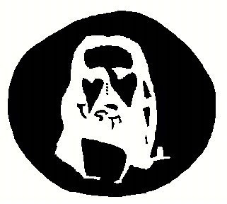
Retinal Fatigue

Slide 15
Flag

Slide 17

The Rose

Slide 19
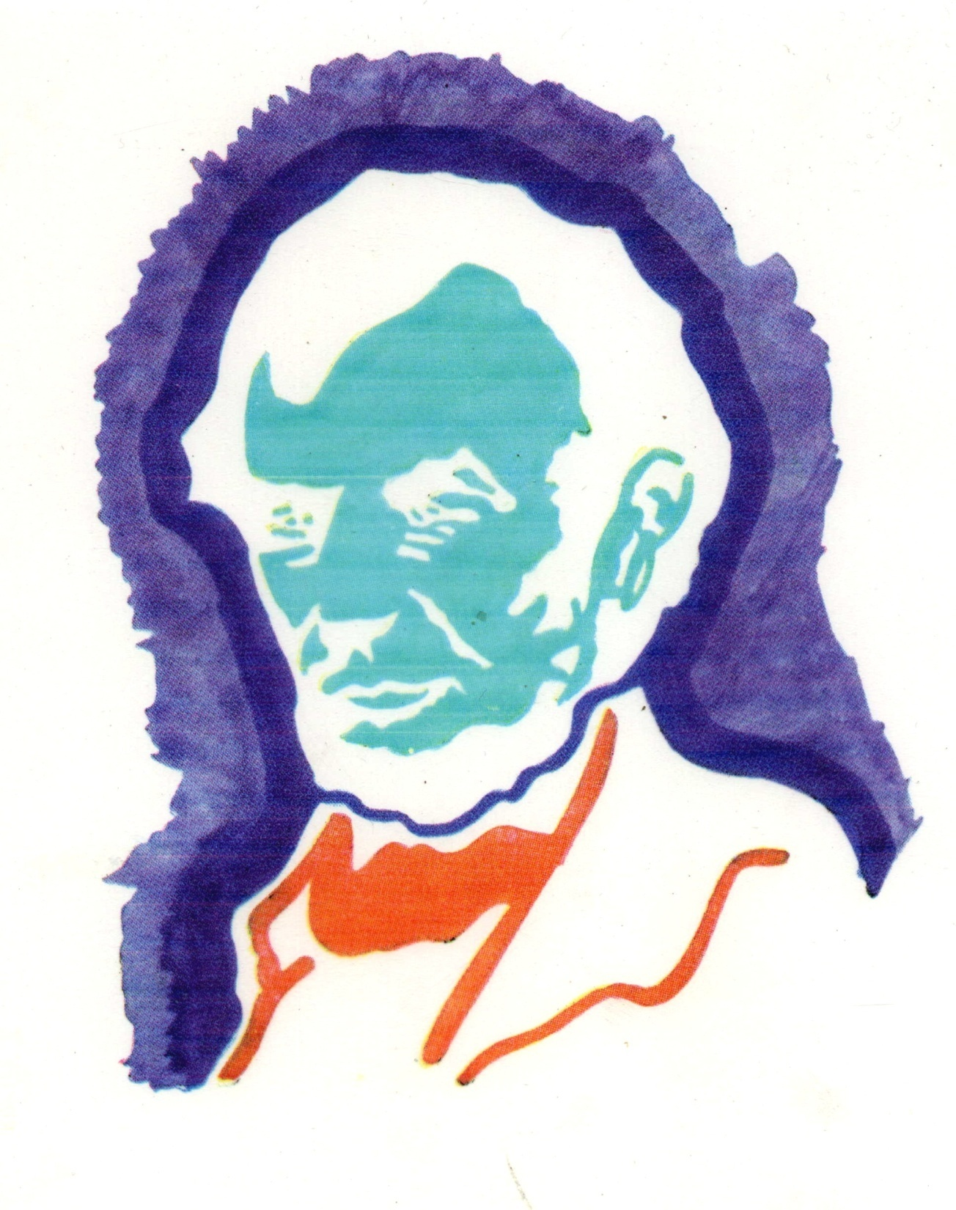

Slide 23
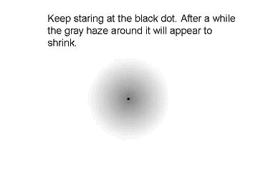
Black dot

Slide 24
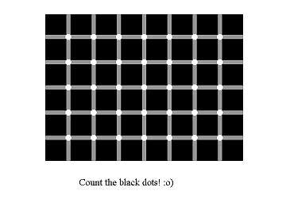
Black Dots

Slide 25
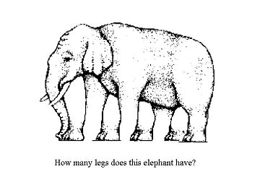
Elephant Legs

Slide 26
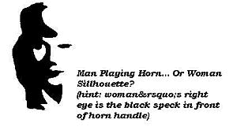
Man & Woman

Slide 27
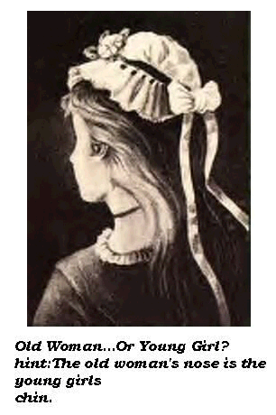
Old Woman … Young Girl

Slide 28
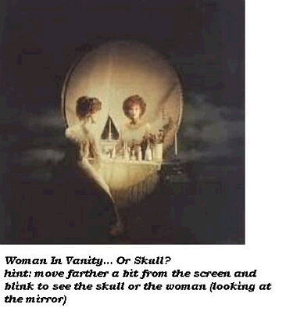
Vanity

Slide 29
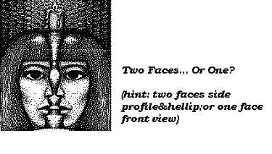
Two Faces … Or One?

Slide 30
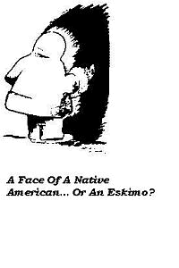
Face or Aleut

Slide 31
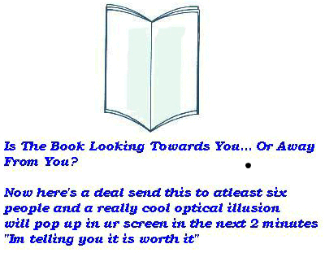
Book

Slide 32
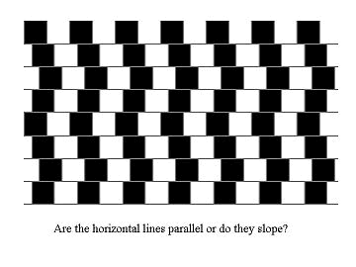
Lines

Slide 33
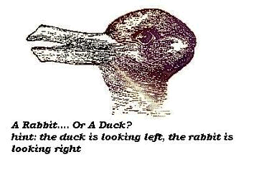
Rabbit Duck

Slide 35
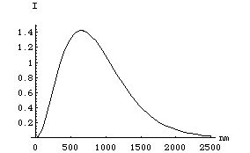
Spectral Distribution of Sun

Slide 36
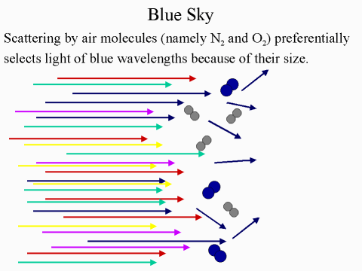
Scattering

Slide 37
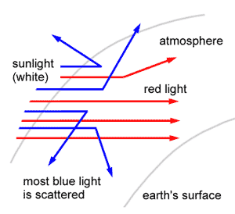
Scattering

Slide 38
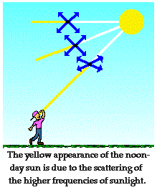
Why is the Sky Blue
Blue Sky – Red Sunset

Slide 39
http://www.stillmoving.ca/physics/faq/General/BlueSky/blue_sky.html

Slide 40
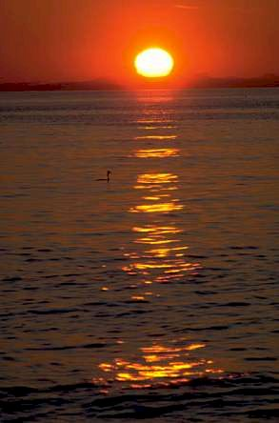

Slide 41
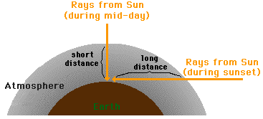

Slide 42
Assorted Links
Link Showing Absorption Graph
Smithsonian Link

