Slide 1
Gases and Plasmas

Slide 2
Earth’s Atmosphere
Balance of
  Gravity
  Energy
More compressed at sea level than at higher altitudes
Moon has no atmosphere

Slide 3
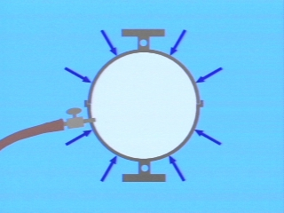
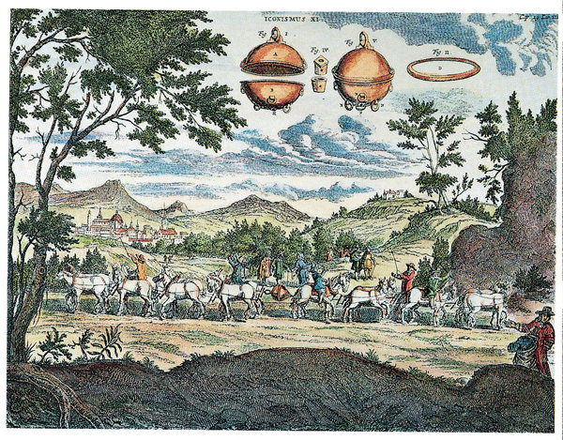
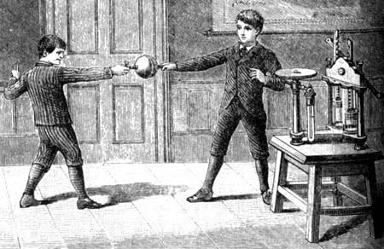
Magdeburg Hemispheres
Two teams of horses couldn't pull the evacuated hemispheres apart.

Slide 4
Weight of Air
mass of air that would occupy a thin bamboo pole that extends 30 km up—to the “top” of the atmosphere—is about 1 kg.
This air weighs about 10 N.

Slide 5
Weight of Air
weight of air bearing down on a one-square-meter surface at sea level is about 100,000 N
atmospheric pressure is about 10⁵ N/m², or about 100 kPa.
At sea level, 1 cubic meter of air has a mass of about 1 1/4 kilograms

Slide 6
Check Yourself
About how many kilograms of air occupy a classroom that has a 200-m² floor area and a 4-m-high ceiling? (Assume a chilly 10°C temperature.)

Slide 7
Check Yourself
Why doesn't the pressure of the atmosphere break windows?

Slide 8
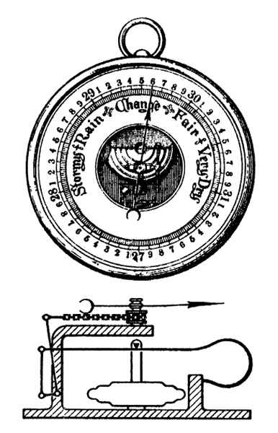
Barometers
Barometer – instrument for measuring atmospheric pressure

Slide 9
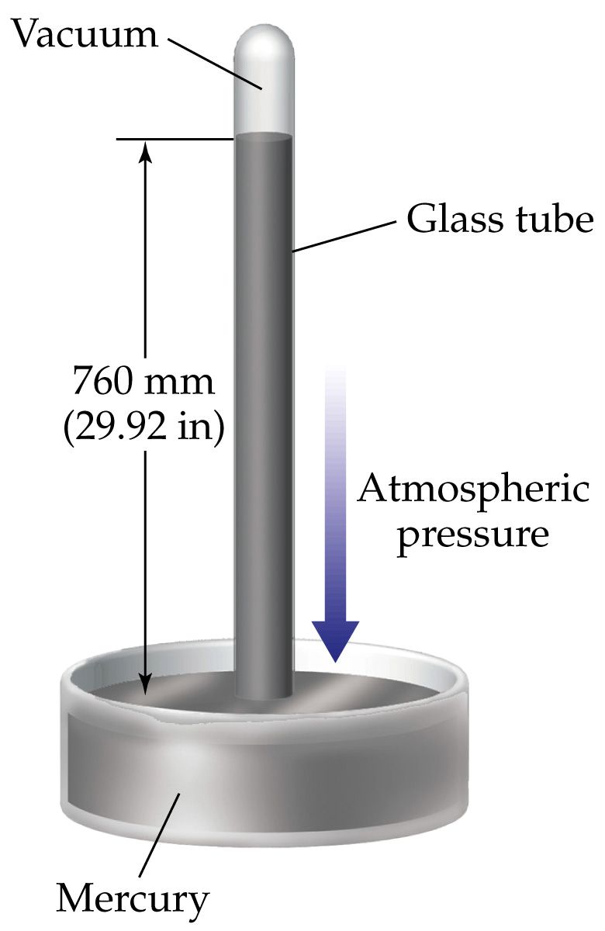
Mercury Barometer
The barometer “balances” when the weight of liquid in the tube exerts the same pressure as the atmosphere outside
Whatever the width of the tube, a 76-centimeter column of mercury weighs the same as the air that would fill a super-tall 30-kilometer tube of the same width
mercury is literally pushed up into the tube of a barometer by the weight of the atmosphere.

Slide 10
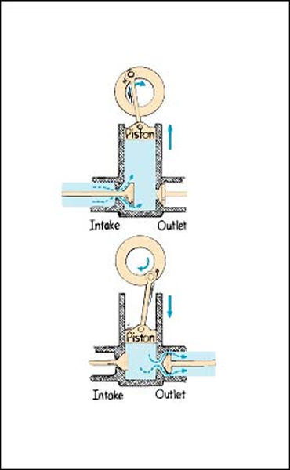
Vacuum
air pressure is repeatedly lowered by piston and valve action
best vacuums attainable with mechanical pumps are about 1 pascal.
Better vacuums, down to 10⁻⁸ Pa, are attainable with vapor diffusion or vapor jet pumps.
Sublimation pumps can reach 10⁻¹² Pa. Greater vacuums are very difficult to attain

Slide 11
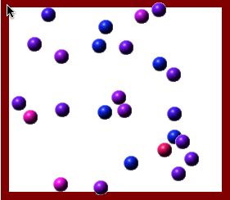
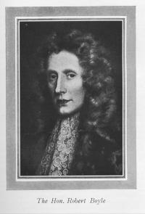
Gas Molecules
Behavior of Gas Molecules
Kinetic Theory Applet
Gas molecules are perpetually moving
Robert Boyle (1627-1691)

Slide 12
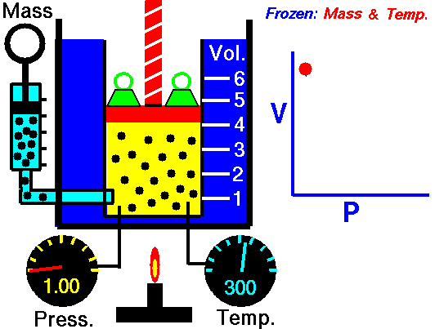
Boyle’s Law

Slide 13
Check Yourself
A piston in an airtight pump is withdrawn so that the volume of the air chamber is increased three times. What is the change in pressure?

Slide 14
Check Yourself
A scuba diver 10.3 m deep breathes compressed air. If she were to hold her breath while returning to the surface, by how much would the volume of her lungs tend to increase?

Slide 15
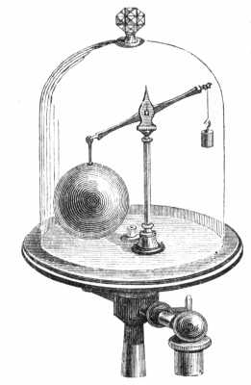
Buoyancy of Air
Archimedes' principle holds for air just as it does for water:
An object surrounded by air is buoyed up by a force equal to the weight of the air displaced.
a cubic meter of air at ordinary atmospheric pressure and room temperature has a mass of about 1.2 kilograms
its weight is about 12 newtons
any 1-cubic-meter object in air is buoyed up with a force of 12 newtons.

Slide 16
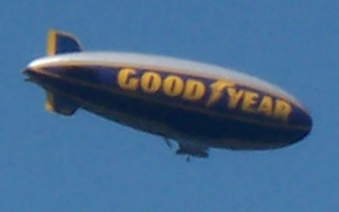
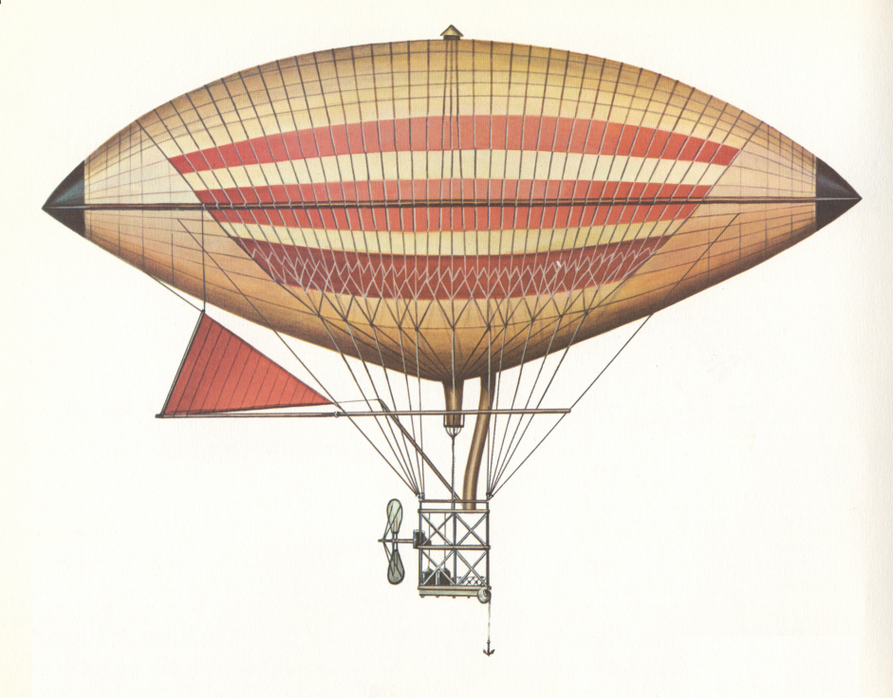
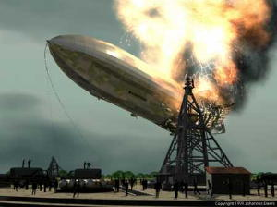
Dirigibles & Blimps
Large dirigible airships are designed so that when loaded they will slowly rise in air
their total weight is a little less than the weight of air displaced.
Hindenberg used hydrogen instead of helium

Slide 17
Check Yourself
Is there a buoyant force acting on you? If there is, why are you not buoyed up by this force?

Slide 18
Check Yourself
How does buoyancy change as a helium-filled balloon ascends?

Slide 19
Rising Balloon
(Left) At ground level the balloon is partially inflated.
(Right) The same balloon is fully inflated at high altitudes where surrounding pressure is less.

Slide 20
Fluid Flow
Water speeds up when it flows into the narrower pipe.
The motion of a fluid in steady flow follows imaginary streamlines, represented by thin lines
Streamlines are visible when smoke or other visible fluids are passed through evenly spaced openings, as in a wind tunnel.
Streamlines are the smooth paths, or trajectories, of bits of fluid.
One small bit of fluid follows along the same path as a bit of fluid in front of it.
The lines are closer together in narrower regions, where the flow speed is greater.

Slide 21
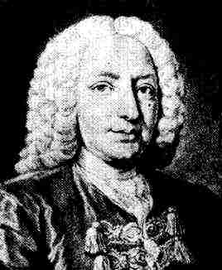
Bernoulli’s Principle
Where the speed of a fluid increases, internal pressure in the fluid decreases.
Daniel Bernoulli
1700-1782
Internal pressure is greater in slower moving water in the wide part of the pipe, as evidenced by the more squeezed air bubbles.
The bubbles are bigger in the narrow part because internal pressure there is less.

Slide 22
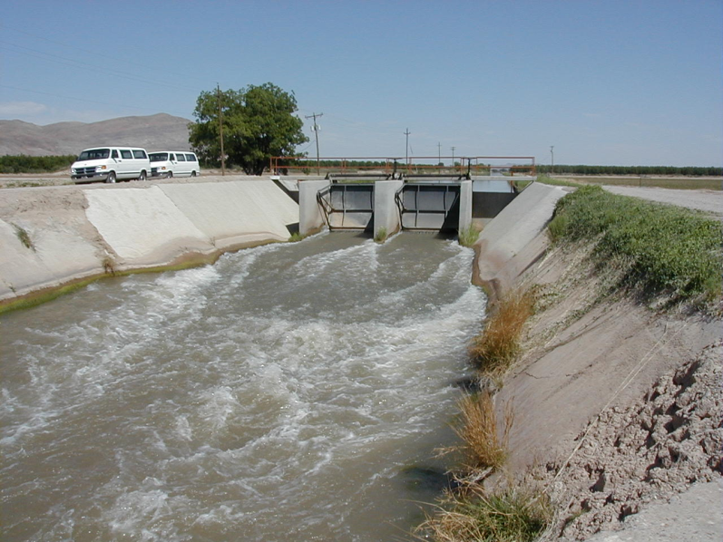
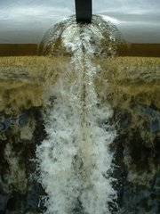
Bernoulli’s Principle
Bernoulli's principle applies to a smooth, steady flow (called laminar flow) of constant-density fluid.
At speeds above some critical point, however, the flow may become chaotic (called turbulent flow) and follow changing, curling paths called eddies.

Slide 23
Bernoulli Applications
The streamlines are the same on either side of a non-spinning baseball.
A spinning ball produces a crowding of streamlines. The resulting “lift” (red arrow) causes the ball to curve as shown by the blue arrow.
Air pressure above the roof is less than air pressure beneath the roof.
The vertical vector represents the net upward force (lift) that results from more air pressure below the wing than above the wing. The horizontal vector represents air drag.
Wing lift

Slide 24
Bernoulli Applications
When you squeeze the bulb, air rushes across the open end of a tube that sticks into the perfume. This reduces pressure in the tube, whereupon atmospheric pressure on the liquid below pushes it up into the tube where it is carried away by the stream of air.
Pressure is greater in the stationary fluid (air) than in the moving fluid (water stream). The atmosphere pushes the ball into the region of reduced pressure.

Slide 25
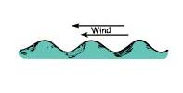
Bernoulli Applications
The troughs of the waves are partially shielded from the wind, so air travels faster over the crests.
Pressure there is therefore lower than down below in the troughs.
The greater pressure in the troughs pushes water into the even higher crests.

Slide 26
Plasma
Plasma – 4th phase of matter – electrified gas
Least common in everyday world
Most prevalent in the universe – stars
Also found in gas inside operating
  fluorescent light tubes
  neon sign tubes
  vapor lights
MagnetoHydroDynamic Power

