Slide 1
Wave
Transfers Energy Without Transferring Matter

Slide 2
Wave
A wave can be described as a disturbance that travels through a medium from one location to another location.

Slide 3
There are three types of waves:
Mechanical waves require a material medium to travel (air, water, ropes).
Electromagnetic waves do not require a medium to travel (light, radio).
Matter waves quantum mechanical waves – particles also exhibit wave properties

Slide 4
Mechanical Waves
Transverse waves cause particles of medium to move perpendicular to the direction of the wave.
Longitudinal waves cause particles of medium to move parallel to the direction of the wave.
Surface waves – particles of medium oscillate in circular paths
Torsional waves produce a twisting motion through the medium – such as the ones which caused the collapse of the Tacoma Narrows Bridge.

Slide 5
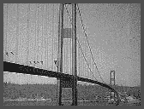
Tacoma Narrows Bridge
Torsional Oscillation
Mechanical Universe Video

Slide 6
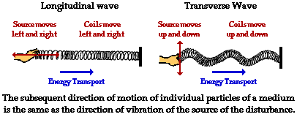

3 Types of Mechanical Waves

Slide 7
Wave Tutorial Links
http://library.thinkquest.org/10796/ch8/ch8.htm
http://www.physicsclassroom.com/Class/waves/wavestoc.html

Slide 8

Longitudinal Tuning Fork Wave
Vibrating tines produce an alternating pattern of high pressure and low pressure regions.
This pattern travels away from the fork.
Compression – high pressure
Rarefaction – low pressure

Slide 9

Period: T
The PERIOD of a wave is the time for a particle of the medium to complete one oscillation.
The SI unit for period is the second.

Slide 10
Frequency: f
The FREQUENCY of a wave is the number of cycles per unit time.
The unit is Hertz (Hz) which is a cycle per second.
FREQUENCY is also the reciprocal of the period.

Slide 12
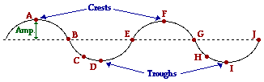
Amplitude: A
The AMPLITUDE of a wave is the maximum distance of a particle from the equilibrium position.
The SI unit for amplitude is meter

Slide 13
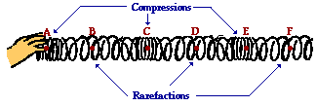
Wavelength: λ (lambda)
The WAVELENGTH of a wave is the length of one complete cycle.
It is the distance between two consecutive “in phase” points.
In phase points are those that are moving in step with each other.

Slide 14
Wave Applets
Wavelength, Amplitude, Phase
Frequency, Wavelength, Speed
Longitudinal Wave
Transverse Wave
Superposition Principle 1
Superposition Principle 2

Slide 15
Wave Equation
The speed of a wave is equal to the product of the wave’s frequency and wavelength.
v: wave speed
f: frequency
λ : wavelength

Slide 16
Superposition Principle
Wave interference occurs when two or more waves act simultaneously on a medium.
Whenever two or more waves pass through each other, the resulting disturbance at a given point in the medium may usually be found by adding the individual displacements that each wave would have caused. (Principle of Superposition)

Slide 17
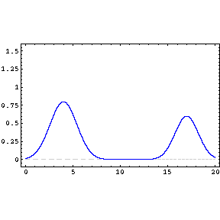
Constructive Interference
Constructive interference occurs when the waves are trying to displace the medium in the same direction.

Slide 18

Destructive Interference
When these two waves are completely overlapping, there will be complete destructive interference.
Destructive interference occurs when the waves are trying to displace the medium in opposite directions.

Slide 19
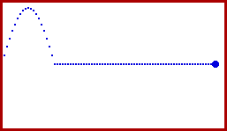
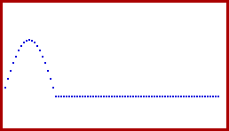

Pulse/Wave Reflection
Fixed End Reflection
Free End Reflection
Interference between incident and reflected pulse in a fixed end reflection
Fixed/Free End Reflection of Sine Wave

Slide 20
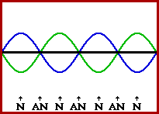
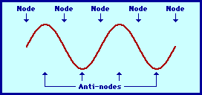
Standing Waves
For certain frequencies, the interference of the incident and reflected waves results in a standing wave pattern.

Slide 21
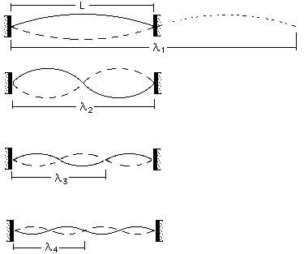
Fundamental Frequency and Harmonics

Slide 22
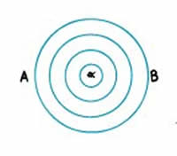
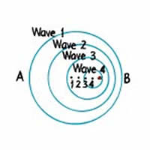

Doppler Effect
Doppler Effect Lesson

Slide 23
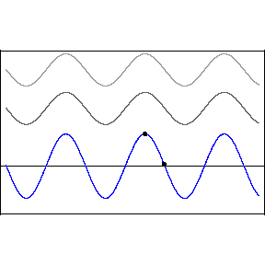
Waves Moving in and Out of Phase
When the 2 waves are in phase, the resulting disturbance has a maximum amplitude.
When the 2 waves are out of phase, the resulting disturbance has a minimum amplitude.

Slide 24
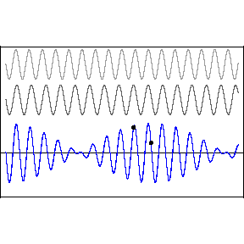
Beats
Waves of slightly different frequencies form a pattern of alternating maximum and minimum amplitude.
The packets of maximum amplitude are called beats.

