Slide 1

Chapter 14: Money and the Economy
© 2014 Cengage Learning. All Rights Reserved. May not be copied, scanned, or duplicated, in whole or in part, except for use as permitted in a license distributed with certain product , service, or otherwise on password-protected website for classroom use

Slide 2

In This Lecture…..
The Equation of Exchange
Monetarism
One-Shot Inflation and Continued Inflation
The Money Supply and Interest Rates
Nominal and Real Interest Rates
To select a topic, click on its link above
© 2014 Cengage Learning. All Rights Reserved. May not be copied, scanned, or duplicated, in whole or in part, except for use as permitted in a license distributed with certain product , service, or otherwise on password-protected website for classroom use

Slide 3
Money and the Price Level
The Classical View
Classical economists believed that changes in the money supply affect the price level in the economy, but not the level of output;
Based upon the Equation of Exchange which is an identity stating that the money supply times velocity* must be equal to the price level times Real GDP.
M x V ≡ P x Q
*The average number of times a dollar is spent to buy final goods and services in a year.
Click to return to “In this Lesson”
© 2014 Cengage Learning. All Rights Reserved. May not be copied, scanned, or duplicated, in whole or in part, except for use as permitted in a license distributed with certain product , service, or otherwise on password-protected website for classroom use

Slide 4
Equation of Exchange
M x V ≡ P x Q
where:
M represents Money Supply
V represents Velocity*
≡ means must be equal to
P represents Price
Q represents Real GDP
Click to return to “In this Lesson”
© 2014 Cengage Learning. All Rights Reserved. May not be copied, scanned, or duplicated, in whole or in part, except for use as permitted in a license distributed with certain product , service, or otherwise on password-protected website for classroom use

Slide 5
Calculating Velocity
In a large economy such as ours, it is impossible to simply count how many times each dollar changes hands (velocity).
As an alternative:
M x V = P x Q
GDP is equal to P x Q
M x V = GDP
V = GDP* / M*
GDP data is available from the Bureau of Economic Analysis;
M is available from the Federal Reserve.
Click to return to “In this Lesson”
© 2014 Cengage Learning. All Rights Reserved. May not be copied, scanned, or duplicated, in whole or in part, except for use as permitted in a license distributed with certain product , service, or otherwise on password-protected website for classroom use

Slide 6

Equation of Exchange - Revisited
M x V = Total Spending
P x Q = Total Sales Revenue of Business Firms (GDP)
so :
Total Spending
≡
Total Sales Revenue of Business Firms
Click to return to “In this Lesson”
© 2014 Cengage Learning. All Rights Reserved. May not be copied, scanned, or duplicated, in whole or in part, except for use as permitted in a license distributed with certain product , service, or otherwise on password-protected website for classroom use

Slide 7
Simple Quantity Theory of Money
The theory that assumes* that velocity (V) and Real GDP (Q) are constant and predicts that changes in the money supply (M) lead to strictly proportional changes in the price level (P).
M x V ≡ P x Q
*Note: “M x V ≡ P x Q” is an identity, not a theory.
‾‾‾
‾‾‾
Click to return to “In this Lesson”
© 2014 Cengage Learning. All Rights Reserved. May not be copied, scanned, or duplicated, in whole or in part, except for use as permitted in a license distributed with certain product , service, or otherwise on password-protected website for classroom use

Slide 8
Assumptions and Predictions of the
Simple Quantity Theory of Money
The simple quantity theory of money assumes that both V and Q are constant. (A bar over each indicates this in the exhibit.) The prediction is that changes in M lead to strictly proportional changes in P. Think of Q as “so many units of goods” and of P as the “average price paid per unit of these goods.”)
Click to return to “In this Lesson”
© 2014 Cengage Learning. All Rights Reserved. May not be copied, scanned, or duplicated, in whole or in part, except for use as permitted in a license distributed with certain product , service, or otherwise on password-protected website for classroom use

Slide 9

THE AD CURVE IN THE SIMPLE QUANTITY THEORY OF MONEY
M x V = Total Expenditures (TE)
TE = C + I + G + (X-M)
M x V = C + I + G + (X-M) = Aggregate Demand (AD)
Change in M and/or V will cause a change in AD
Click to return to “In this Lesson”
© 2014 Cengage Learning. All Rights Reserved. May not be copied, scanned, or duplicated, in whole or in part, except for use as permitted in a license distributed with certain product , service, or otherwise on password-protected website for classroom use

Slide 10
THE AD CURVE IN THE SIMPLE QUANTITY THEORY OF MONEY
M x V = Total Expenditures
TE = C + I + G + (X-M)
M x V = C + I + G + (X-M) = Aggregate Demand (AD)
Change in M and/or V will cause a change in AD
Click to return to “In this Lesson”
© 2014 Cengage Learning. All Rights Reserved. May not be copied, scanned, or duplicated, in whole or in part, except for use as permitted in a license distributed with certain product , service, or otherwise on password-protected website for classroom use

Slide 11
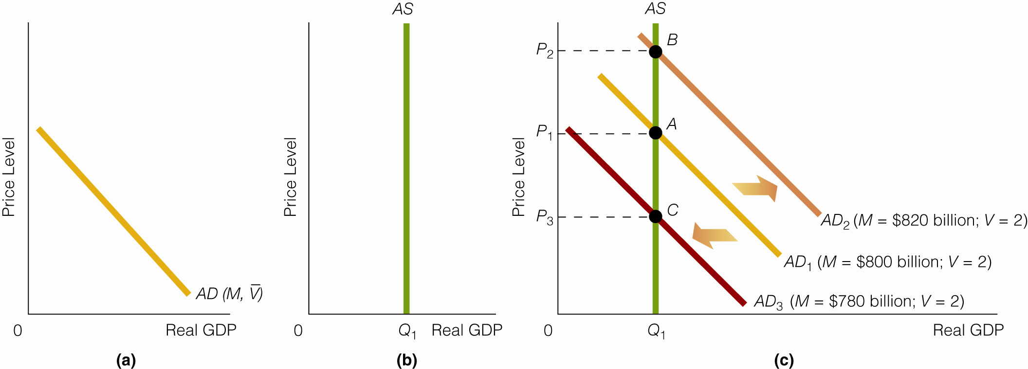
Aggregate Demand in the Simple Quantity Theory of Money
AD with V constant (a)
RGDP fixed in short run (b) -the level of Real GDP is assumed to be constant in the short run
M increases/decreases (c) causing AD to shift
Click to return to “In this Lesson”
© 2014 Cengage Learning. All Rights Reserved. May not be copied, scanned, or duplicated, in whole or in part, except for use as permitted in a license distributed with certain product , service, or otherwise on password-protected website for classroom use

Slide 12
Velocity and Real GDP Variable
If we drop the assumptions that velocity (V ) and Real GDP (Q) are constant, we have a more general theory of the factors that cause changes in the price level. In this theory, changes in the price level depend on three variables:
1. Money supply (M)
2. Velocity (V)
3. Real GDP (Q)
Click to return to “In this Lesson”
© 2014 Cengage Learning. All Rights Reserved. May not be copied, scanned, or duplicated, in whole or in part, except for use as permitted in a license distributed with certain product , service, or otherwise on password-protected website for classroom use

Slide 13
Velocity and Real GDP Variable
M x V ≡ P x Q
If the equation of exchange holds, then
P ≡ M x V
Q
An increase in M and/or V and/or a decrease in Q will cause prices to rise.
Click to return to “In this Lesson”
© 2014 Cengage Learning. All Rights Reserved. May not be copied, scanned, or duplicated, in whole or in part, except for use as permitted in a license distributed with certain product , service, or otherwise on password-protected website for classroom use

Slide 14
Self-test
1. If M times V increases, why does P times Q have to rise?
If M times V increases, total expenditures increase. In other words, people spend more. For example, instead of spending $3 billion on goods and services, they spend $4 billion. But if there is more spending (greater total expenditures), there must be greater total sales. P times Q represents this total dollar value of sales.
Click to return to “In this Lesson”
© 2014 Cengage Learning. All Rights Reserved. May not be copied, scanned, or duplicated, in whole or in part, except for use as permitted in a license distributed with certain product , service, or otherwise on password-protected website for classroom use

Slide 15
Self-test
2. What is the difference between the equation of exchange and the simple quantity theory of money?
The equation of exchange is a truism: MV necessarily equals PQ. This is similar to saying that 2 + 2 necessarily equals 4. It cannot be otherwise. The simple quantity theory of money, which is built on the equation of exchange, can be tested against real-world events.
(continued)
Click to return to “In this Lesson”
© 2014 Cengage Learning. All Rights Reserved. May not be copied, scanned, or duplicated, in whole or in part, except for use as permitted in a license distributed with certain product , service, or otherwise on password-protected website for classroom use

Slide 16
Self-test
That is, the simple quantity theory of money assumes that both velocity and Real GDP are constant and then, based on these assumptions, predicts that changes in the money supply will be strictly proportional to changes in the price level. Because this prediction can be measured against real-world data, the simple quantity theory of money may offer insights into the way the economy works. The equation of exchange does not do this.
Click to return to “In this Lesson”
© 2014 Cengage Learning. All Rights Reserved. May not be copied, scanned, or duplicated, in whole or in part, except for use as permitted in a license distributed with certain product , service, or otherwise on password-protected website for classroom use

Slide 17
Self-test
3. Predict what will happen to the AD curve as a result of each of the following: a. The money supply rises.
b. Velocity falls.
c. The money supply rises by a greater percentage than velocity falls.
d. The money supply falls.
a. AD curve shifts rightward.
b. AD curve shifts leftward.
c. AD curve shifts rightward.
d. AD curve shifts leftward.
Click to return to “In this Lesson”
© 2014 Cengage Learning. All Rights Reserved. May not be copied, scanned, or duplicated, in whole or in part, except for use as permitted in a license distributed with certain product , service, or otherwise on password-protected website for classroom use

Slide 18
Monetarism
Four Monetarists Positions
Velocity changes in a predictable way but does not change very much from one period to the next
Aggregate demand depends on the money supply and velocity
The SRAS curve is upward sloping
The economy is self regulating (prices and wages are flexible)
Click to return to “In this Lesson”
© 2014 Cengage Learning. All Rights Reserved. May not be copied, scanned, or duplicated, in whole or in part, except for use as permitted in a license distributed with certain product , service, or otherwise on password-protected website for classroom use

Slide 19
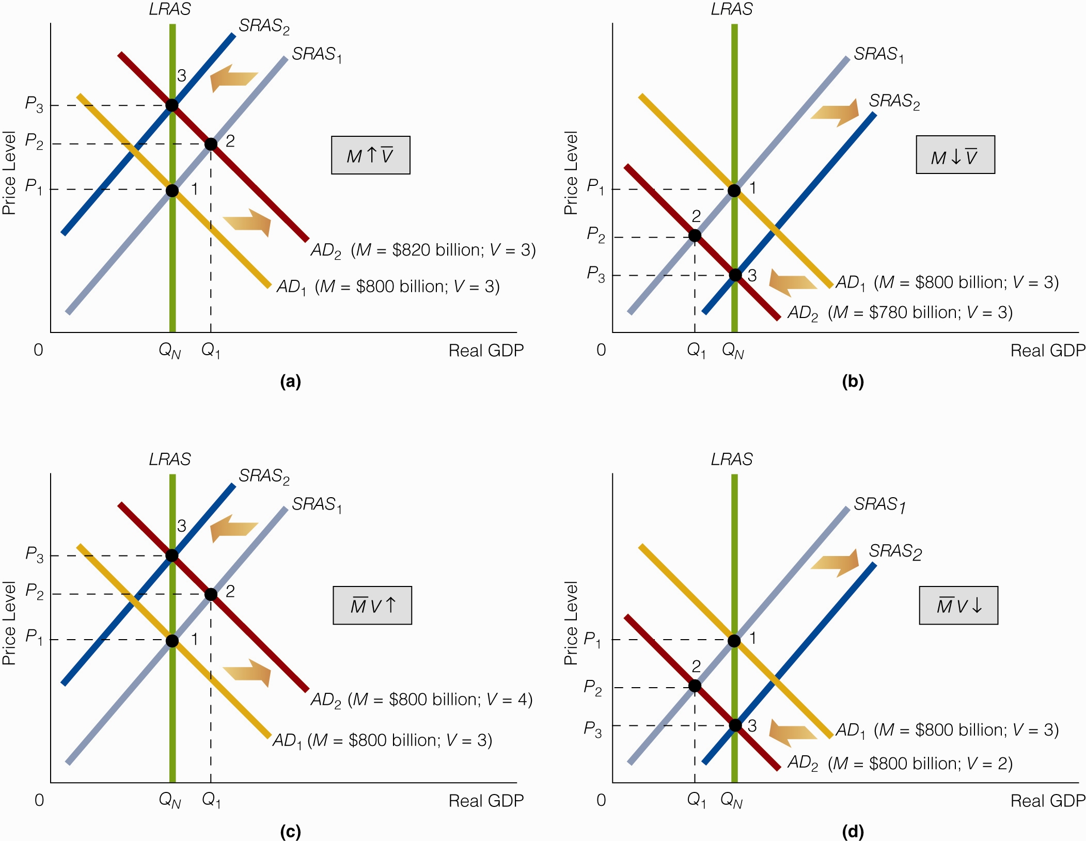
Monetarism in a AD–AS Framework If:
Money Supply Increases
Click to return to “In this Lesson”
© 2014 Cengage Learning. All Rights Reserved. May not be copied, scanned, or duplicated, in whole or in part, except for use as permitted in a license distributed with certain product , service, or otherwise on password-protected website for classroom use

Slide 20

Monetarism in a AD–AS Framework If:
Money Supply Decreases
Click to return to “In this Lesson”
© 2014 Cengage Learning. All Rights Reserved. May not be copied, scanned, or duplicated, in whole or in part, except for use as permitted in a license distributed with certain product , service, or otherwise on password-protected website for classroom use

Slide 21
Monetarism in a AD–AS Framework If:
Velocity Increases
Click to return to “In this Lesson”
© 2014 Cengage Learning. All Rights Reserved. May not be copied, scanned, or duplicated, in whole or in part, except for use as permitted in a license distributed with certain product , service, or otherwise on password-protected website for classroom use

Slide 22
Monetarism in a AD–AS Framework If:
Velocity Decreases
Click to return to “In this Lesson”
© 2014 Cengage Learning. All Rights Reserved. May not be copied, scanned, or duplicated, in whole or in part, except for use as permitted in a license distributed with certain product , service, or otherwise on password-protected website for classroom use

Slide 23
Monetarist View of the Economy
Monetarists believe:
the economy is self-regulating.
changes in velocity and the money supply can change aggregate demand.
changes in velocity and the money supply will change the price level and Real GDP in the short run but only the price level in the long run.
Click to return to “In this Lesson”
© 2014 Cengage Learning. All Rights Reserved. May not be copied, scanned, or duplicated, in whole or in part, except for use as permitted in a license distributed with certain product , service, or otherwise on password-protected website for classroom use

Slide 24
Self-test
1.What do monetarists predict will happen in the short run and in the long run as a result of each of the following (in each case, assume the economy is currently in long-run equilibrium)?
a. Velocity rises. .
As velocity rises, the AD curve shifts to the right. In the short run, P and Q rise. In the long run, Q will return to its original level, and P will be higher than it was in the short run.
b. Velocity falls.
As velocity falls, the AD curve shifts to the left. In the short run, P and Q fall. In the long run, Q will return to its original level, and P will be lower than it was in the short run.
(continued)
Click to return to “In this Lesson”
© 2014 Cengage Learning. All Rights Reserved. May not be copied, scanned, or duplicated, in whole or in part, except for use as permitted in a license distributed with certain product , service, or otherwise on password-protected website for classroom use

Slide 25
Self-test
c. The money supply rises.
As the money supply rises, the AD curve shifts to the right. In the short run, P and Q rise. In the long run, Q will return to its original level, and P will be higher than it was in the short run.
d. The money supply falls.
As the money supply falls, the AD curve shifts to the left. In the short run, P and Q fall. In the long run, Q will return to its original level, and P will be lower than it was in the short run
Click to return to “In this Lesson”
© 2014 Cengage Learning. All Rights Reserved. May not be copied, scanned, or duplicated, in whole or in part, except for use as permitted in a license distributed with certain product , service, or otherwise on password-protected website for classroom use

Slide 26
Self-test
2. Can a change in velocity offset a change in the money supply (on aggregate demand)? Explain your answer.
Yes, a change in velocity can offset a change in the money supply (on aggregate demand). Suppose that the money supply rises and velocity falls. A rise in the money supply shifts the AD curve to the right, and a fall in velocity shifts the AD curve to the left. If the strength of each change is the same, there is no change in AD.
Click to return to “In this Lesson”

Slide 27
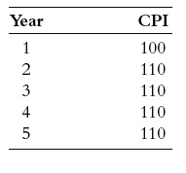
Inflation
Increase in the Price Level I
One-Shot Inflation - A one-time increase in the price level. An increase in the price level that does not continue.
Click to return to “In this Lesson”
© 2014 Cengage Learning. All Rights Reserved. May not be copied, scanned, or duplicated, in whole or in part, except for use as permitted in a license distributed with certain product , service, or otherwise on password-protected website for classroom use

Slide 28
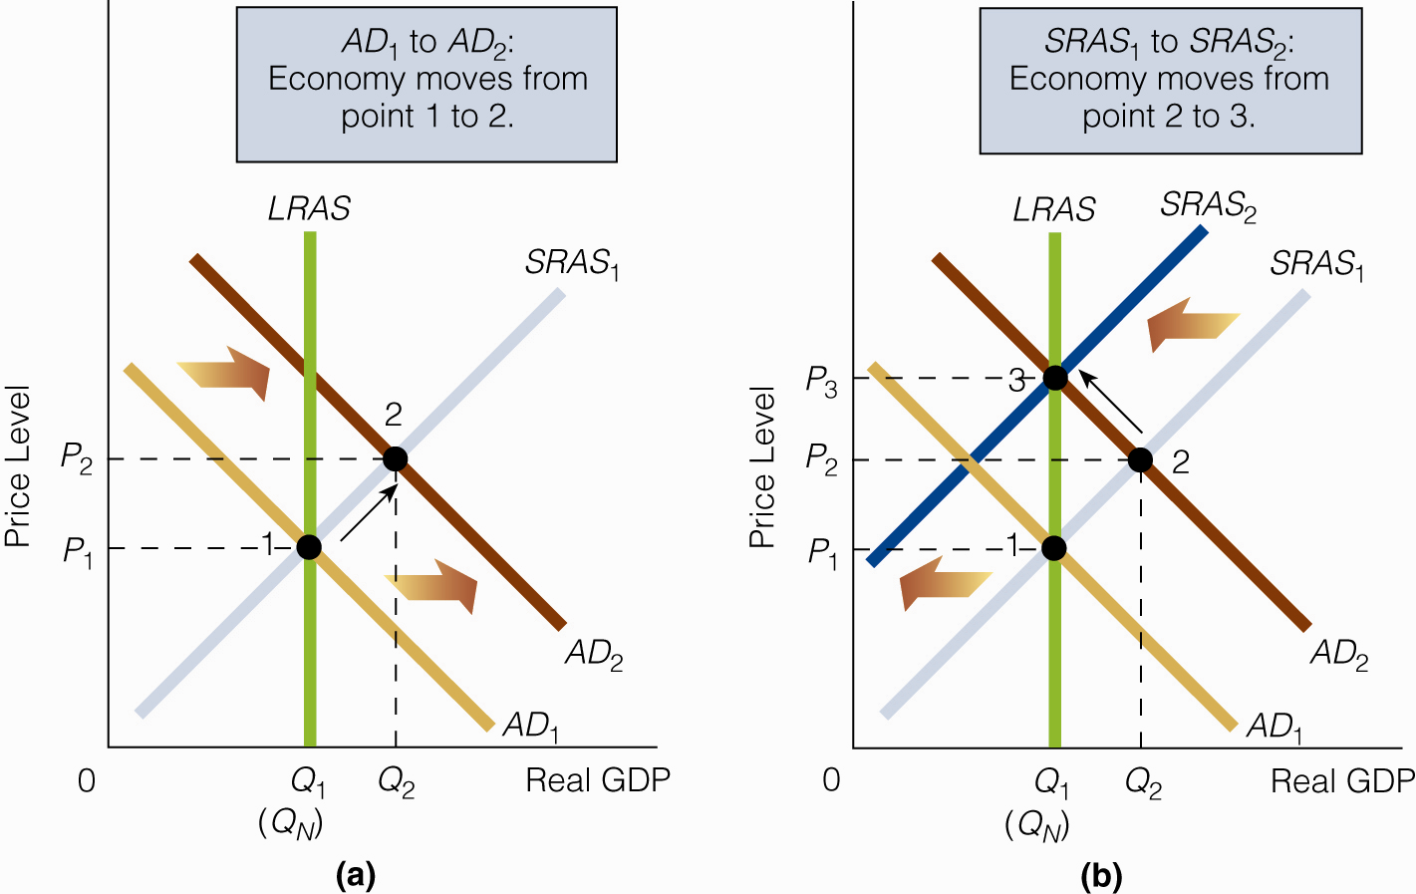
One-Shot Inflation: Demand-Side
Induced I
The aggregate demand curve shifts rightward from AD1 to AD2.
As a result, the price level increases from P1 to P2.
The economy moves from point 1 to point 2.
Click to return to “In this Lesson”
© 2014 Cengage Learning. All Rights Reserved. May not be copied, scanned, or duplicated, in whole or in part, except for use as permitted in a license distributed with certain product , service, or otherwise on password-protected website for classroom use

Slide 29
One-Shot Inflation: Demand-Side
Induced II
Because the Real GDP the economy produces (Q2) is greater than Natural Real GDP, the unemployment rate that exists is less than the natural unemployment rate.
Wage rates rise, and the short-run aggregate supply curve shifts leftward from SRAS1 to SRAS2.
Long-run equilibrium is at point 3.
Click to return to “In this Lesson”
© 2014 Cengage Learning. All Rights Reserved. May not be copied, scanned, or duplicated, in whole or in part, except for use as permitted in a license distributed with certain product , service, or otherwise on password-protected website for classroom use

Slide 30
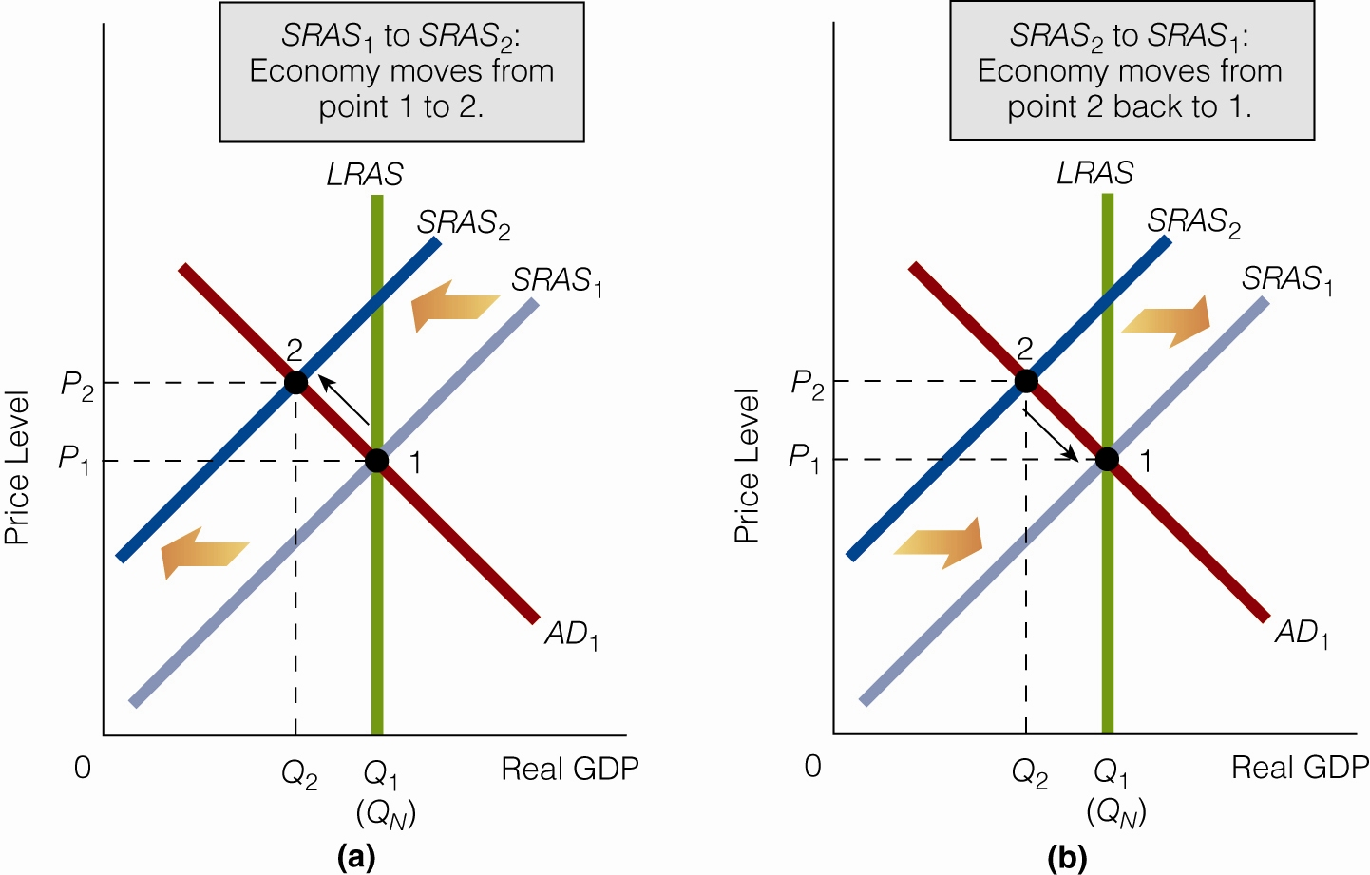
One-Shot Inflation: Supply-Side
Induced I
The short-run aggregate supply curve shifts leftward from SRAS1 to SRAS2.
As a result, the price level increases from P1 to P2; the economy moves from point 1 to point 2.
Click to return to “In this Lesson”
© 2014 Cengage Learning. All Rights Reserved. May not be copied, scanned, or duplicated, in whole or in part, except for use as permitted in a license distributed with certain product , service, or otherwise on password-protected website for classroom use

Slide 31
One-Shot Inflation: Supply-Side
Induced II
Because the Real GDP the economy produces (Q2) is less than Natural Real GDP, the unemployment rate that exists is greater than the natural unemployment rate.
Some economists argue that when this happens, wage rates will fall and the short-run aggregate supply curve will shift rightward from SRAS2 (back to SRAS1).
Long-run equilibrium is at point 1.
Click to return to “In this Lesson”
© 2014 Cengage Learning. All Rights Reserved. May not be copied, scanned, or duplicated, in whole or in part, except for use as permitted in a license distributed with certain product , service, or otherwise on password-protected website for classroom use

Slide 32
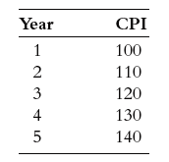
Inflation
Increase in the Price Level II
Continued Inflation - A continued increase in the price level.
Click to return to “In this Lesson”
© 2014 Cengage Learning. All Rights Reserved. May not be copied, scanned, or duplicated, in whole or in part, except for use as permitted in a license distributed with certain product , service, or otherwise on password-protected website for classroom use

Slide 33
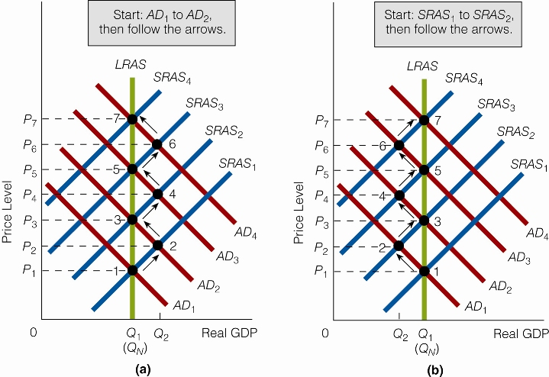
Continuous Inflation I
Begins with Shift in AD
The aggregate demand curve shifts rightward from AD₁ to AD₂.
The economy initially moves from point 1to point 2 and finally to point 3.
Continued increases in the price level are brought about through continued increases in aggregate demand.
Click to return to “In this Lesson”
© 2014 Cengage Learning. All Rights Reserved. May not be copied, scanned, or duplicated, in whole or in part, except for use as permitted in a license distributed with certain product , service, or otherwise on password-protected website for classroom use

Slide 34
Continuous Inflation II
The short-run aggregate supply curve shifts leftward from SRAS1 to SRAS2.
The economy initially moves from point 1 to point 2.
The economy will return to point 1 unless there is an increase in aggregate demand.
We see here that continued increases in the price level are brought about through continued increases in aggregate demand.
Click to return to “In this Lesson”
© 2014 Cengage Learning. All Rights Reserved. May not be copied, scanned, or duplicated, in whole or in part, except for use as permitted in a license distributed with certain product , service, or otherwise on password-protected website for classroom use

Slide 35
2 Inflation Questions
1. Can continued declines in SRAS cause continued inflation?
Not likely as it is not supported by recent history, and, wages are not likely to increase as demand for labor decreases.
2. What causes continued increases in aggregate demand?
Continued ↑ in M → Continued ↑ in AD → Continued inflation
Click to return to “In this Lesson”
© 2014 Cengage Learning. All Rights Reserved. May not be copied, scanned, or duplicated, in whole or in part, except for use as permitted in a license distributed with certain product , service, or otherwise on password-protected website for classroom use

Slide 36
Self-test
1. The prices of houses, cars, and television sets have increased. Has there been inflation?
We cannot answer this question based on the information given. We know only that three prices have gone up; we don’t know if other prices (in the economy) have gone up, if other prices have gone down, or if some have gone up and others have gone down. To determine whether inflation has occurred, we have to know what has happened to the price level, not simply to three prices.
Click to return to “In this Lesson”
© 2014 Cengage Learning. All Rights Reserved. May not be copied, scanned, or duplicated, in whole or in part, except for use as permitted in a license distributed with certain product , service, or otherwise on password-protected website for classroom use

Slide 37
Self-test
2. Is continued inflation likely to be supply-side induced? Explain your answer.
No. For continued inflation (continued increases in the price level) to be the result of continued decreases in SRAS, workers would have to continually ask for and receive higher wages while output was dropping and the unemployment rate rising. This set of conditions is not likely.
Click to return to “In this Lesson”
© 2014 Cengage Learning. All Rights Reserved. May not be copied, scanned, or duplicated, in whole or in part, except for use as permitted in a license distributed with certain product , service, or otherwise on password-protected website for classroom use

Slide 38
Self-test
3. What type of inflation is Milton Friedman referring to when he says that “inflation is always and everywhere a monetary phenomenon”?
Continued inflation.
Click to return to “In this Lesson”
© 2014 Cengage Learning. All Rights Reserved. May not be copied, scanned, or duplicated, in whole or in part, except for use as permitted in a license distributed with certain product , service, or otherwise on password-protected website for classroom use

Slide 39




Economic Variables Affected by a Change in the Money Supply
The supply of loans
Real GDP
The price level, and
The expected inflation rate
Click to return to “In this Lesson”
© 2014 Cengage Learning. All Rights Reserved. May not be copied, scanned, or duplicated, in whole or in part, except for use as permitted in a license distributed with certain product , service, or otherwise on password-protected website for classroom use

Slide 40
The Interest Rate and the Loanable Funds Market
A Fed open market purchase increases reserves in the banking system and therefore increases the supply of loanable funds. As a result, the interest rate declines.
Click to return to “In this Lesson”
© 2014 Cengage Learning. All Rights Reserved. May not be copied, scanned, or duplicated, in whole or in part, except for use as permitted in a license distributed with certain product , service, or otherwise on password-protected website for classroom use

Slide 41
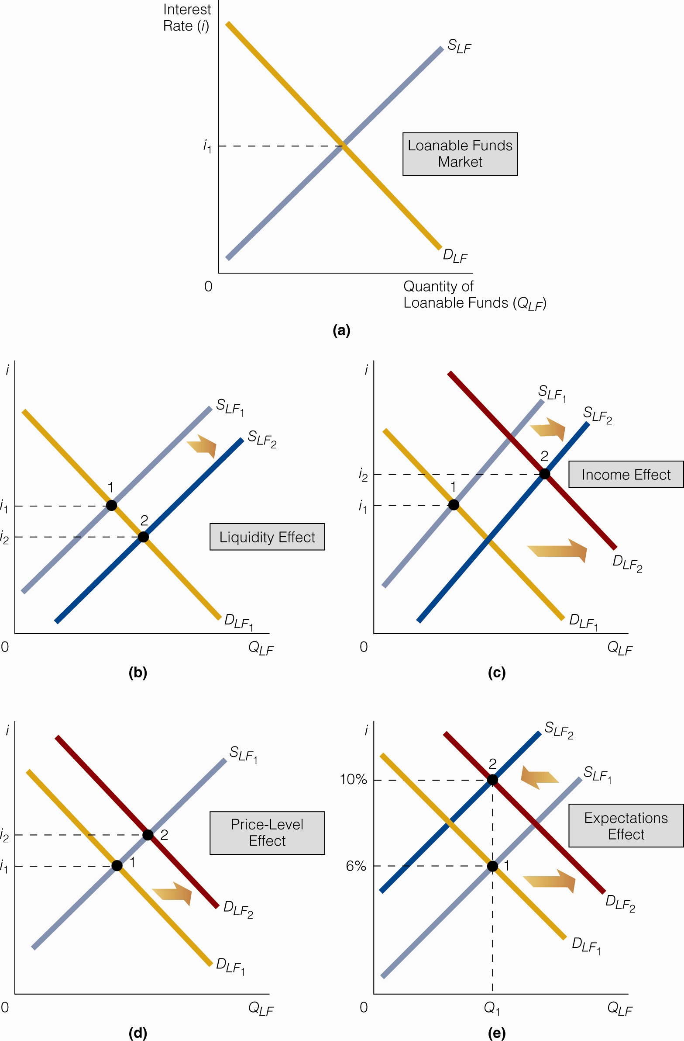
The Interest Rate and the Loanable Funds Market
To supply bonds is to demand loanable funds.
To demand bonds is to supply loanable funds
Click to return to “In this Lesson”
© 2014 Cengage Learning. All Rights Reserved. May not be copied, scanned, or duplicated, in whole or in part, except for use as permitted in a license distributed with certain product , service, or otherwise on password-protected website for classroom use

Slide 42

Liquidity Effect
The change in the interest rate due to a change in the supply of loanable funds. A Fed open market purchase increases reserves in the banking system and therefore increases the supply of loanable funds. As a result, the interest rate declines.
Click to return to “In this Lesson”
© 2014 Cengage Learning. All Rights Reserved. May not be copied, scanned, or duplicated, in whole or in part, except for use as permitted in a license distributed with certain product , service, or otherwise on password-protected website for classroom use

Slide 43
Income Effect I
When real GDP increases, both the supply of and the demand for loanable funds increase.
Click to return to “In this Lesson”
© 2014 Cengage Learning. All Rights Reserved. May not be copied, scanned, or duplicated, in whole or in part, except for use as permitted in a license distributed with certain product , service, or otherwise on password-protected website for classroom use

Slide 44
Income Effect II
The overall effect on the interest rate is that, usually, the demand for loanable funds increases by more than the supply so that the interest rate rises.
The change in the interest rate due to a change in real GDP is called the income effect.
Click to return to “In this Lesson”
© 2014 Cengage Learning. All Rights Reserved. May not be copied, scanned, or duplicated, in whole or in part, except for use as permitted in a license distributed with certain product , service, or otherwise on password-protected website for classroom use

Slide 45
Price Level Effect
When the price level rises, the purchasing power of money falls. People may therefore increase their demand for credit or loanable funds to borrow the funds necessary to buy a fixed bundle of goods.
This change in the interest rate due to a change in the price level is called the price-level effect.
Click to return to “In this Lesson”
© 2014 Cengage Learning. All Rights Reserved. May not be copied, scanned, or duplicated, in whole or in part, except for use as permitted in a license distributed with certain product , service, or otherwise on password-protected website for classroom use

Slide 46
Expectations Effect I
Borrowers (demanders of loanable funds) will be willing to pay more interest for their loans because they expect to be paying back the loans with dollars that have less buying power than the dollars they are borrowing.
Click to return to “In this Lesson”
© 2014 Cengage Learning. All Rights Reserved. May not be copied, scanned, or duplicated, in whole or in part, except for use as permitted in a license distributed with certain product , service, or otherwise on password-protected website for classroom use

Slide 47
Expectations Effect II
Lenders (the suppliers of loanable funds) require a higher interest rate to compensate them for the less valuable dollars with which the loan will be repaid.
In effect, the supply of loanable funds curve shifts leftward.
The change in the interest rate due to a change in the expected inflation rate.
Click to return to “In this Lesson”
© 2014 Cengage Learning. All Rights Reserved. May not be copied, scanned, or duplicated, in whole or in part, except for use as permitted in a license distributed with certain product , service, or otherwise on password-protected website for classroom use

Slide 48
What Happens to the Interest Rate as the
Money Supply Changes?
Point 1 in time: Fed says it will increase the growth rate of the money supply.
Point 2 in time: If the expectations effect kicks in immediately, then . . .
Point 3 in time: Interest rates rise.
Point 4 in time: Liquidity effect kicks in.
Point 5 in time: As a result of what happened at point 4, the interest rate drops.
The interest rate is now lower than it was at point 3.
Click to return to “In this Lesson”
© 2014 Cengage Learning. All Rights Reserved. May not be copied, scanned, or duplicated, in whole or in part, except for use as permitted in a license distributed with certain product , service, or otherwise on password-protected website for classroom use

Slide 49
What Happens to the Interest Rate as the
Money Supply Changes?
A change in the money supply affects the economy in many ways.
Changing the supply of loanable funds directly, changing Real GDP and therefore changing the demand for and supply of loanable funds, changing the expected inflation rate, and so on. The timing and magnitude of these effects determine the changes in the interest rate
Click to return to “In this Lesson”
© 2014 Cengage Learning. All Rights Reserved. May not be copied, scanned, or duplicated, in whole or in part, except for use as permitted in a license distributed with certain product , service, or otherwise on password-protected website for classroom use

Slide 50
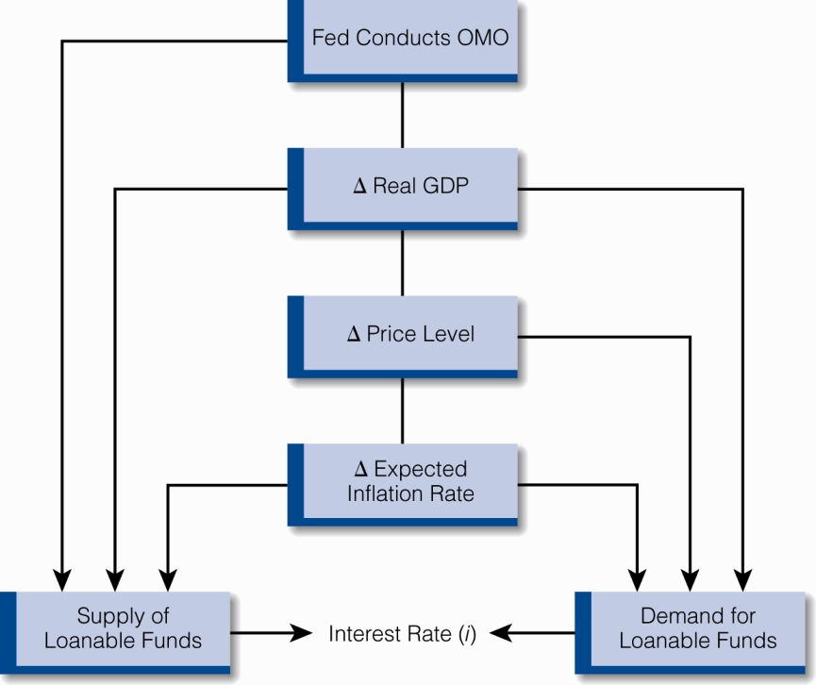
How the Fed Affects the Interest Rates
Liquidity Effect →
Income Effect →
Price Level Effect →
Expectations Effect →
↓
↓
↓
Click to return to “In this Lesson”
© 2014 Cengage Learning. All Rights Reserved. May not be copied, scanned, or duplicated, in whole or in part, except for use as permitted in a license distributed with certain product , service, or otherwise on password-protected website for classroom use

Slide 51
Nominal Interest Rate
The interest rate actually charged (or paid) in the market; the market interest rate.
Nominal interest rate = Real interest rate + Expected inflation rate.
i%
Click to return to “In this Lesson”
© 2014 Cengage Learning. All Rights Reserved. May not be copied, scanned, or duplicated, in whole or in part, except for use as permitted in a license distributed with certain product , service, or otherwise on password-protected website for classroom use

Slide 52
Real Interest Rate
The nominal interest rate minus the expected inflation rate. When the expected inflation rate is zero, the real interest rate equals the nominal interest rate.
Real interest rate = Nominal interest rate – Expected inflation rate
i%
Click to return to “In this Lesson”
© 2014 Cengage Learning. All Rights Reserved. May not be copied, scanned, or duplicated, in whole or in part, except for use as permitted in a license distributed with certain product , service, or otherwise on password-protected website for classroom use

Slide 53
Self-test
If the expected inflation rate is 4 percent and the nominal interest rate is 7 percent, what is the real interest rate?
Three percent.
Click to return to “In this Lesson”
© 2014 Cengage Learning. All Rights Reserved. May not be copied, scanned, or duplicated, in whole or in part, except for use as permitted in a license distributed with certain product , service, or otherwise on password-protected website for classroom use

Slide 54
Self-test
2. Is it possible for the nominal interest rate to immediately rise following an increase in the money supply? Explain your answer.
Yes, it is possible if the expectations effect immediately sets in and outweighs the liquidity effect.
Click to return to “In this Lesson”
© 2014 Cengage Learning. All Rights Reserved. May not be copied, scanned, or duplicated, in whole or in part, except for use as permitted in a license distributed with certain product , service, or otherwise on password-protected website for classroom use

Slide 55
Self-test
3. The Fed only affects the interest rate via the liquidity effect. Do you agree or disagree? Explain your answer.
Certainly, the Fed directly affects the supply of loanable funds and the interest rate through an open market operation. But it works as a catalyst to indirectly affect the loanable funds market and the interest rate via the changes in Real GDP, the price level, and the expected inflation rate. We can say this: The Fed directly affects the interest rate by means of the liquidity effect, and it indirectly affects the interest rate by means of the income, price-level, and expectations effects.
Click to return to “In this Lesson”
© 2014 Cengage Learning. All Rights Reserved. May not be copied, scanned, or duplicated, in whole or in part, except for use as permitted in a license distributed with certain product , service, or otherwise on password-protected website for classroom use

Slide 56

Wall Street Journal
The Wall Street Journal is a is a rich source of information which provides real life examples of micro- and macro economic activities. Check today’s issue to see the most current news.
http://www.wsj.com
Click to return to “In this Lesson”
© 2014 Cengage Learning. All Rights Reserved. May not be copied, scanned, or duplicated, in whole or in part, except for use as permitted in a license distributed with certain product , service, or otherwise on password-protected website for classroom use

